Slide 1
ITU / WHO Focus Group on
Artificial Intelligence for Health
Thomas Wiegand
TU Berlin / Fraunhofer HHI
thomas.wiegand@hhi.fraunhofer.de

Slide 2
ITU/WHO Focus Group AI for Health
Artificial Intelligence for Health (A4IH) offers substantial improvements for public and clinical health, e.g. early detection, diagnosis and risk identification, treatment decision support, self-management, improved outcomes, …
For world-wide adoption, need evaluation standards on effective AI for Health
Focus Group AI for Health (FG-AI4H) created July 2018; open platform
FG-AI4H goals: standardized framework
for benchmarking and evaluation
of AI solutions
Notes:
The image illustrates an AI-based diagnosis of eye disease using from photos. How to screen good implementations from bad ones? Using a standard assessment / benchmarking framework.

Slide 3
AI for Health Use Case in Histopathology:
Diagnostic Support for Breast Cancer Treatment
Tumor infiltrating lymphocytes (TILs) are implicated in eliminating tumor cells
Quantification of TILs relevant for patient prognosis estimation and therapy selection
Replace “eye-balling” by pathologist with Machine Learning method for TIL quantification
Focus Group: specify process on data generation and evaluate accuracy of Machine Learning method
Source: Hendry, S., Salgado, R., Gevaert, T., Russell, P. A., John, T., Thapa, B., ... & Sanders, M. (2017). Assessing Tumor-Infiltrating Lymphocytes in Solid Tumors: A Practical Review for Pathologists and Proposal for a Standardized Method from the International Immuno-Oncology Biomarkers Working Group Part 2 (…). Advances in anatomic pathology, 24(6), 311-335.
Copyright 2017 Wolters Kluwer Health, Inc. All rights reserved.
Notes:
The image illustrates an AI-based diagnosis of eye disease using from photos. How to screen good implementations from bad ones? Using a standard assessment / benchmarking framework.

Slide 4
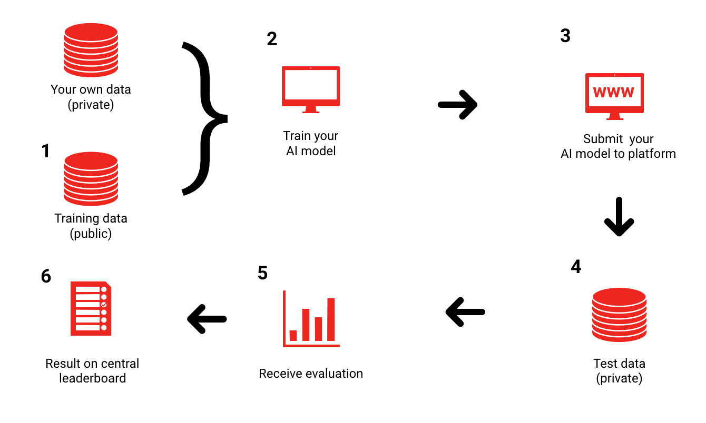
Approach
Notes:
New types of analyses: Counting lymphocytes and cancer cells

Slide 5
Collection of Data Sets
Gather data sets to test AI4H algorithms including clear source identification: ethical, privacy, ownership issues
Reproduceable reference data sets, i.e. specify human-level annotation and determine performance
Keeping the test data set private
Splitting a private data set into a public and private data set, s.t. the public data set is a validated representative of the whole data set

Slide 6
Creation of Metrics
Comparison of AI solutions to human-level performance
Generate metric, e.g.
  Discrete metric (yes or no)
  Euclidian metric
  Hamming distance
  Distance for segmentation tasks
  Pearson correlation
  …
Metric needs to be specific for the problem
Multiple and combined metrics are conceivable
Needs further work

Slide 7
Topic Groups as of Meeting C
Topic groups:
Cardiovascular disease risk prediction (TG-Cardio)
Classifying autism through analysis of brain imagery (TG-Autism)
Dermatology (TG-Derm)
Falls among the elderly (TG-Falls)
Histopathology (TG-Histo)
Neuro-cognitive diseases (TG-Cogni)
Ophthalmology (TG-Ophthalmo)
Psychiatry (TG-Psy)
Snakebite and snake identification (TG-Snake)
Symptom assessment (TG-Symptom)
Tuberculosis (TG-TB)

Slide 8
Focus Group Operation
Process steps:
A) Community: Creating and extending a community around a health topic
B) Proposals: Solicitation of AI for health proposals
C) Evaluation: Setting up evaluation criteria including data sets and metrics
D) Report: Publishing reports about the evaluation and the results
E) Dissemination: After successful use of an AI for health solution in practice, repeat FG-Ai4H process steps (A-E)
All steps (A-E) require strong voluntary participation, while being monitored and documented by ITU or WHO officials.
Most of the work will be conducted using on-line tools and virtual meetings.
It is envisioned, that the number of health topic communities will be large 100+

Slide 9
Leadership
Chair
Thomas Wiegand, Fraunhofer HHI, Germany
Vice-Chairs:
Stephen Ibaraki, ACM, Canada
Ramesh Krishnamurthy, World Health Organization
Naomi Lee, The Lancet, United Kingdom
Sameer Pujari World Health Organization
Marcel Salathe, EPFL, Switzerland
Shan Xu, CAICT, China
Secretariat
Simao, Ayda, and Bastiaan

Slide 10
Timeline
November 2018:
Meeting B, Columbia University
September 2019:
Meeting F, Zanzibar
April 2019: Meeting D, Shanghai World Expo
January 2020: Meeting H, Brasilia, Brazil
July 2018: formal creation
May 2018: idea
at AI for Good
January 2019:
Meeting C, EPFL
November 2019:
Meeting G hosted by NICF, DoT & ICMR, New Delhi
September 2018:
Meeting A, WHO HQ
May 2019:
Meeting E, AI for Good
Notes:
Meeting A: 22 contributions
Meeting B: 21 contributions; 8 topic areas
Meeting C: 21 contributions; 3 additional topic areas
Columbia University (Department of Biomedical Informatics)
EPFL (of VC Marcel Salathe), back-to-back with Applied Machine Learning Days (ITU is organizational sponsor)
Shanghai World Expo, CAICT (of VC Shan Xu) organizing high-level National Summit on AI for Health around FG meeting
(ITU co-organizer)

Slide 11
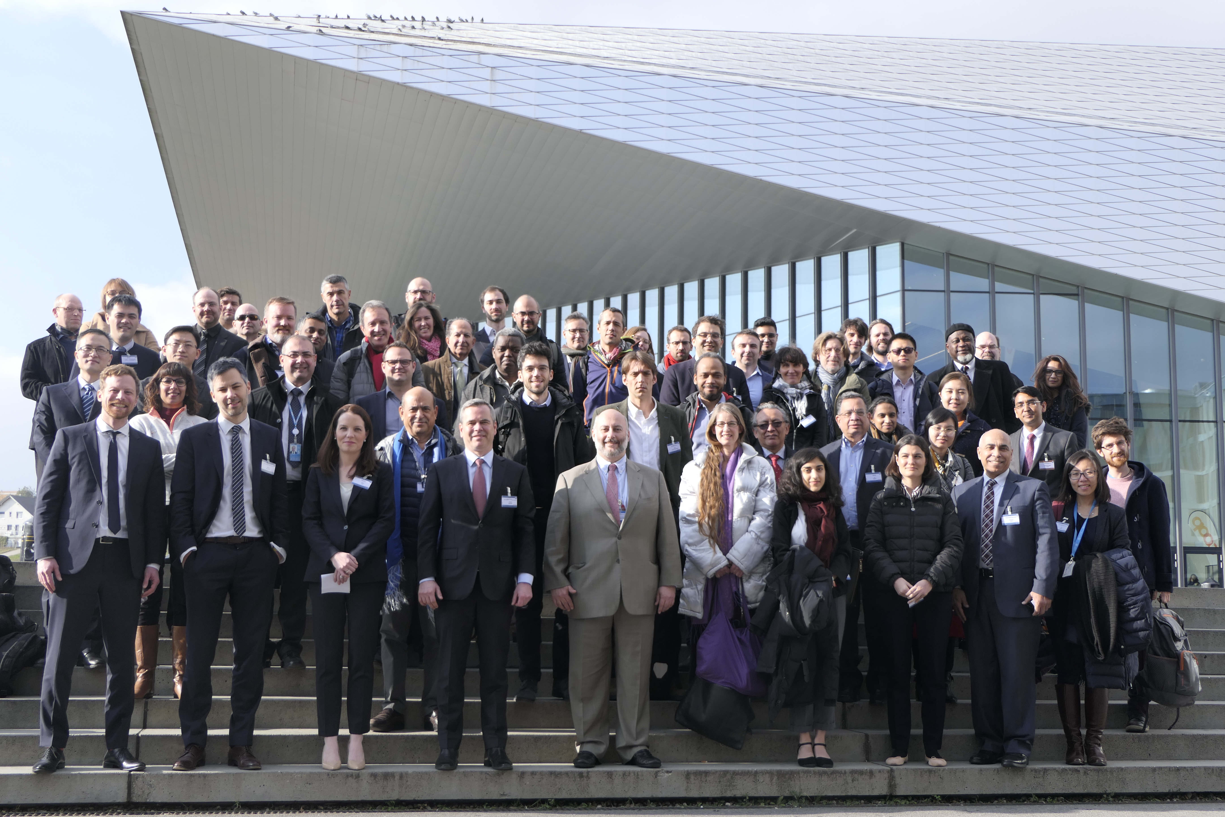
More Information:
ITU/WHO Focus Group AI for Health
Search: use „AI4H“ as string
Website: https://itu.int/go/fgai4h
Next meetings:
  2 - 5 April 2019
  Shanghai, China
  29 May - 1 June 2019
  Geneva, Switzerland
  2-5 September 2019
  Sanzibar, Tansania

