Slide 1
Fourth meeting of WHO-ITU - FGAI4H
TOPIC GROUP: ‘TUBERCULOSIS’
4th April, 2019
Dr. Manjula Singh
Deputy Director General,
Indian Council of Medical Research
New Delhi, India

Slide 2
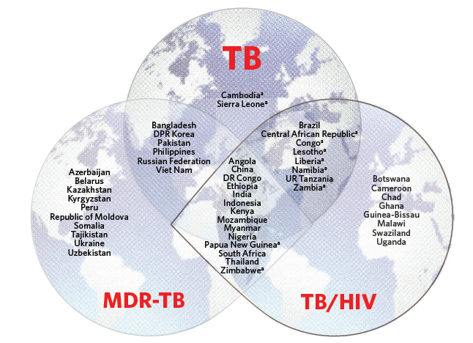
Countries in the three TB high-burden country lists
TB is biggest infectious killer in the world
India has the highest burden of TB in the world
BRICS countries have about 50% of the TB cases in the world
WHO/HTM/TB/2016.13

Slide 3
Current Burden
Estimates of TB Burden (2015) | Global | India
Incidence TB cases | 10.4 million | 2.8 million
Mortality of TB | 1.8 million | 480,000
Incidence HIV TB | 0.4 million | 0.11 million
MDR-TB | 480,000 | 130,000

Slide 4
TB Diagnosis: a challenge
One of the most important strategies is reducing the TB burden is early detection and management for which screening methodologies play a vital role.
Use of Sputum microscopy, & molecular diagnostic tests but in most places still sputum microscopy is used
We still miss millions of TB cases that go undetected or misdiagnosed specially in rural areas
There is a need to have a tool that can reach remote areas and help in detection of TB cases.
An average TB patient is diagnosed with TB after a delay of 2 months, and is seen by 3 healthcare providers before diagnosis

Slide 5
TB Diagnosis
WHO recommended on programmatic use of chest radiography for TB detection
Essential role of a chest X-ray (CXR) as a sensitive tool for screening active TB disease, diagnosing childhood TB (pulmonary & extrapulmonary) and excluding active TB before initiating treatment of latent TB.
Data worldwide shows that chest radiology is available at over 90% of district hospitals or community health centres, microscopy centres or primary health centres and in 100% of reference or tertiary hospitals.
As digital technology becomes more affordable and accessible, the use of AI for Radiographic detection of TB can help clinicians and TB programmes specially in resource constrained settings and have global impact in improving the healthcare

Slide 6
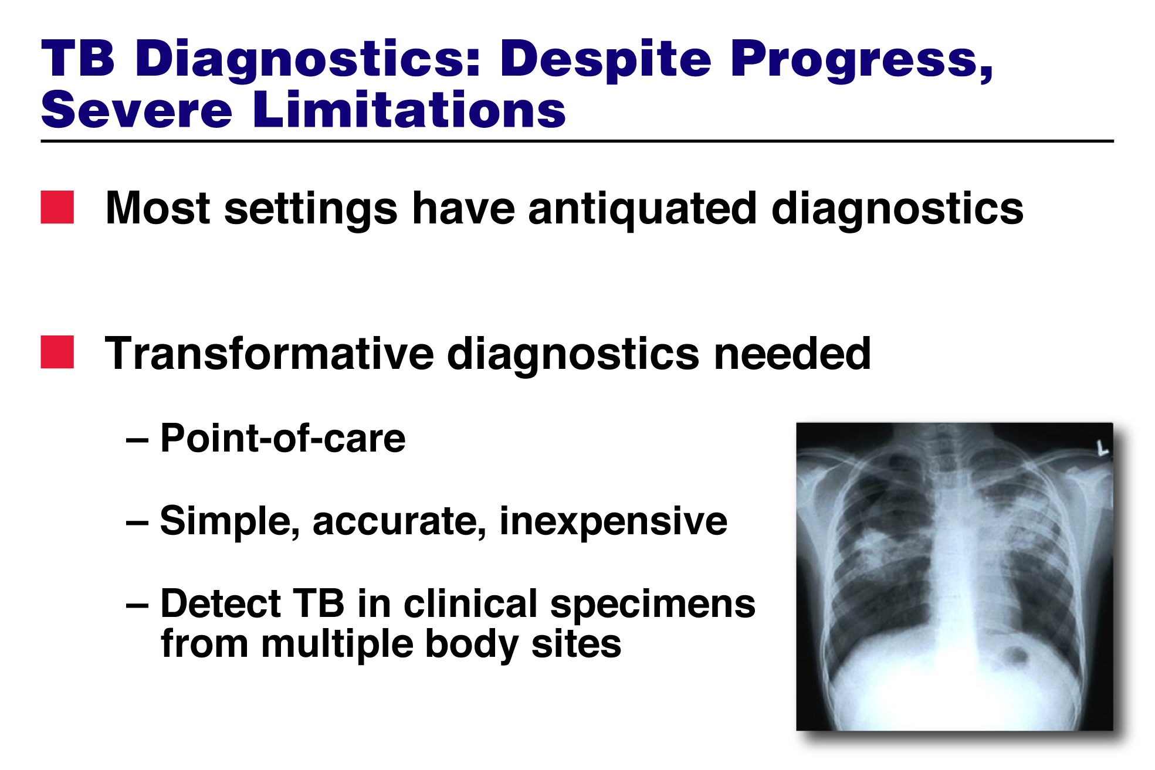
Proposal
Proposal on ‘Development of AI tool for radiographic detection of TB’ (under development)
Submitted By ICMR during Lausanne meeting
Topic Group ‘Tuberculosis’ was formed and a call was published
No response in this area, (8 weeks too less a time/ or was not widely publicized)
Need to add more information pertaining to data quality for this group
Data Requirement: Is it representative of Entire country/region Can National Programmes use it?
Hospital based:
Confirmed Pulmonary TB cases (Bacteriologically & clinical)
Confirmed Non-TB cases: Pneumonia, Asthma, Bronchitis, Bronchiectasis, Lung Abscess, Lung cancer, Pleural effusion, calcification, atelectasis, interstitial scar, post operative
Healthy: Smokers, Non-Smokers
Community based: Suspected TB cases, Other cases of chest Infections, fever

Slide 7
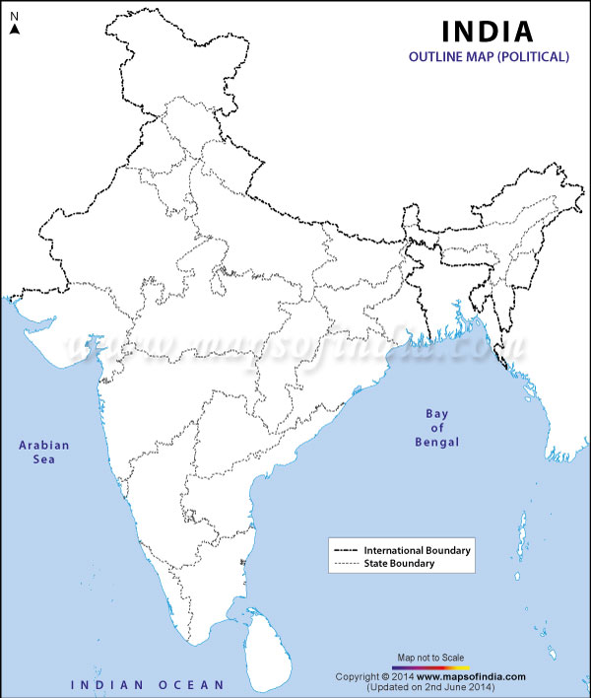
ICMR’s Data Source
Has a network of 33 institutes across India, of which the NIRT), Chennai, and NJIL&OMD, Agra, and RMRC’s work on TB and mycobacterial diseases
PGI,CHANDIGARH
AIIMS ,DELHI
Data source:
Current data: 69000 X-rays from prevalence survey in Thiruvallum, Chennai
10000 X-rays collected during Mobile TB diagnostic van intervention in Tribal population in difficult to reach areas 5 states in the country
BMC,VADODRA
IGMER,NAGPUR
Data source:
National TB Prevalence survey: To begin in May 2019 to cover 500,000 population across all states of the country with 625 clusters. (to be covered in 8-9 months time.
RMRC,
BHUBANESHWAR
NARI,PUNE
BMMRC,TELANGANA
NTI,BENGALURU
NIRT, CHENNAI

Slide 8
Benchmarking
Bench mark data set would include a subset of data from the entire dataset which can then be used to test any algorithm
Would it work for other countries also? May/Maynot
If Not then, we need data from other countries also;
We can have a common pool of data set and then mixed pool be used for learning and testing (Benchmarking)
Data Sharing: There is a need to develop a data sharing policy for this important topic which is a global problem

Slide 9

THE NEED
We need to publicize the call for this Topic Group “TUBERCULOSIS” widely and actively to invite more proposals in this important area

