Slide 1
FGAI4H-H-021-A03
  Brasilia, 22-24 January 2020
Source: | TG-Symptom topic driver
Title: | TDD update: Standardized benchmarking for AI-based symptom assessment
Purpose: | Discussion
Contact: | Henry Hoffmann | E-mail: henry.hoffmann@ada.com
Abstract: | This PPT summarizes the content of H-021-A01 with the TDD on the standardized benchmarking of system for AI-based symptom assessment, for presentation and discussion during the meeting.

Slide 2

Meeting H Update Topic Group
“Symptom Assessment”
Brasilia, 22-24 January 2020

Slide 3

Why AI-based Symptom Assessment?
Growing shortage of health workers
  Growing population
  Increasing life expectancy, but also burden of disease
  7.2 million shortfall in 2013 to 12.9 million by 2035
Growing shortage in developed countries
  Less and less time for patients
  Large proportion of doctor time spent on minor problems
  8 years for rare disease diagnosis
AI could help to close this gap
  Especially in the field of symptom based decisions support tools
  “Symptom-Checkers” for supporting patients and health workers
  Large potential to reduce cost and optimize care navigation too
But Standardized Benchmarking is needed
  FG AI4H
  TG-Symptom
Notes:
Why this Topic Group? Context, WHO/ITU necessity
The Global Problem
The opportunity (and the challenge) | What is Symptom Assessment? How might it help?
The case for benchmarking? Why needed?
How the Topic Group can help, what outcomes might feed into

Slide 4
Benchmarking
What do we need?
Inputs
  General Patient Information (age, sex, pregnancy, region, …)
  Presenting Complaints (coded symptoms, free texts )
  Additional symptoms, findings, factors, attributes, (lab, imaging, genetics, …)
Outputs
  Pre-Clinical Triage (emergency, see doctor today, self-care … )
  Differential Diagnosis (disease A 93%, B 73% - e.g. in ICD10, SnomedCT)
  Additional diagnostic tests to perform, treatment advice, explanations
Scores & Metrics
  Top-N Condition Accuracy, Quality/distance of differentials …
  Triage Accuracy, Deviation from correct triage
  Robustness, informative scores
Report
  By data source, condition set, specialty, region, age-group, sex, ...

Slide 5
Benchmarking - Data
What Data do we need?
Challenge: high quality independently curated data sets
AI Providers
  Have datasets for internal QA and evaluation
  But they have seen it – possibly overfit to unknown degree
Clinics / Hospitals
  Incomplete (negative evidence vs. missing often not explicit)
  Doctor specific, templates, abbreviated free text
  Reimbursement bias
Solution
  Case annotation platform
  Distributed creation of
    Case vignettes peer reviewed by x doctors
    Clinical cases labeled by x doctors
  Synthetic Data -> will be needed in any case

Slide 6
Benchmarking - Iterations
What are the step we plan to take
Minimal Minimal Viable Benchmarking MMVB 1.0-x.0
  Benchmarking platform where everything is visible to everyone
  Synthetic dummy data
  Dummy algorithms
  Some first metrics
  Some first report
  → learn all the things we need to learn for the real benchmarking
Minimal Viable Benchmarking MVB
  first real benchmarking
  Real data
  Real company Ais
  Real results

Slide 7

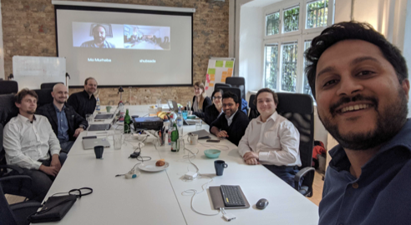
The London/Berlin Meeting
London Meeting / MMVB 1
  Establish common ground
  Getting to know each other
  Agree on inputs & output
  Discuss technical implementation details
  Define simple disease model
  Discuss how to approach case annotation
  MMVB 1.0
Berlin Meeting / MMVB 2
  Symptom Attributes
  Refined risk factors
  Started discussion on ontologies
*Rex Cooper / Your.MD is missing in the picture

Slide 8
Updates since meeting G
Overview
New Topic Group Members - (now 14+2)
  Before Meeting G: Ada, Babylon, Baidu, Buoy, Deepcare, Infermedica, Inspired Ideas, Isabel Healthcare, mfine , MyDoctor, Symptify, Visiba Care, Your.MD
  Since Meeting G: 1DOC3
  Independent contributors: Thomas Neumark, Muhammad Murhaba
Minimal Minimal Viable Benchmarking 1.0 (MMVB)
  Added support for benchmarking on doctor defined cases
  One new Toy AI by Inspired Ideas
Continue Refinement of TDD & Call For Participation
  New numbers! H-021-A01, H021-A02
  MMVB 1.0 (use of doctor cases)

Slide 9
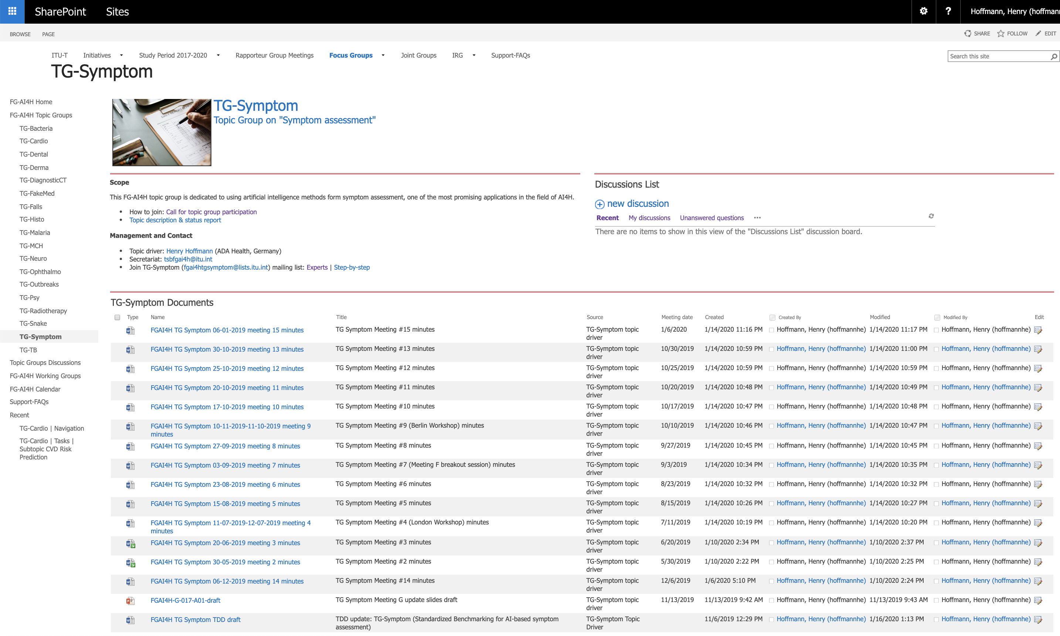
Updates since meeting G
Overview
Online Collaboration
  Telco Meeting (#14-#15)
  TG reflector: fgai4htgsymptom@lists.itu.int​​ (56 subscribers (+12))
  Migrated all meeting documents to SharePoint
Focus Group / External
  TG-Dental onboarding
  WG-DAISAM/DASH workshop participation
  Continued outreach to Botnar and Wellcome on requirements/criteria for funding benchmarking case creation

Slide 10
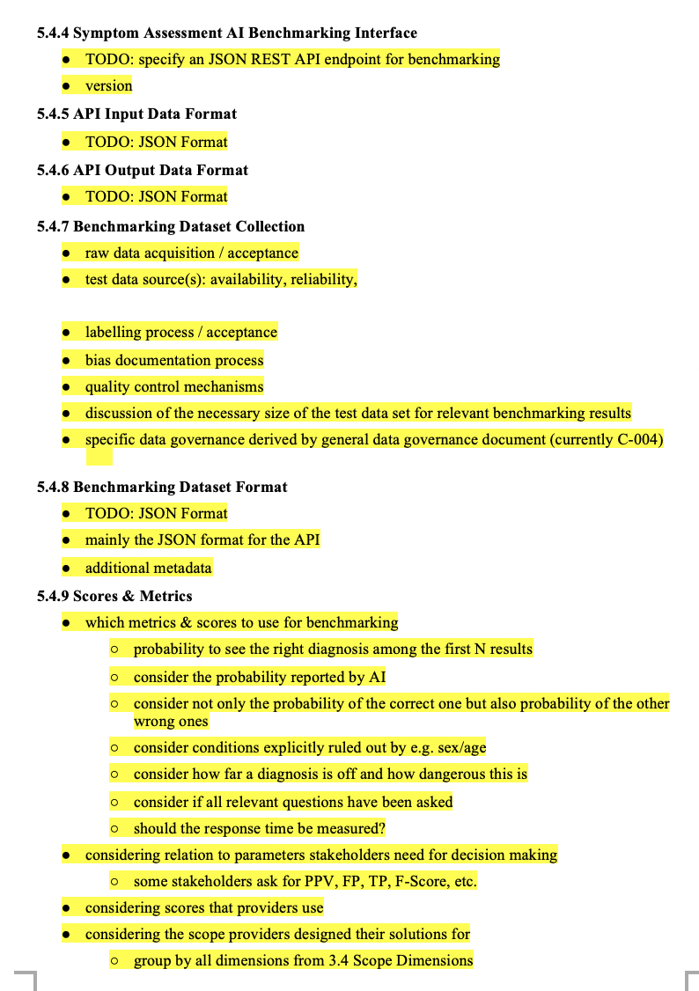
Next Steps
What to focus on until meeting I
Continue MMVB 2.0
  Switch to the Berlin model
  Ontologies, reporting dimensions, health-checks
  Robustness scores, informative scores, error handling
  Dedicated frontend app (filtering, case viewer, statistics, …)
Case Annotation Guidelines
  Discuss country level annotion guidelines
  Contribute to FG Annotation Plattform Discussion
TDD & Outreach
  Discuss Ethics section with corresponding WG
  Metrics
  Regulatory Considerations
  More systematic approach to fill the „yellow“

Slide 11
Live Demo Links
Model:
  https://docs.google.com/spreadsheets/d/111D40yoJqvvHZEYI8RNSnemGf0abC9hQjQ7crFzNrdk/edit#gid=980125545
Demo:
  https://demo-who2019.air.babylontech.co.uk:5005/

Slide 12














Thank you!
WHO/ITU FG AI4H TG Symptom Assessment
Meeting G
Brasilia, 22-24 January 2020

