Slide 1
Document No: | GSC-19_101
Source: | 3GPP SA Chairman
Contact: | Erik Guttman, erik.guttman@partner.samsung.com
Agenda Item: | 3.1
3GPP and Critical Communications Standardization
Erik Guttman, 3GPP SA Chairman, Consultant to Samsung Electronics Co., Ltd.

Slide 2
3GPP and Critical Communications, Public Safety
In 2012, 3GPP began work to support Public Safety communications facilities via 3GPP standards.
Starting and ongoing 3GPP work took on Public Safety (and later Critical Communications) requirements and objectives for features in Release 12 (frozen March 2015) and Release 13 (planned to freeze March 2016.)
What follows is the status and background of this work.

Slide 3
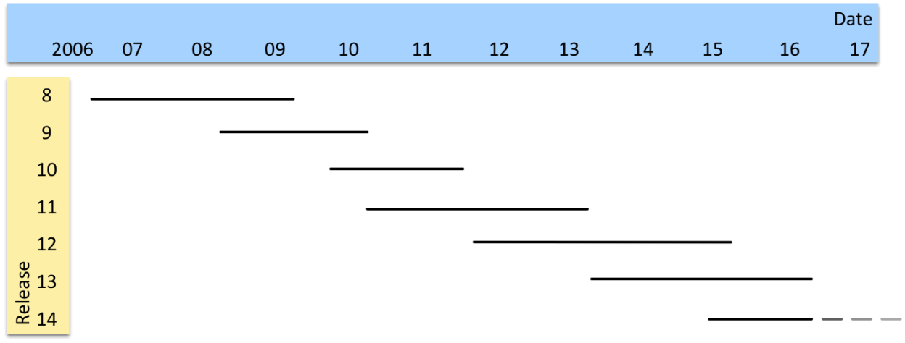
3GPP Releases
A Release introduces Features.
These features are compatible with each other and past releases.
Releases align testing, implementation, acquisition, deployment.

Slide 4
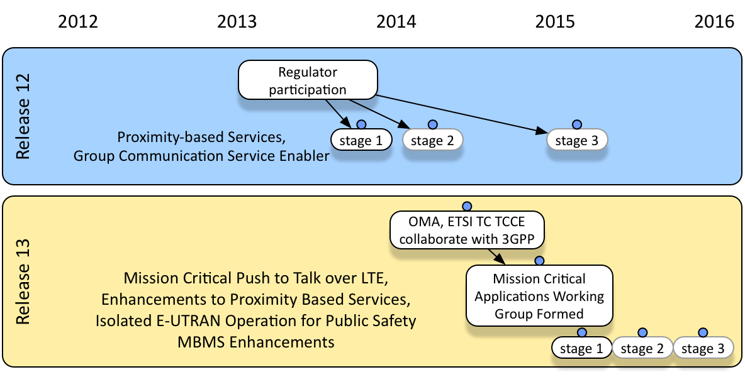
Critical Communications Standardization Status
Release 14 Stage 1 work has begun in 2015. This includes:
• Mission Critical Video
• Mission Critical Data Applications

Slide 5
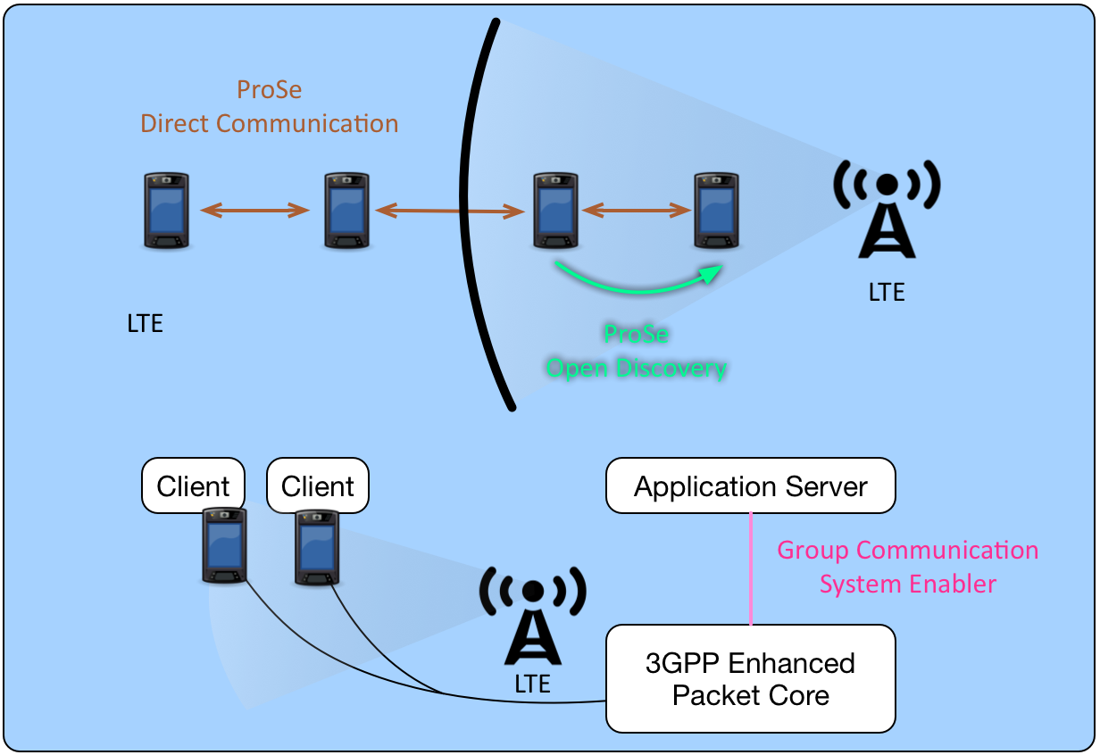
Release 12 Standards Related to Public Safety
A fraction of stage 1 requirements fulfilled...

Slide 6
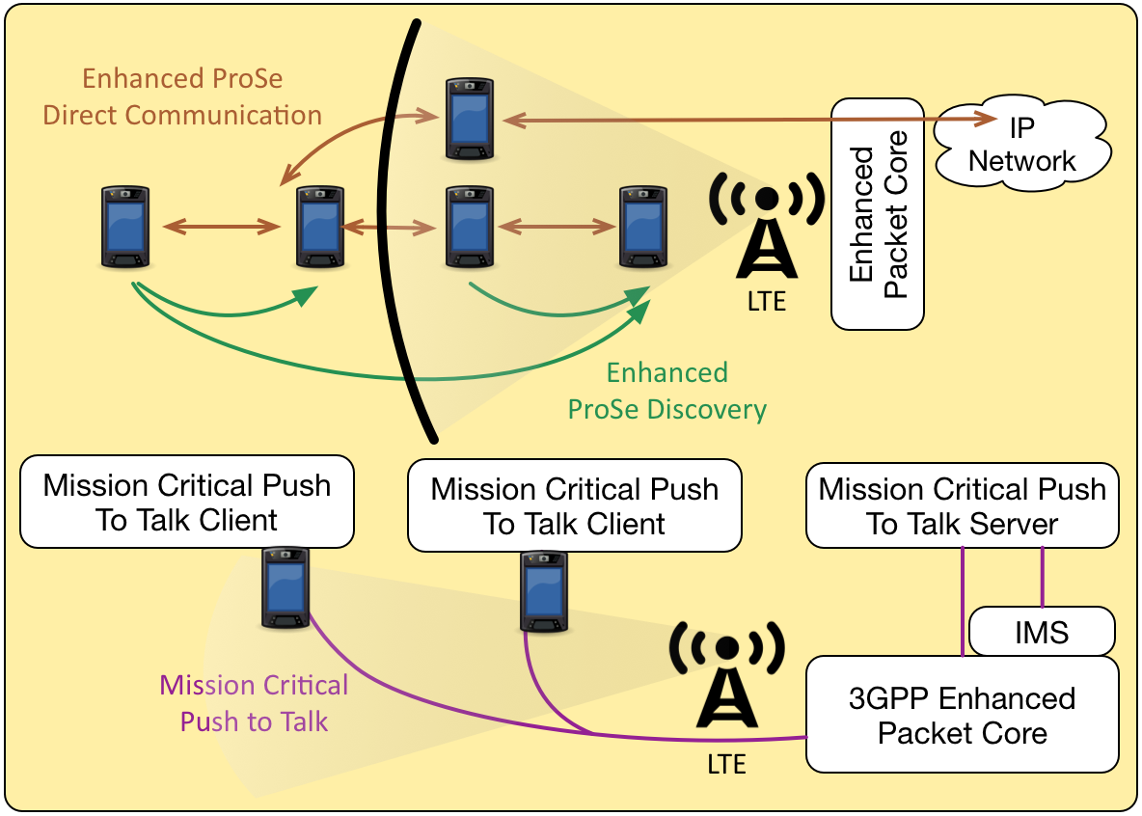
Release 13 Standards Related to Public Safety
More stage 1 requirements will be fulfilled. Stage 2 completion in progress.
Some public-safety
related features are
not shown, e.g.
Isolated E-UTRAN
Operation for Public
Safety

Slide 7
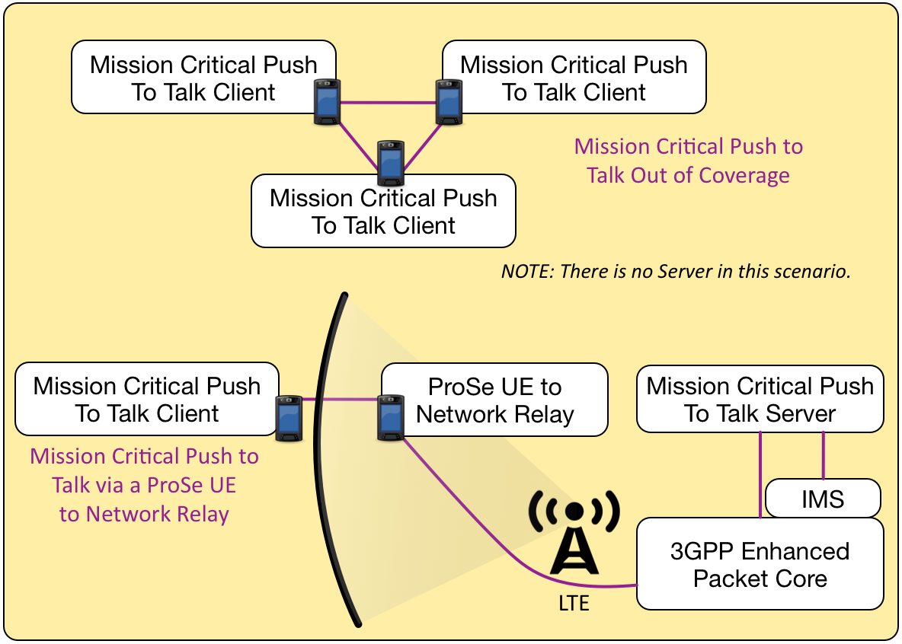
MCPTT in more detail
These two scenarios
whose support is
sought by public safety
agencies are also being
developed for Release
13.

Slide 8
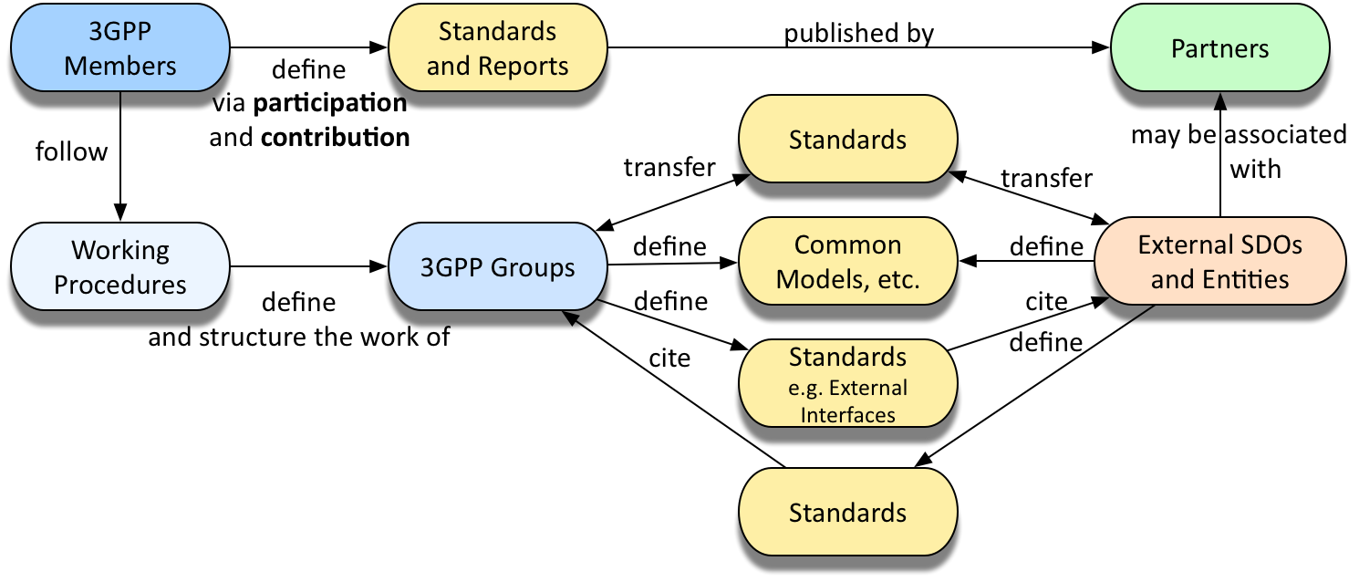
3GPP Collaboration Model

Slide 9
Q&A and thanks.
Erik Guttman • 3GPP TSG SA Chairman • erik.guttman@partner.samsung.com

