Slide 1
Document No: | GSC-19_106
Source: | ATIS
Contact: | Farrokh Khatibi, Qualcomm (fkhatibi@qti.qualcomm.com)
Agenda Item: | 3.6
ATIS Critical Communications Activities since GSC-18
Dr. Farrokh Khatibi (ATIS)
Director of Engineering, Qualcomm

Slide 2
Activities related to Individual to Authorities
Text to 9-1-1
  ATIS WTSC/ESIF developed current SMS text to
  9-1-1 standard (J-STD-110); will publish MMS text to 9-1-1 standard in June 2015.
    Developed implementation guidelines for Commercial Mobile Service and Text Control Center Providers deployment considerations.
    As the long-term solution, support for images, video, etc., anticipated to be included in future 3GPP-based Multimedia Emergency Services (MMES) efforts.
Emergency Location (ELOC) Task Force
  ATIS ELOC TF developing needed solutions in support of November 2014 voluntary agreement and roadmap by AT&T, Verizon Wireless, T-Mobile, Sprint, APCO, and NENA.
    Proactively supporting evaluation of outdoor/indoor location accuracy technologies.
    Advance the improvement of North American emergency location capabilities and services.
    Collaborate with other organizations, including 3GPP, IEEE, and IETF, to seek broader implementation and adoption of solutions and to progress global solutions.

Slide 3
ATIS Activities related to Individual to Authorities (cont.)
Location Accuracy
  ATIS ESIF continues to develop consensus-based industry requirements for testing location accuracy performance, including:
    Recommendations for Establishing Wide Scale Indoor Location Performance (ATIS-0500027)
    Current projects underway include vertical axis measurement test methodology, methodologies for crowd-sourced and dispatchable location technologies, and others.
Next Generation Emergency Services (NG911)
  ATIS WTSC defined the North American emergency call handling procedures in an IMS-based origination network and the routing of such calls to a terminating ESInet or legacy emergency services network.
    Expanded to support MMES for a full multimedia experience encompassing simultaneous text, voice, pictures, and video and published as ATIS-0700015.v003.
  ATIS ESIF provided Stage 1 view of applying Common IMS to NG911 networks (ATIS-0500023).
    Expanded to define architecture, functional elements, call flows and interfaces (Stage 2 and 3) derived from the Stage 1 Requirements.
      Defines specific functional elements that are functionally equivalent to the existing NENA i3 architecture with compatible interfaces to support the delivery of emergency calls to legacy and NG9-1-1/i3 PSAPs.

Slide 4

ATIS Activities related to Individual to Authorities (cont.)
Over the Top (OTT) Services
  ATIS WTSC developing solution that will identify the technical methods by which an operator of a user access network can acquire and convey location for Non-Operator-Managed OTT citizen-to-authority emergency services (4Q2015).
    Identifies use case scenarios for OTT location acquisition and conveyance.
    Details support for interconnected text service providers.

Slide 5
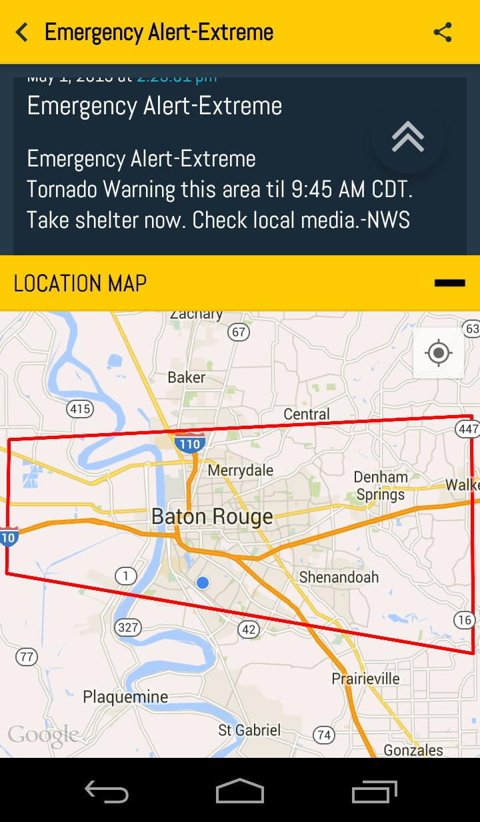
ATIS Activities related to Authorities to Individual
Commercial Mobile Alert System (CMAS)
  ATIS developed CMAS (a.k.a., Wireless Emergency Alert) solutions per the WARN Act.
    Effort included participation from FEMA and DHS and provides capability for devices to receive Presidential, AMBER, and life/property threat alerts.
    Current efforts include:
      Support for Spanish language (3Q2015);
      Canadian/Mexican CMAS and mobile device behavior (2Q2015/1Q2016); and
      Feasibility studies (4Q2015) addressing FCC CSRIC recommendations:
        Display of additional content.
        Geo-targeting.
        Message length.
Your Location

Slide 6
ATIS Activities related to Authorities to Individual (cont.)
ATIS WTSC evaluating feasibility of a proposed California EEW System using commercial wireless services.
  Study to be published in June 2015.
    Understand feasibility of cellular networks for providing early earthquake notifications in an EEW System.
    Perform feasibility study of “quick reliable mass notification” of EEW Systems given current standards and technologies.
    Study how EEW Systems and associated standards deployed in other countries might apply to the proposed system.
    Discussions with California Office of Emergency Services underway.

Slide 7
ATIS Activities related to Authorities to Authorities
Public Safety Related Applications Task Force
  ATIS formed IP Transition of Public Safety Related Applications Task Force (PSRA TF)
LMR-LTE Interconnection
  ATIS WTSC leading joint effort to develop solutions necessary for interconnection of Land Mobile Radio (LMR) and LTE networks (3Q2015).
NS/EP and Priority Services
  ATIS PTSC continues to advance national security and emergency preparedness (NS/EP) in support of priority services.

Slide 8
Other Related Activities
Mobile Device Theft Prevention (MDTP)
  ATIS WTSC project underway in support of FCC TAC recommendations.
    Collaborating with GSMA NA and developing standards, methods and procedures to obtain device identifiers from smartphones including those that are locked or rendered inoperable (4Q2015).
5G
  ATIS evaluating technology impacts of 5G (implementation anticipated ~2020 or later) on North American market, which will likely include public safety impacts.
    Hosted ATIS 5G Symposium from June 8-9 in Chicago (www.atis.org/5g), and included representatives from FCC, FCC TAC, and NIST-CTL.
    3GPP engaged in evolution beyond LTE.
    ATIS will ensure that the needs of the North American market are captured in the global requirements through collaboration with appropriate organizations.

Slide 9
Thank you

