Slide 1
Document No: | GSC-19_200
Source: | ETSI
Contact: | Luis Jorge Romero
Agenda Item: | 4
IoT session
Luis Jorge Romero, Director General, ETSI

Slide 2
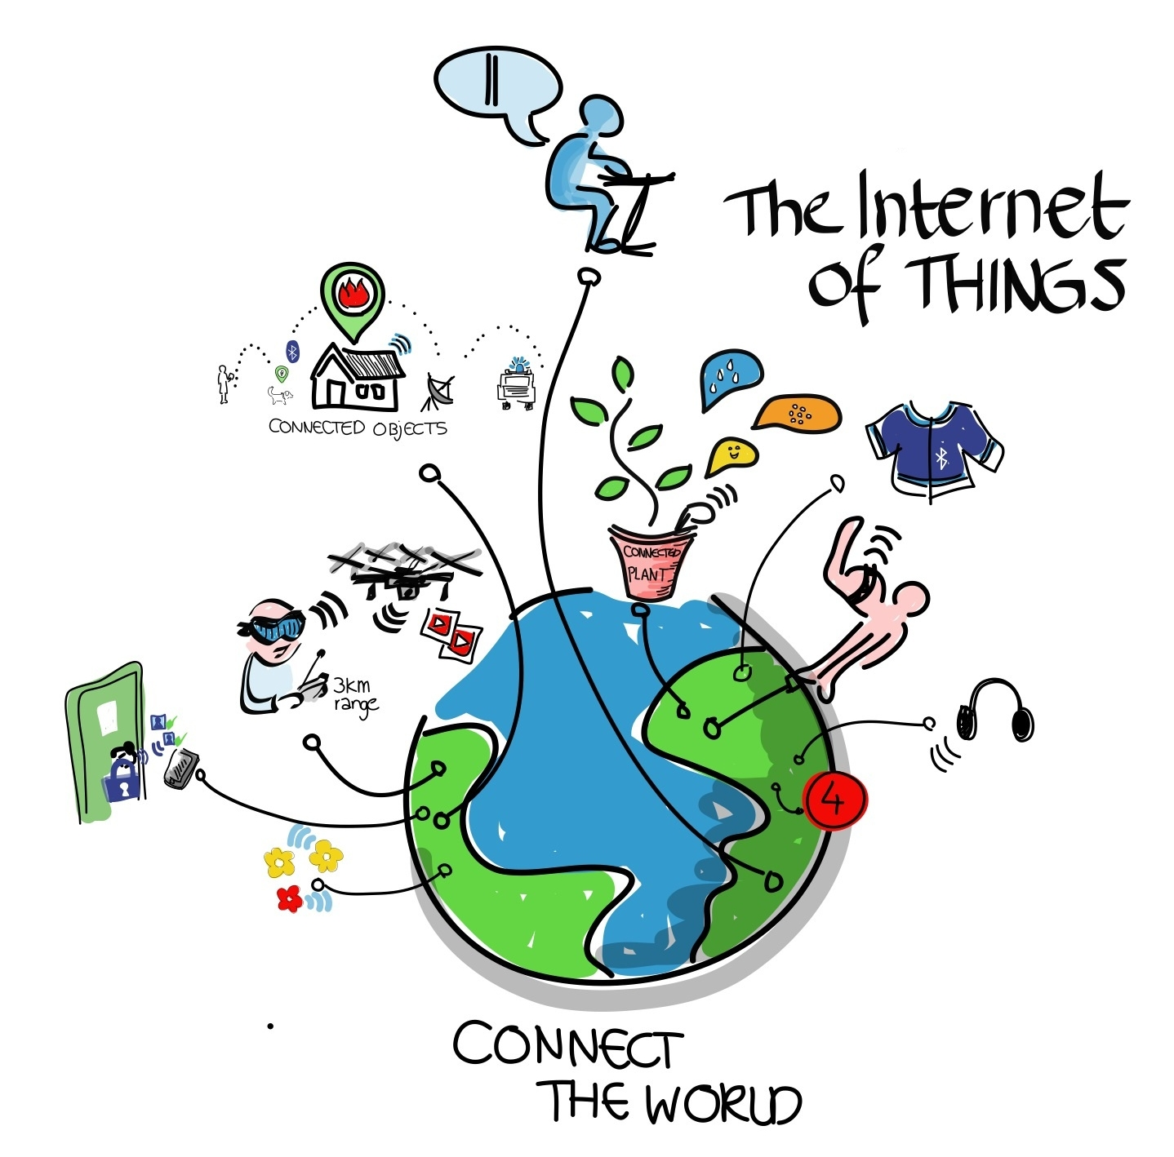
The Internet of Things (IoT)
From the definition, according to Wikipedia (we are “modern”…): 2 lessons learnt
1. You cannot trust Wikipedia
2. IoT is a mess!!!
(and maybe, lesson 3:
“History belongs to those who write it”…
so watch out!)

Slide 3

Objective of the session
CO-OPERATION?
“The act of working together with someone or doing what they ask you”
(Cambridge Dictionaries)
I’d rather say
COLLABORATION
“The situation of two or more people working together to create or achieve the same thing”
(Cambridge Dictionaries)
(For sure, not on its second meaning: “the situation of people working with an enemy who has taken control of their country” - Cambridge Dictionaries)

Slide 4
GSC: Global Standards COLLABORATION
A group of clever people…
Sitting together in a good atmosphere…
With a common objective…
Ready to COLLABORATE…

Slide 5














Really?
Let’s make a quick quiz…

Slide 6

A group of clever people
IQ test: How many squares can you count?

Slide 7
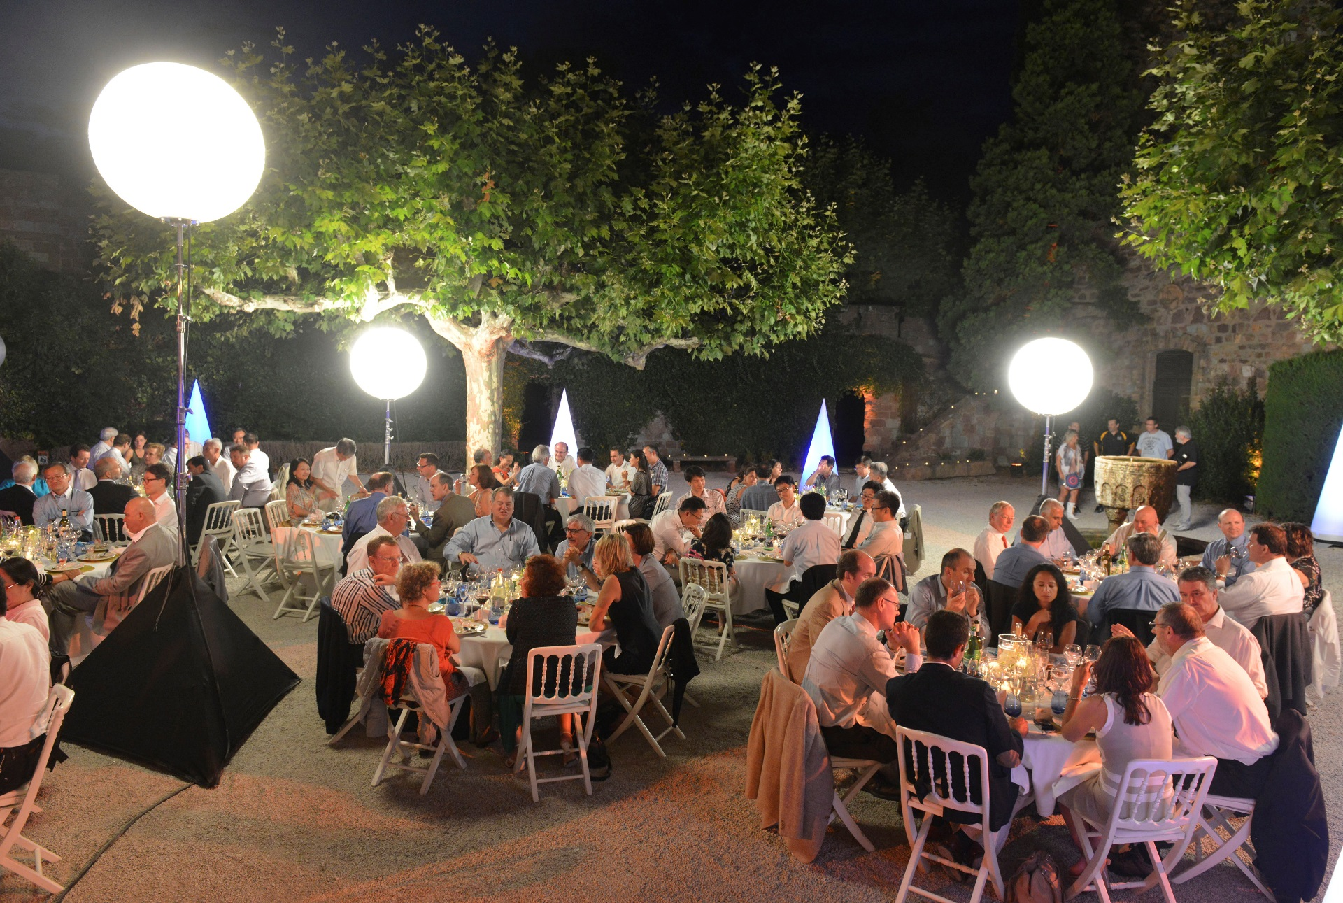
Sitting together in a good atmosphere
Seems obvious

Slide 8
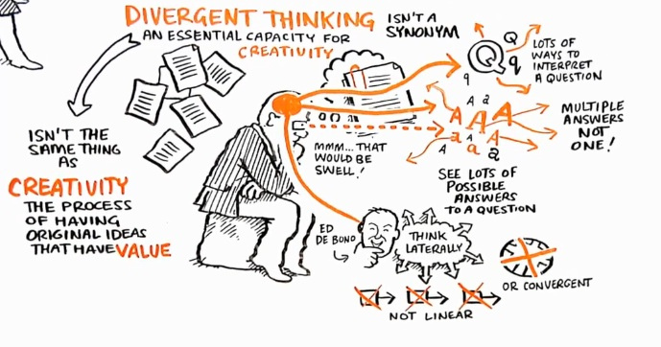
With a common objective
… can anybody remind me of the objective?

Slide 9



Objective
TO MAKE THE MOST OUT OF THE IOT
BY COLLABORATING
FOR THE BENEFIT OF…
                INDUSTRY…
                MEMBERS…
                MARKETS…
                USERS…
                …
                … ALL!

Slide 10
Ready to collaborate?
Let’s see…

Slide 11

Running the discussion
Split in 2 sessions:
  16h00 – 17h30 Wednesday
  09h00 – 10h30 Thursday
  … + tour of the UNITED Nations!!!
Session 1:
  Small introduction of the session (now) and of the questions (to come)
  Work on the questions per table → 35’
    Each table to deliver 2-3 statements
  Group discussion – all tables → 35’
  Wrap up and conclusions of session 1 → 10’
Session 2: following from session 1, ending with key take aways

Slide 12

Getting into Session 1
Imagine a picture of today’s landscape in IoT standardization
If you (as I) simply cannot, please have a look at the coming slides…

Slide 13










































Mapping IoT SDOs and alliances landscape
Service & App
P2413
AIOTI
B2C
B2B
802
connectivity
Source: Modified from an initial contribution from Huawei
Notes:
Marco: If this is agreed as a playground representation then the two dimensions should be in the segmentation (done)
Ovidiu: IIC does health which is consumer
Hypercat is national
NIST is national
Juergen
I have update the map with several organizations that have mostly an industrial focus:
OPC Foundation: https://opcfoundation.org/
Profibus International: http://www.profibus.com/
ASHARE (Bacnet): https://www.ashrae.org/
Health Level Seven HL7 (Heatlhcare): http://www.hl7.org/
DICOM (Healthcare): http://dicom.nema.org/
Object Management Group OMG: http://www.omg.org/
OASIS: https://www.oasis-open.org/
Open Geospatial Consortium OGC: http://www.opengeospatial.org/
Home Gateway Initiative HGI: http://www.homegatewayinitiative.org/
UPNP: http://www.upnp.org/
eCl@ss: http://www.eclass.de/eclasscontent/index.html.en is about device/things properties, a very
important issue for IoT and the virtual representation of things, also IEC (TC65, SC3D) and ISO (TC184)
has activities in this area
Platform Industrie 4.0: http://www.plattform-i40.de/ as a specific German activity
CEN and CENELC as European counterparts of IEC and ISO.
and I am still not sure that this is everything, for example the logistics/supply chain, retail and
automotive business has for sure some standardization activities like SAE and GS1
I also reposition some of the entries. The issue is, that large SDOs like IEC, ISO, ITU, IEEE, JTC1 and ETSI
have activities that go from connectivity to services&apps and are used in the consumer and industrial
market. For the analysis we have to look on the specific activities and not on the whole SDO. Also
architecture activities like P2413 cover the whole stack, so not with specific protocols, but general
issues.

Slide 14













Open source initiatives
Service & App
Linux IoTDM
short life cycle (B2C)
long life cycle (B2B)
connectivity
Notes:
Fiware
Ovidiu: Different level of size maturity and membership
PG removed LiveOS on request of Georgios

Slide 15

Questions for session 1
What about
  the IoT standardization landscape – what’s your views?
  our level of responsibility, commitment from GSC members?
How would we like the IoT standardization landscape to be
  What can we do?
  What do we want to do?

Slide 16
Some considerations to help the discussion (i)
Are there too many initiatives, too few? Overlaps? Gaps? Which? Where?
What are the reasons behind this picture, in your own opinion?
Are you happy, do you feel comfortable with this picture?
Would you depict it this way if you could organize it? What would you do equally – or different?
How would you draw this picture?
What if someone else does for us – including implementing it?
What about Government initiatives? Are they helping?

Slide 17
Some considerations to help the discussion (ii)
What would you change from the existing picture?
Do you miss connectors? Which ones?
Would connectors work?
Who can build these connectors? How?
Considering connectors, how would your “ideal picture/drawing” look like?
Can we change the world?
  Do we want to?

Slide 18

Now, GO FOR IT!
You have 35’

