Slide 1
Document No: | GSC-19_200c
Source: | ETSI
Contact: | Luis Jorge Romero
Agenda Item: | 4
Agenda IoT session – part 2
Luis Jorge Romero, Director General, ETSI

Slide 2
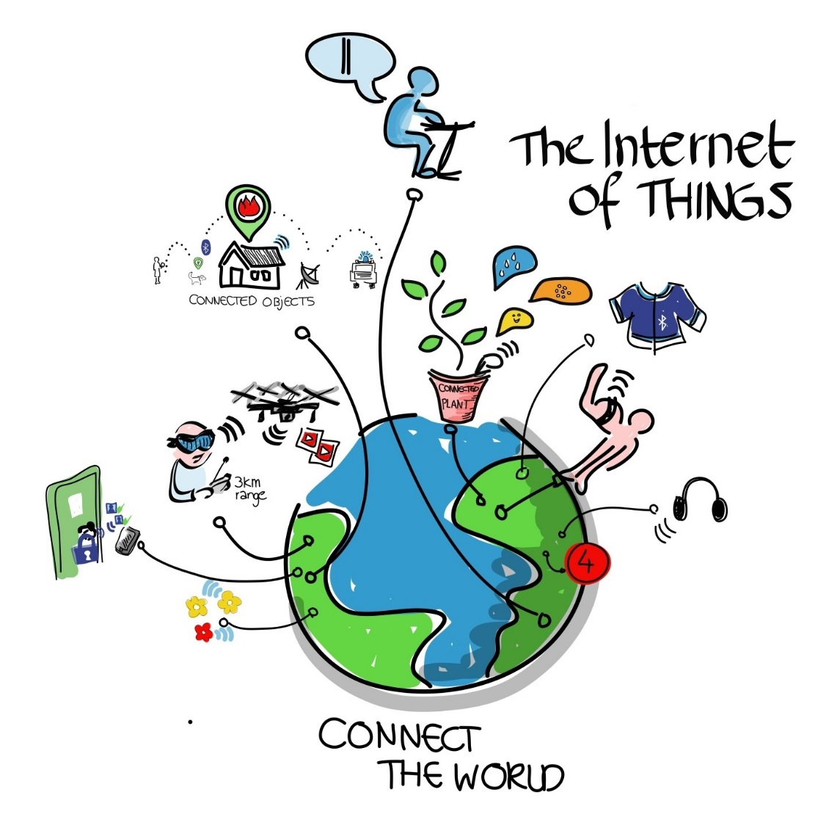
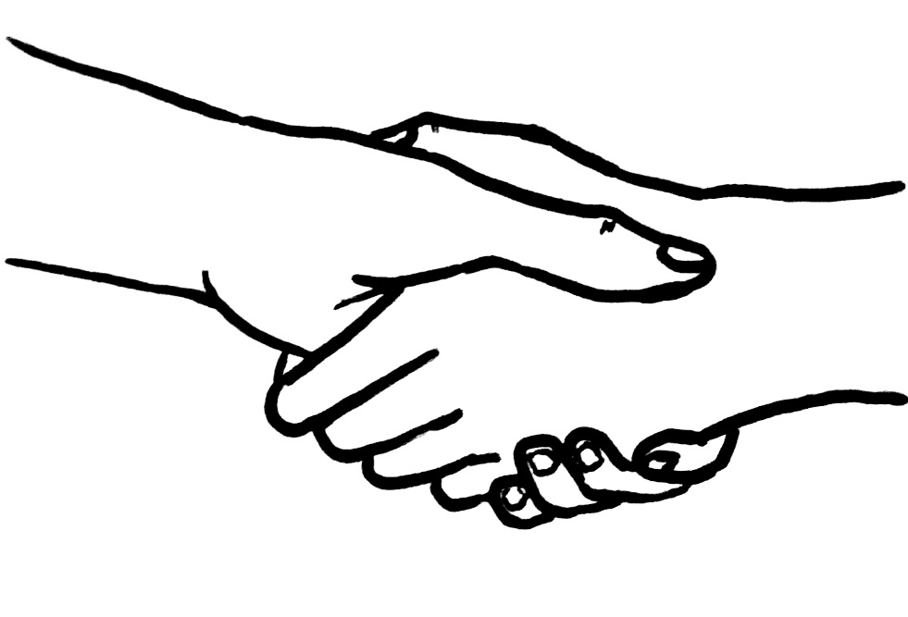

Objective
TO MAKE THE MOST OUT OF THE IOT
BY COLLABORATING
FOR THE BENEFIT OF…
                INDUSTRY…
                MEMBERS…
                MARKETS…
                USERS…
                …
                … ALL!

Slide 3

Wrap-up from yesterday
General statements, facts?
Embracing Open Source
Addressing different domains
Starting from commonalities, moving on

Slide 4

General statements, facts? (i)
What’s IoT? What’s not IoT?
  Too many use cases, too many perspectives
Trust is KEY
  How do we ensure TRUST
Standards should address market needs
  Industry takes care, or does it not?
The customer will decide, regardless of standards
  But we need standards… for the customer, for the investor

Slide 5














Do we agree?
Yes, no, maybe…

Slide 6
General statements, facts? (ii)
Fragmentation is logical, even necessary at this (early) stage
  Is it? Even among those who decided to collaborate?
Follow the money! → a survival exercise
Solution: no money, no competition
  … and maybe no investment at all!

Slide 7
Do we agree?
Yes, no, maybe…

Slide 8
Embracing Open Source
Inevitable in the IoT space
  Inevitable in the standardization arena
How could SDOs work together on this subject?
FFS
AS SPECIFIC STRATEGIC TOPIC

Slide 9
Addressing different domains
Different semantic models coming from different sectors
  No one addressing this, yet…
Each domain will have its own picture of the landscape for IoT
  Can we help the integration? How?
Need to better understand the others
  Get their contribution direct
  ISO/IEC’s role? GSC SDO’s role?

Slide 10


Starting from commonalities, moving on
oneM2M signaled as the “logical” starting point
  Many GSC already members, why just many?
  oneM2M members starting parallel initiatives?
Some pillars in oneM2M
  An architecture
  Security by default
Important players not in oneM2M
  E.g. Internet companies, users…

Slide 11

So, questions for part 2 of the session
Under our responsibility as GSC members
What could SDOs/ISO/IEC role to get closer to other domains?
What are the 3 things you would change/improve in oneM2M… or else?

Slide 12

Running the discussion
Work on the questions per table → 30’
  Each table to deliver 2-3 statements
Group discussion – all tables → 30’
Wrap up and conclusions of the full session → 15’

Slide 13
So, questions for part 2 of the session
Under our responsibility as GSC members
What could SDOs/ISO/IEC role to get closer to other domains?
What are the 3 things you would change/improve in oneM2M… or else?

Slide 14

Now, GO FOR IT!
You have 30’

