Slide 1
Document No: | GSC-19_002
Source: | GSC-18 Chair
Contact: | Dirk Weiler
Agenda Item: | 1.4
GSC-18 Summary Report
Dirk Weiler, ETSI

Slide 2
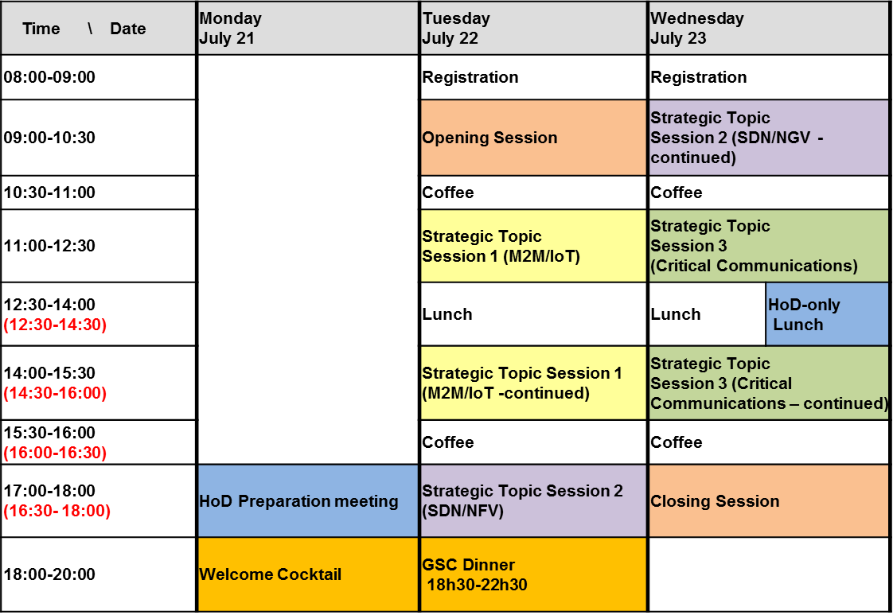
GSC-18 Schedule

Slide 3
GSC-18 Attendance
Members (65 Delegates) :
ARIB : 6
ATIS : 6
CCSA : 6
ETSI : 16 (including GSC Secretariat)
IEEE-SA : 7
ITU : 4
TIA : 5
TTA : 10
TTC : 5
Guests (12 Delegates) :
Continua Health Alliance
DOT India
GISFI
General Motors
HGI
ISO
ISO/IEC JTC1
OMA
TCCA
TSDSI
W3C
IEEE-SA was welcomed as a new member of GSC before GSC-18
TSDSI was welcomed as a new member of GSC at GSC-18

Slide 4
Contributions
Opening session: 14
Topic 1 - M2M/IoT: 9
Topic 2 – SDN/NFV: 5
Topic 3 – Critical Communications: 9
Closing session: 5
All documents can be found on the Repository hosted by ITU-T:
http://www.itu.int/en/ITU-T/gsc/Pages/GSC-18/documents.aspx

Slide 5
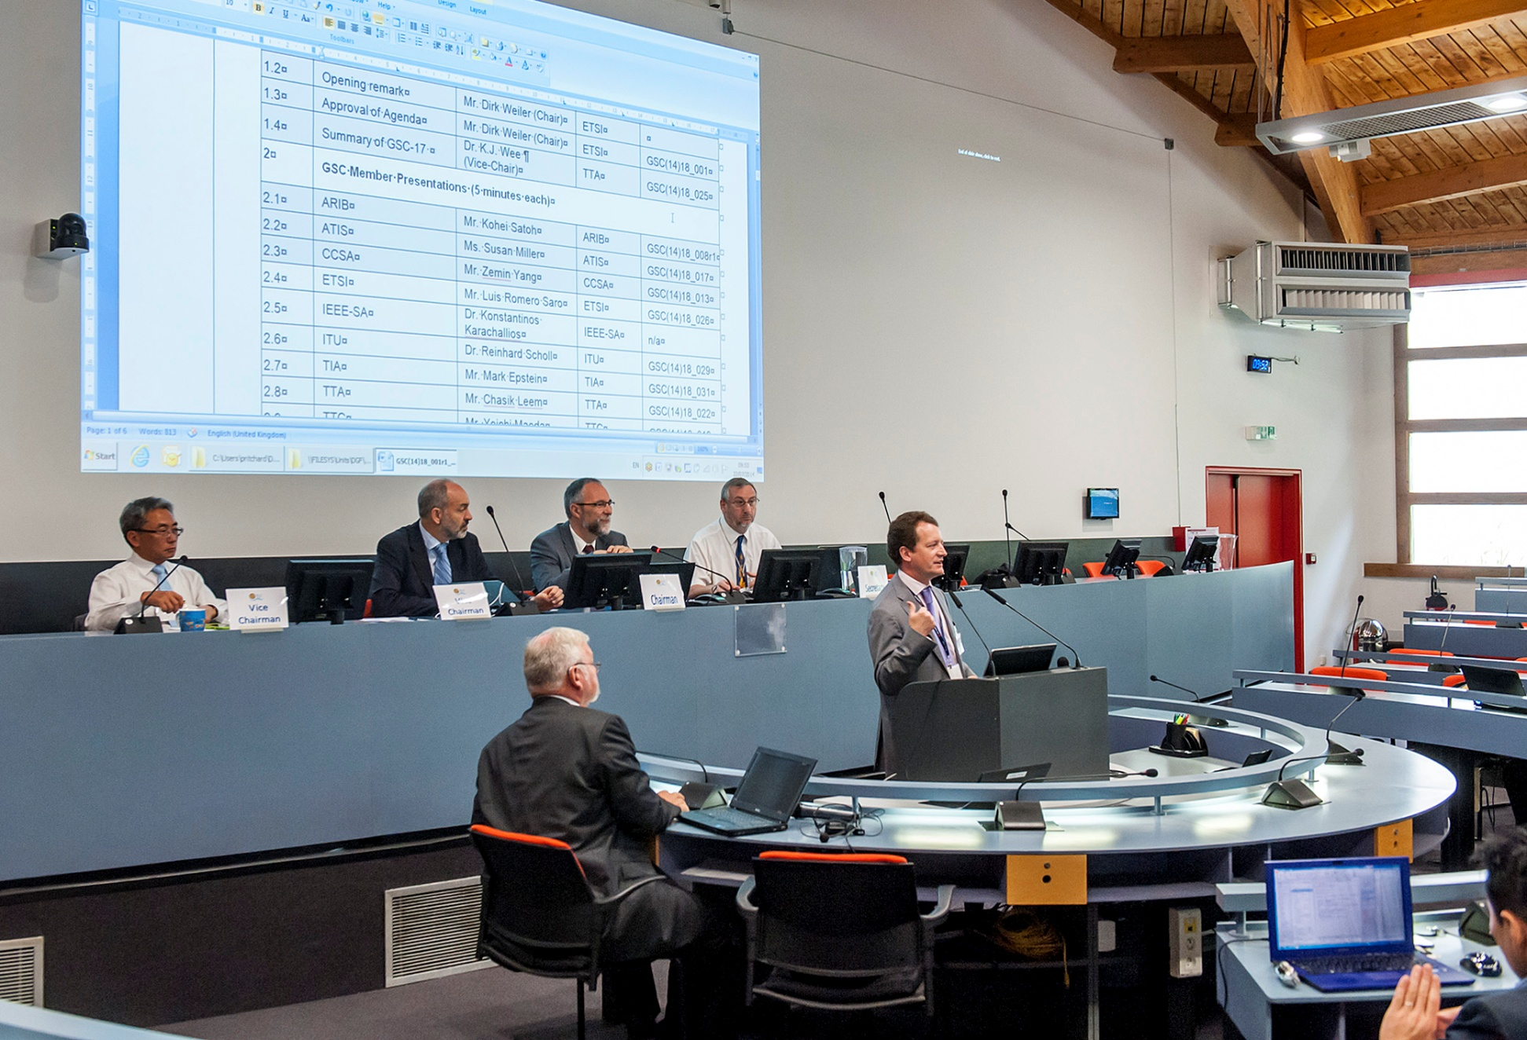
GSC-18 Opening Plenary

Slide 6
Presentations in Opening Plenary
The ETSI Director General welcomed the GSC 18 participants;
The GSC 17 Chairman (TTA) gave a summary of the previous GSC;
The long standing GSC members presented the developments in their organizations since the last meeting;
IEEE-SA, being a new member, presented their principal activities and their way of working;
The Indian government presented their approach to telecommunication standardization, announcing that TSDSI is the Indian Telecommunications Standard Development Organisation (TSDO) as identified in the National Telecom Policy 2012 (NTP 2012);

Slide 7
Presentations in Closing Plenary (1)
Opening Session Report
(see document GSC(14)18_040)
Report from Strategic Topic session #1 on M2M/IoT
(see document GSC(14)18_039r1)
Report from Strategic Topic session #2 on SDN/NFV
(see document GSC(14)18_041)
Report from Strategic Topic session #3 on Critical Communications
(see document GSC(14)18_042r1)

Slide 8
Presentations in Closing Plenary (2)
Report from HoD Meeting during GSC-18
IEEE-SA welcomed as a member of GSC and inducted into HoD group
Request from TSDSI to become a member of GSC accepted
New format of GSC meeting discussed:
  HoDs agreed that the new format provided for better opportunities for discussion and collaboration
  More work will be put in the preparation of the strategic topic sessions, with regards to their content, format, key issues to address and expected results
  Refining the structure for GSC-19
Press release was issued (GSC(14)18_037r2)

Slide 9
GSC-19 and Beyond
Sequence of hosts and locations for future GSC meetings
  ITU will host GSC-19
  TSDSI and IEEE-SA offered to host following two meetings (accepted)
  GSC-19 hosted by ITU, 15th and 16th July 2015, Geneva, Switzerland
  GSC-20 hosted by TSDSI in 2016
  GSC-21 hosted by IEEE-SA in 2017
  GSC-22 hosted by ATIS/TIA in 2018
  GSC-23 hosted by CCSA in 2019
  GSC-24 hosted by ARIB/TTC in 2020

Slide 10
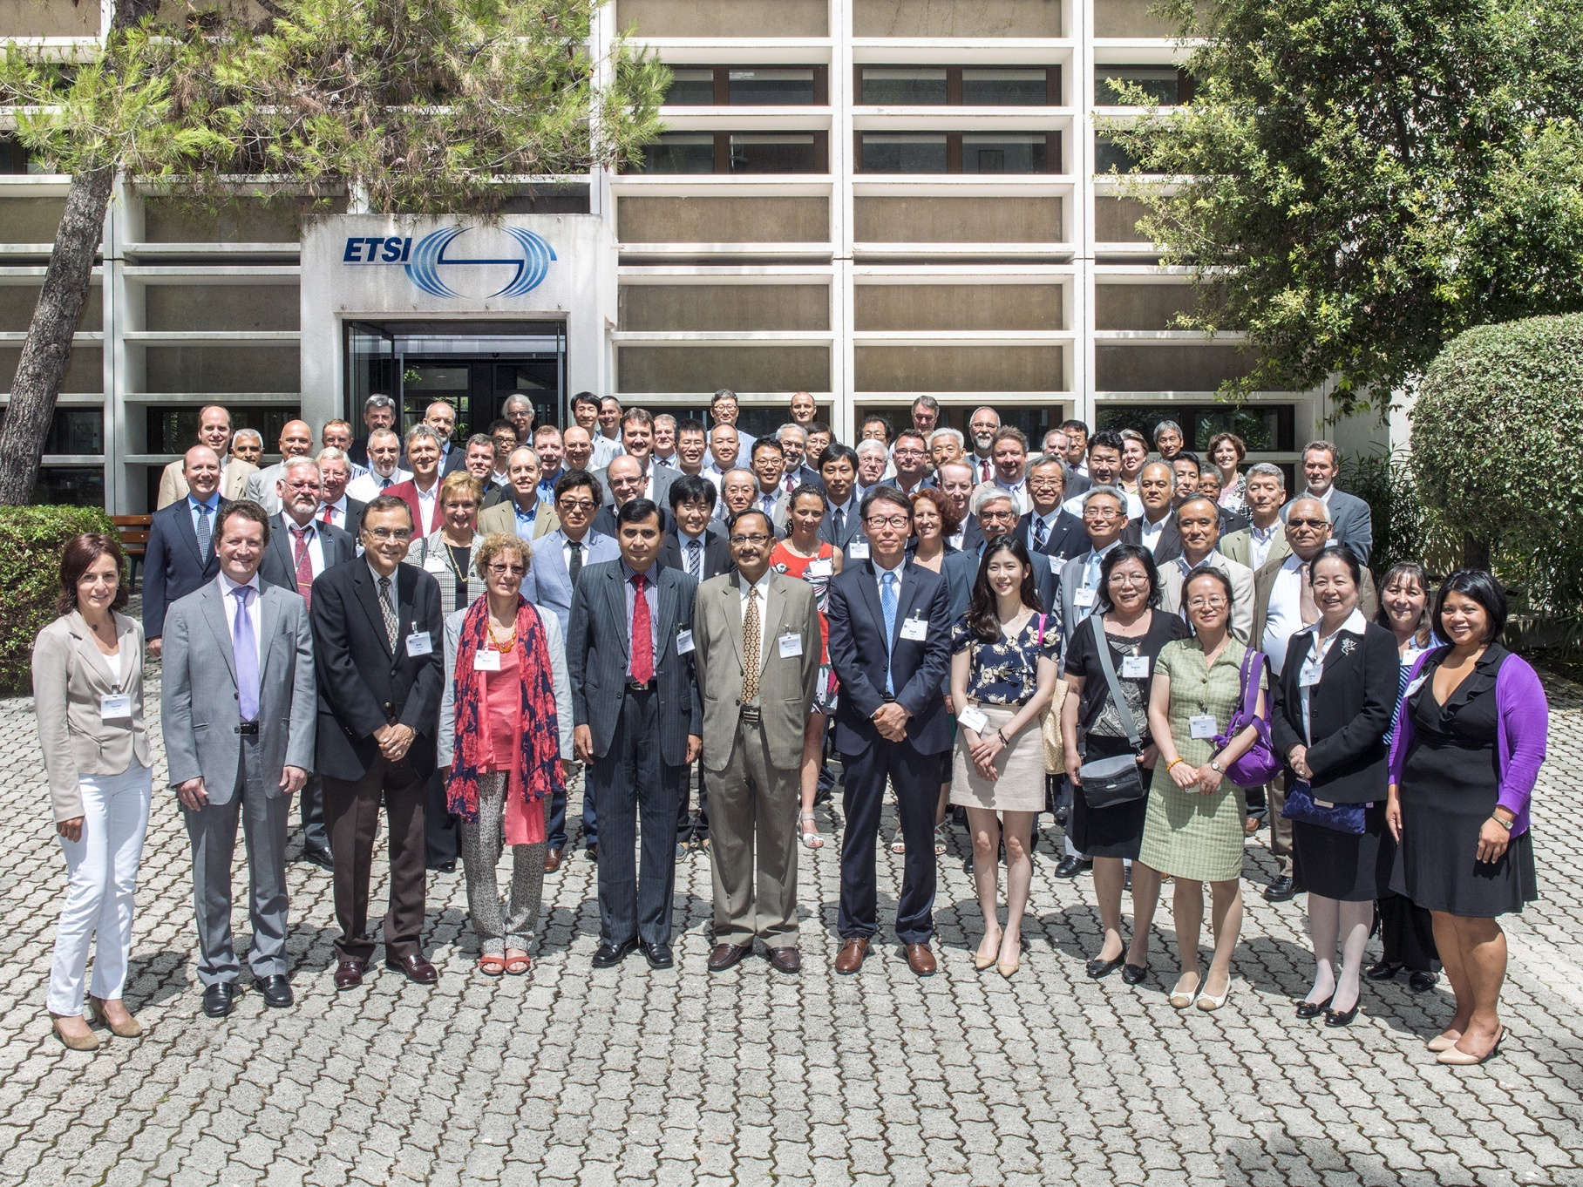
GSC-18 delegates

