Slide 1
Role of GISFI in Global Standardization
Document No: | GSC16-OBS-01
Source: | Global ICT Standardization Forum for India (GISFI)
Contact: | Ramjee Prasad
GSC Session: | OBS
Agenda Item: | 2.1
Ramjee Prasad
Founding Chairman, GISFI
www.gisfi.org

Slide 2
What is GISFI?
GISFI is an Indian Standardisation Organization based on a voluntary cooperation among industry, academia, public and private authorities, and other interested parties for the development of technical specifications in the area of ICT
Officially approved and recognized by Department of Telecommunication (DoT), Government of India
GISFI implements both an Indian and global standardisation policies:
  By basing its work on the Indian governmental policy
  By cooperating with international standardization organizations

Slide 3
Members and Collaborators
Corporate and academic institutional members
  NIKSUN
  NEC
  Ericsson
  Motorola
  VNL
  Tejas Networks
  Tata Consultancy Services (TCS)
  Nokia Siemens Networks (NSN)
  HUAWEI
  WIP Labs
  Cellular Operators Association of India (COAI)
  IIT- Hyderabad
  IIIT-Allahabad
  Rajiv Gandhi University of Knowledge Technologies, Hyderabad, India
  Sinhgad Technical Education Society
Supported by Telecommunication Engineering Centre (TEC), DoT, Government of India
ITU-T Sector Member
ETSI
ARIB
TTC
TIA

Slide 4
GISFI Standardisation Topic Groups:
Internet of Things (IoT)
Chair: Debasis Bandopadhyay,TCS
Service-Oriented Networks (SeON)
Chair: Parag Pruthi, NIKSUN
Green ICT
Chair: Anand Prasad: NEC
Future Radio Network (FRN)
Chair: Krishna Sirohi,VNL
Spectrum
Chair: Pawan Garg, Former Advisor, Government of India
Special Interest Group (SIG)
Chair: Debu Nayak, HUAWEI

Slide 5
GISFI as an Indian Standardization Organization (1)
Information Communication Technologies and Electronics have been contributing significantly to the economic growth of India and have the potential to script India’s future (National Policy onTelecommunications 2011: http://mit.gov.in/content/public-consultation-2011)
GISFI Objectives and Approach :
  To harness the power and capability of India in ICT to meet global demand
  To facilitate the application of new, technology-enabled approaches to overcome the Indian ICT developmental challenges
  To maximally leverage the power of Indian ICT to international developments in order to help address the economic and developmental challenges the country faces.

Slide 6
GISFI as an Indian Standardization organization (2)
GISFI allows that specific to India standardization activities are undertaken in India and that any accomplished standards for India can be referred to as global standards

Slide 7
GISFI’s Motivation and Approach to Standardization
Drive innovation and competitiveness in India by adapting global ICT standardization policy to Indian market and policy developments and vice versa;
Provide high-quality ICT standards in a timely manner to ensure competitiveness in the global market while responding to societal expectations;
Enhance the position of Indian ICT standardization at global level;
Assure consumer benefits by facilitating competition in Indian and international ICT markets;
Strengthen the Indian internal market by setting common criteria and processes for referencing ICT standards in Indian legislation, policies and public procurement
Increase the quality, coherence and consistency of ICT standards;

Slide 8
GISFI and GSC
GISFI
Indian ICT advances
Modernized Indian ICT: Indian standards can be referred in a global context
The necessary ICT technologies are properly defined to reflect both Indian and global specifics and that interoperability between various systems is assured on a global level
COLLABORATION
Interoperability and flexibility of global standards
GSC
Global dynamics and requirements of the ICT sector
Support to implementation of global ICT standards

Slide 9
Attributes of GISFI Standards
Openness
Consensus
Balance

Slide 10
Supplementary Slides

Slide 11






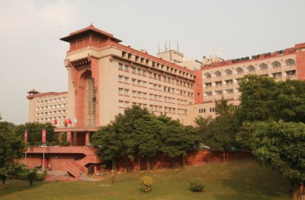
Upcoming GISFI Event
Joint
ITU Workshop on Standards and Intellectual Property Rights (IPR) Issues
and
Seventh GISFI Standardisation Series Meeting
Venue:
Hotel Ashok
Diplomatic Enclave, 50-B Chanakayapuri
New Delhi - 110021 INDIA
Phone: (91-11) 26110101/(91-11) 26116161
Fax: (91-11) 26876060/(91-11) 26873216
Date: 19-22 December 2011
Notes:
GISFI develops technical specifications that
support the development of an open and competitive Indian global market for the benefit of both consumers and industry worldwide.
respond to the needs of the highly changing and complex ICT environment
ICT-based applications will deliver their full potential only if interoperability is ensured
India is a huge market and producer: INTEROPERABILITY is important for realizing the potential of both aspects!!!

Slide 12


Proposal for a GSC Special Session at the
European Commission
Future Internet Assembly, Aalborg
(FIA)
Aalborg, Denmark
May 9 – 11, 2012
Notes:
GISFI develops technical specifications that
support the development of an open and competitive Indian global market for the benefit of both consumers and industry worldwide.
respond to the needs of the highly changing and complex ICT environment
ICT-based applications will deliver their full potential only if interoperability is ensured
India is a huge market and producer: INTEROPERABILITY is important for realizing the potential of both aspects!!!

Slide 13

GISFI membership to GSC
GISFI would like to host a future GSC meeting in India

Slide 14

GISFI as A GSC Member???

Slide 15
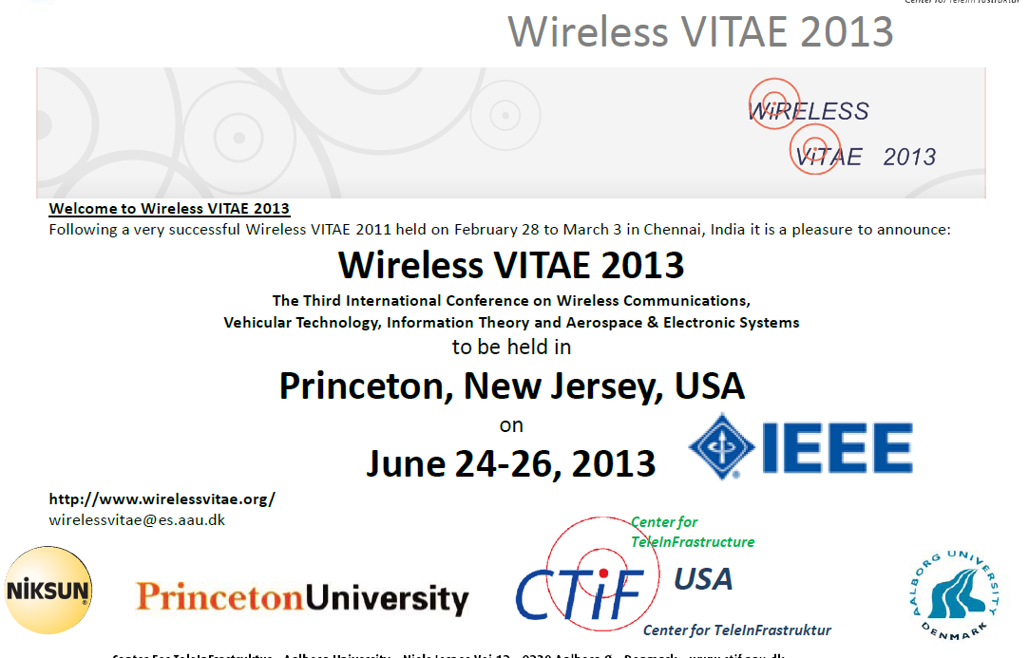
Other Related Events

