Slide 1
SG17 Presentation Collaborative environment
30 August 2013
SG/IS/USD/WEBCMS
International Telecommunication Union

Slide 2
Objective
A Web collaborative environment for the Study Groups:
Inform and stay informed
Share documents / info. with colleagues
Organize work
Discuss topics/questions

Slide 3
Enabling tools
One Collaborative Web site, shared by the Community
Each Member has its own “My Site” (view on collaboration activities)
Collaborative Web Site
Official ITU Web Site

Slide 4
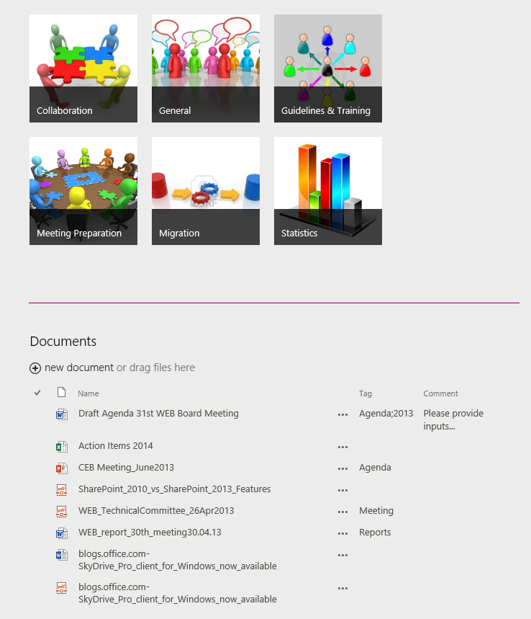
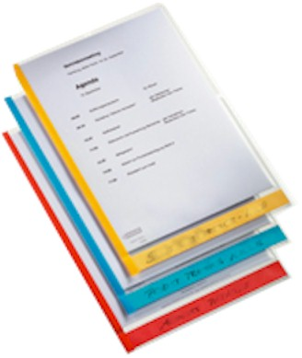
Enabling tools : document sharing
Share with Colleagues:
Drag and Drop documents

Slide 5
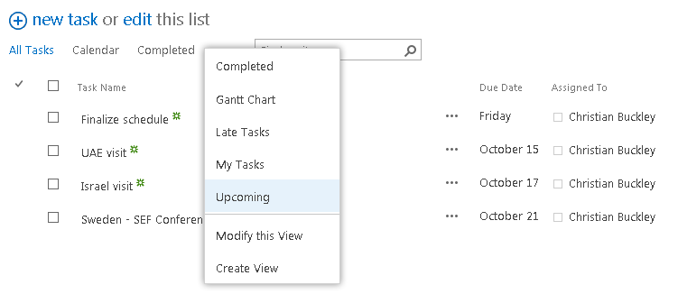
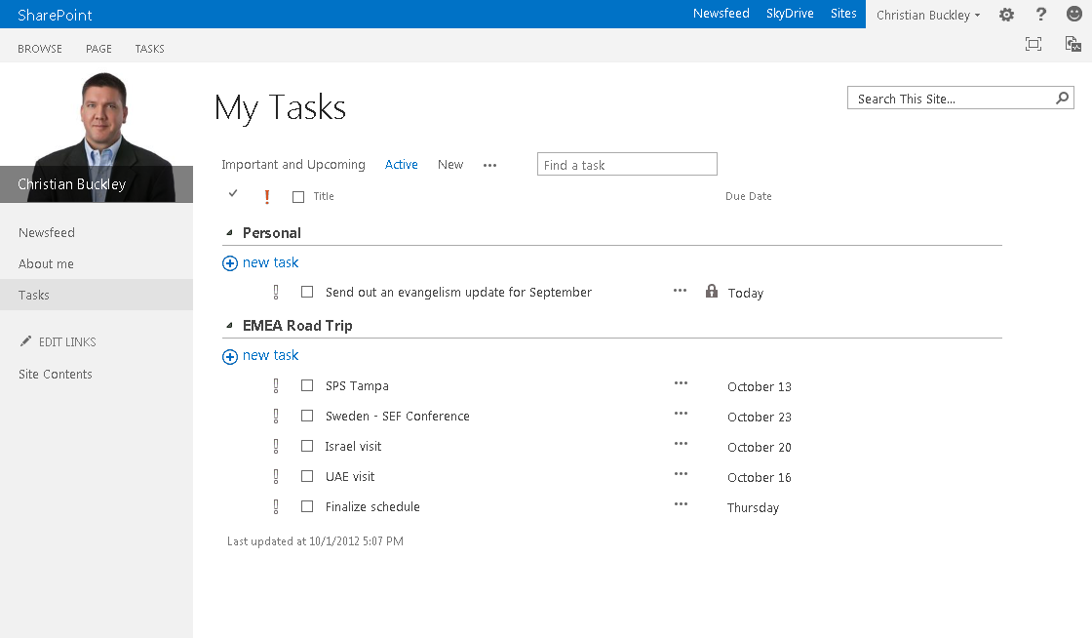
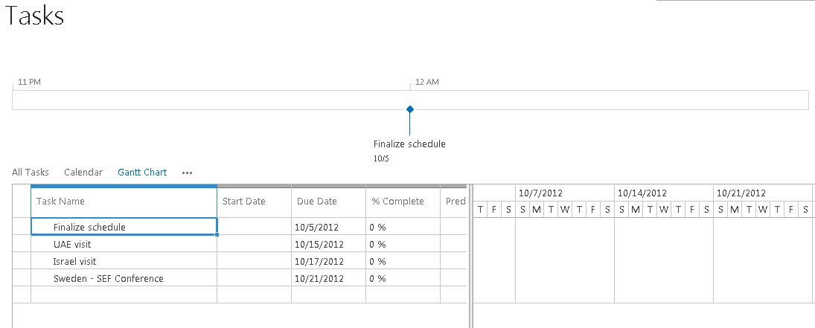
Enabling tools : Task management
Organize the work:
Personal / project tasks and deadlines

Slide 6
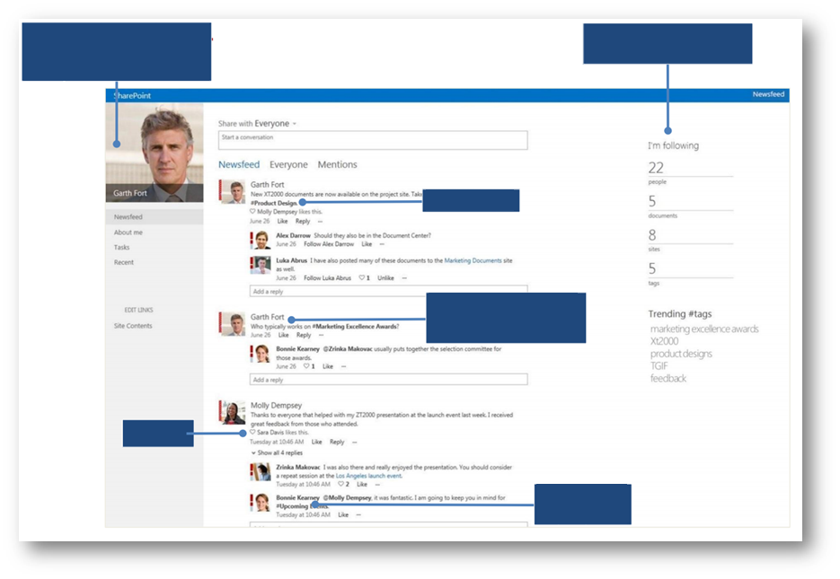
Enabling tools : Social features

Slide 7
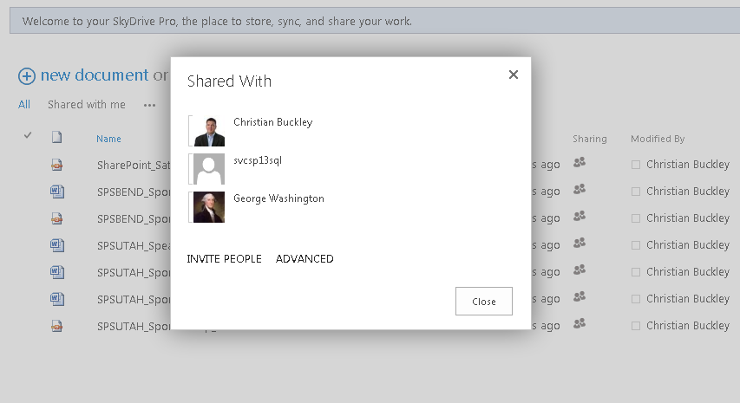
Enabling tools : Simplified sharing
Invite additional persons :
Just need to provide their email

Slide 8
Demonstration
Case study:
ITU WEB Board Meeting collaborative Preparation
Submit documents (Draft agenda, Action items)
Inform community working on the preparation
Manage tasks and timeline
Discuss agenda and planning
Chat
Collaborate on the same document

Slide 9
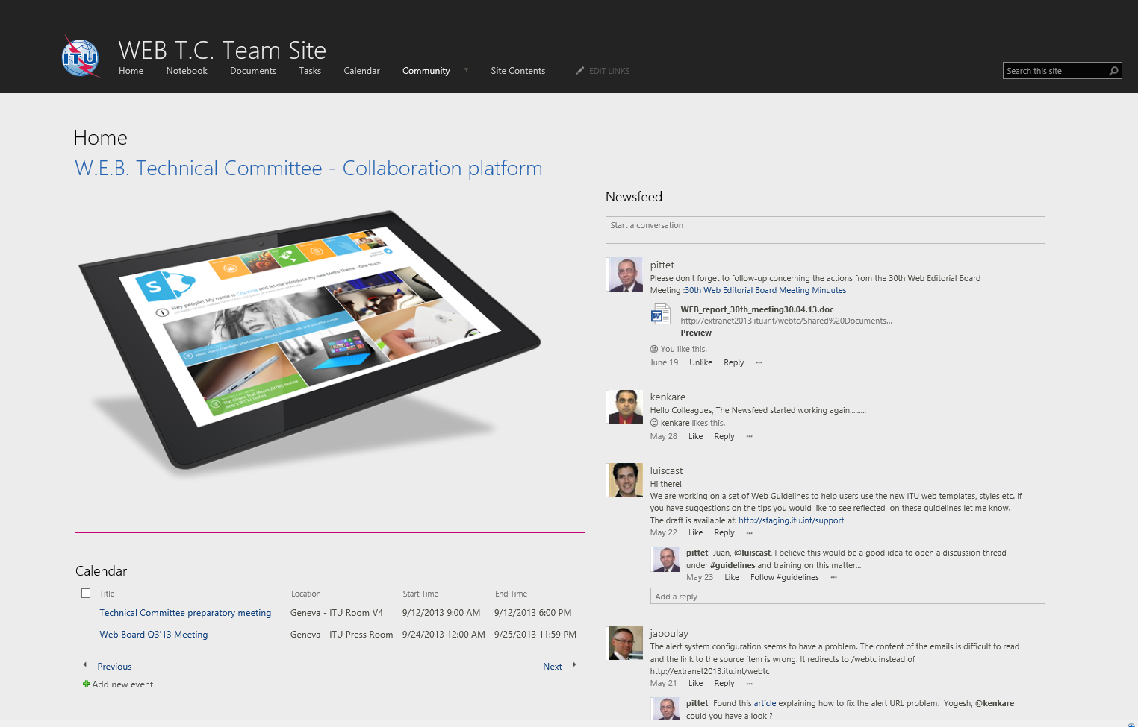
Demonstration Site…

Slide 10
www.itu.int/...
Notes:
Thank you.

