Slide 1
3rd Generation eID
Agile eIDs for Widespread National Use
Jon Shamah
30 August 2011
Northern Europe’s leading Payments and Identity Services Provider
V1.00

Slide 2
3rd Generation eID
Agile eIDs for Widespread National Use
Jon Shamah
30 August 2011
Jon Shamah
Work Package 4
Coordinator
SSEDIC
V1.00

Slide 3
Agile eIDs for Widespread National Use
Introduction
1st and 2nd Generation Architectures
3rd Generation Architectures

Slide 4
Agile eIDs for Widespread National Use
Introduction
1st and 2nd Generation Architectures
3rd Generation Architectures

Slide 5
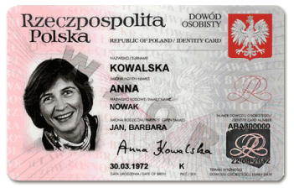
It is a National eID – not National Identity Card

Slide 6
Agile eIDs for Widespread National Use
Introduction
1st and 2nd Generation Architectures
3rd Generation Architectures

Slide 7
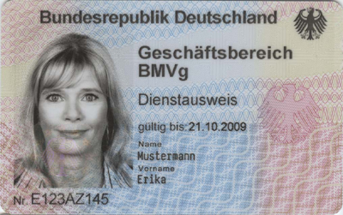
1st Generation eID
Government Owned
Embedded Chip
Contact/contactless interface
ICAO Applet
2 or 3 digital certificates
Printed Data on surface
Facial Biometric
Name
Date of Birth
T1 form factor polymer card
On-line or off-line use

Slide 8
1st Generation eID Schemes
eGovernment access
ICAO Travel Document
Digital signing via contact interface with digital certificate (EU Qualified)
Authentication for private applications with limited liability
Expensive to implement, slow to deploy, and heavy on support

Slide 9
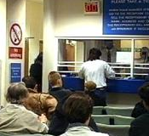
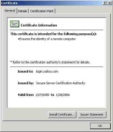
1st Generation eID Architecture

Slide 10
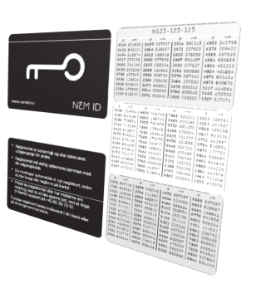
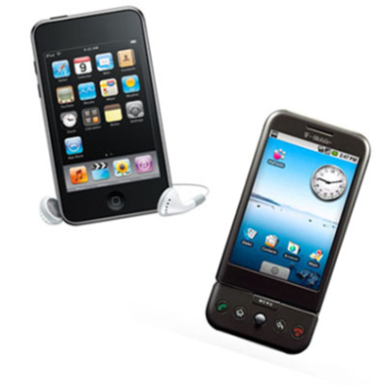
2nd Generation eID
On-line use only
Mainly Bank or Private Sector owned
PKI stored centrally
Released by a On-Time Password device
Multiple authentication methods with ‘platformless’ option
Example:

Slide 11
2nd Generation eID Schemes
No travel document
Cannot be used for ad-hoc digital signing
Server form and on-line digital signing
Uses existing registration processes via banks, telco operators and local government
Simple to use
Fast deployment
Low-support costs
Low cost to implement, fast to deploy, and light to support,
but no off-line capability and cannot be used as an ID card

Slide 12
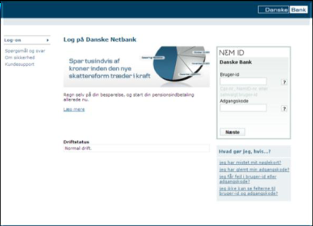
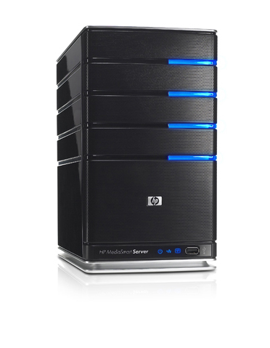
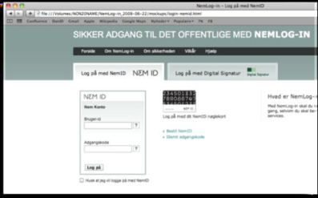
2nd Generation eID Architecture
Private Sector provides Identity Assurance
User is logged in
Central server stores keys
One Time Password authenticates and instructs to release keys

Slide 13
Agile eIDs for Widespread National Use
Introduction
1st and 2nd Generation Architectures
3rd Generation Architectures

Slide 14
3rd Generation eID – EcoSystem
A multitude of brands providing credentials

Slide 15
3rd Generation eID – EcoSystem
Mixed with existing government issued credentials

Slide 16
What are the Benefits?
eID Card may already be distributed
Travel Document
Offline ID Card
Many Governments may be nervous to have 3rd party applications residing on the credential
Many 3rd parties may not be happy to be associated with the State and/or give up their own branding
3rd Generation eID enables Relying Parties to benefit from privately operated eIDs anchored to a government credential.

Slide 17
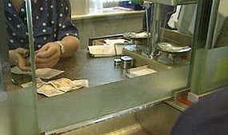
3rd Generation eID Architecture
eGov
HUB
eGov
HUB
?
Hubs
Applications
eID as a 3–Tier Architecture

Slide 18
3rd Generation eID Assurance Levels
High*
Assurance
Hub
** Example only
Enterprise Level Assurance eID
Credential
Application
Identrust**
Application
Multi
Assurance
Hub
Standard Certificate
Application
Application
High Assurance eID
Credentials
Standard *
Assurance
Hub
Application
Session Cert
Application
* Assurance levels to be defined

Slide 19
Why is this better?
Government eID Card can be used as breeder document
Government acceptance of private eID service signed by citizen using eID Card
Trust flows through Government credential
Improves cost of offsetting risk by IdPs and relying parties
Familiar branding encourages uptake
Increased trust
Ability to ‘spread’ segments of identity across multiple service providers
Less direct connection to government in day-to-day use
However…..
The cost of establishing an IdP is high

Slide 20
3rd Generation eID Architecture
eGov
HUB
eGov
HUB
?
Hubs
Hubs in 3–Tier Architecture

Slide 21
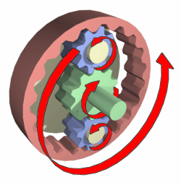
Hubs - Classic Middle-Tier Component
Identity Providers
Hub
SAML
Relying Parties
Hub
SAML
Multiple Protocols

Slide 22
Hubs - Additional Roles
Preserve data integrity, security and privacy both up and down tiers
Mediate Assurance Levels, Minimum Information Datasets
Perform auditing and logging at request of the relying application and agreement of individual
Provide anti-fraud protection similar to credit-card transaction monitoring
Provide assurance to individuals that data is only retained for agreed lengths of time - Can it be totally “stateless” ?
Accept routing interfaces and trust paths for inter-hub and cross-border requests (example: STORK)

Slide 23
Hubs - Validating the State of Identity
Identity Credentials must be checked against
Revocation
Suspension
Source Identity Provider must be checked for
Current Certified Assurance Level
Demonstration must provide Relying Party Application with
Auditable proof that the credential is fit for purpose against a pre-defined set of policies

Slide 24
Hubs - Ownership
Needs to have ownership
Independent of Identity Providers ?
Independent of Relying Parties (If multi-RP?)
Will require bilateral agreements with all relying parties and IDPs if they require
SLAs
Liabilities
Compliance
Strong regulation required for higher roles

Slide 25
Attribute Management
As authentication becomes accepted attributes and ‘mandates’ will be seen as desirable:
Who will be responsible for managing these mandates?
Government owned Attribute Provider
Citizen owned Attribute Provider
How and when will mandates be certified for accuracy?
How and when will mandates be validated for timeliness?
What are the rules which govern the release?
Who determines what is needed?
Choice of automatic mandate or prompt
Minimal disclosure
How will anonymous credentials be incorporated?
Should they be incorporated via the IdPs or hubs
Is there any conflict of interest?

Slide 26
Key Features
Ethics
Minimum Data Disclosure
User Centric Permission (and revocation)
Usage Governance and remedy management
Technology
Privacy enhancing
Security Assurance

Slide 27
Attribute Types
Public Sector ‘Owned’
Social Security
Driving Licence
Medical reference number
VAT
Passport
Privately owned
Biometrics
Personal Preferences
Bank details
Medical Data
………..

Slide 28
Uses for Attributes
Establishing Identity Credentials
‘Primary’ type attributes
High Assurance
Critical for ecosystem integrity
Supplementing Identity Credentials
‘Secondary’ Type Attributes
Providing Service Providers with data
Additional Authentication

Slide 29
Introducing Attributes
Attribute Providers
Relying Party
Relying Party
IdPs
Hubs
Relying Parties / Applications

Slide 30
Introducing Attributes
Attribute Providers
Relying Party
Relying Party
IdPs
Hubs
Relying Parties / Applications

Slide 31
Example of Use - Primary Attributes
Level n Assurance

Slide 32
Example of Use - Primary Attributes
Level n Assurance
Level n + 1 Assurance

Slide 33
Example of Use - Secondary Attributes
Step 1
Enquire

Slide 34
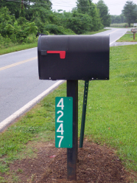
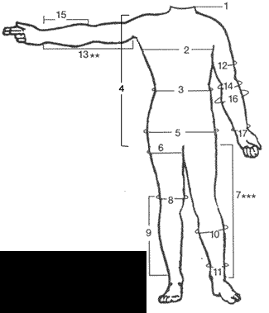
Example of Use - Secondary Attributes
Step 1
Enquire
Step 2
Order

Slide 35
Example of Use - Secondary Attributes
Step 1
Enquire
Step 2
Order
Step 3
Fulfil

Slide 36
Business Models & Revenues
From Government Savings
Movement to “e-only” Government
Front desk outsourced for marginalised citizens
Many statistics available demonstrating savings
From Private Sector
Reduction in identity risk
Compliance
Fraud
Reduced costs
Process automation
Error reduction
“New Business”

Slide 37
Example: Digitisation of Contract Application
Service consisting of a signing and workflow service is used in conjunction with eIDs to digitally process bank loan application
 | Application | Guarantee | Contract | Terms & Conditions
Applicant | X |  | x | x
Advisor | X | x |  | x
Manager | X | x | x
Guarantor |  | x | x | x
Traditionally this process can take over one month in time to complete and require over 70 sheets of paper.
Real examples have shown savings in excess of €50 per application and each bank may process many thousands of applications per week.
For the case of 10,000 applications per month, the saving to a bank is worth approximately €6 million per year.

Slide 38
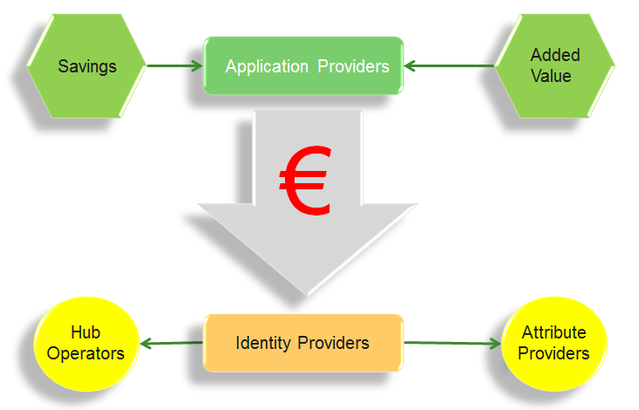
eID Revenue Flows

Slide 39
Roles for Telcos
Unique place in the market
High penetration of global population and geographies
Interoperable framework experience
Wide scale managed networks and datacentres
White-Labelling of IdP Framework Services
Attribute Providers
Hub Operators
Service Providers
Network Operators

Slide 40
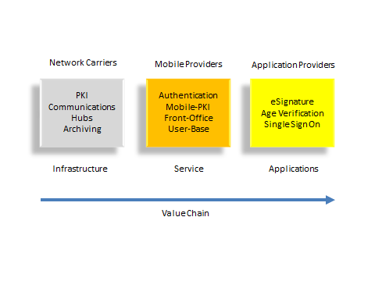
Up the Telco Value Chain

Slide 41
White-Labelling of IdP Framework Services
For IdPs, Framework Services will
reduce cost of entry
reduce on-going specialist resources commitments
provide a common governance framework
Managed Services to include
PKI Back-Office (3 Assurance levels)
Front Office
Authentication (multiple methods)
Registration
Insurance Management
Data Management
IdPs will be able to choose which services that they need

Slide 42
Managed Services Framework
Hubs
PKI Back Office
……..
Common Governance
Registration
Hubs
……..
Authentication
Hubs
IdP Managed Services
IdPs leveraging own brands and client bases
Reduces resource requirements and investment by new IdPs

Slide 43
Common Governance
Technical Interoperability
Assurance Levels for different applications
Protocols, schemas, profiles
Commercial Interoperability
Revenue flows
Liability
Exception Management
Complaint Resolution
Regulatory Compliance
Redress
Recovery

Slide 44
Roles for SDOs
Large number of complex interactions
Many cross-border
Essential that those interactions are standardised
Roles and duties need to be clearly understood by all players
Governance needs to be established against clearly defined actions
Much of the environment has yet
to be defined

Slide 45
Current EU trend towards eIDs
Problems with State issuance of eID credentials
State programs always have long delays
Reluctance to ‘share’ chip space with 3rd parties
Liability
Need to maintain state/citizen separation for privacy
Advantages of private organisations
Agility, innovation and drive
Promotes citizen choice and opt-in
Capability for branding
Multi applications
In line with the Digital Agenda for Europe
45

Slide 47
SSEDIC Rational
A secure cyberspace is critical to the heart of our economy and security
Increasing of online fraud, identity theft and misuse of information online
Need to increase the level of trust associated with digital identity
SSEDIC has the mission to contribute to build a strategic vision for Europe in defining rules and guidelines for a single European e-Identity ecosystem
Individuals and organizations must use secure, efficient, easy to use and interoperable identity solutions to access online services with confidence, privacy, choice and innovation

Slide 48
SSEDIC Impact
“Not just a theoretical exercise, but recommending practical steps in each stakeholder sector
towards a vision of the Single European Digital Identity Community”

Slide 49
SSEDIC Relevance
Relevance for the EU Digital Agenda
Goal 2: improve ICT standard-setting and interoperability
Goal 3: enhance trust and security
Relevance for Business in general
Interest and motivation of 35 partners (67 experts)
Involvement of “associated” partners (50+)
Alignment with STORK
STORK partners in SSEDIC are:
ATOS, A-SIT, T-Systems, BSI, CapGemini, and EEMA.
Connections with other identity related projects: PEPPOL, SPOCS, SEMIRAMIS, TDL ….

Slide 50
Summary & Action Needed
Public Private Partnerships are becoming more accepted for National eID deployments and 3rd Generation eID, can open the market for a large scale single federated digital ID community in the near future
There is profit to be made as the market grows with telcos being very well placed to take advantage of the new revenues
Controls and standards must be in place in order for this new market to flourish. Organisations such as the ITU-T have a duty to provide the standards needed for such a growth and ITU-T needs to be addressing those standards, in coordination with partners urgently.

Slide 51
Thank You
Any questions ?
Jon Shamah
Email: jsham@nets.eu
UK Mobile: +44 7813-111290
NETS eSecurity
Haavard Martinsens vei 54, N-0045 OSLO
SSEDIC
http://www.eid-ssedic.eu

