Slide 1
WTSA-16 Conference Proposals Interface (CPI)
CITEL preparatory meeting, 18 May 2016
Rob Clark
ITU-T Study Groups Department (robert.clark@itu.int)

Slide 2
CPI overview
The Conference Proposals Interface (CPI):
Web-based tool for preparing/submitting proposals to WTSA-16.
Creates formatted proposals in any of the six official UN languages.
Ensures that the authoritative in-force provisions are used as the basis for proposals.

Slide 3
Preparing & submitting proposals using CPI
WTSA-12 proceedings
1
2
3
Create a “skeleton”
Indicate proposed changes
Submit proposal to WTSA-16
Modifications since WTSA-12 (e.g., updated Res.2, A.5, etc.)
“Skeleton” (selected provisions)
Proposal
WTSA-16
Reference text to be used (provisions): Resolutions, Recommendations, Opinions; Questions
Baseline texts
Baseline texts will be available to delegates from June 2016 through the Conference Proposals Interface (CPI) website.
These baseline texts should be used as the starting point for all suggested changes.

Slide 4
Types of change
MOD: Proposal to modify existing provision(s) (use "track changes"). E.g., addition, deletion or replacement of words or figures.
ADD: Proposal to add a new provision, i.e., a draft new WTSA Resolution, A-series Recommendation or Opinion (do not use "track changes.
SUP: Proposal to delete an existing Resolution, Recommendation or Opinion (do not use "track changes"). Reasons/rationale for deletion need to be given.
NOC: Proposal to maintain provision(s) without change (do not use "track changes"). Reasons/rationale for maintaining the text need to be given.
OTHER: Proposal on general matters no included above.

Slide 5
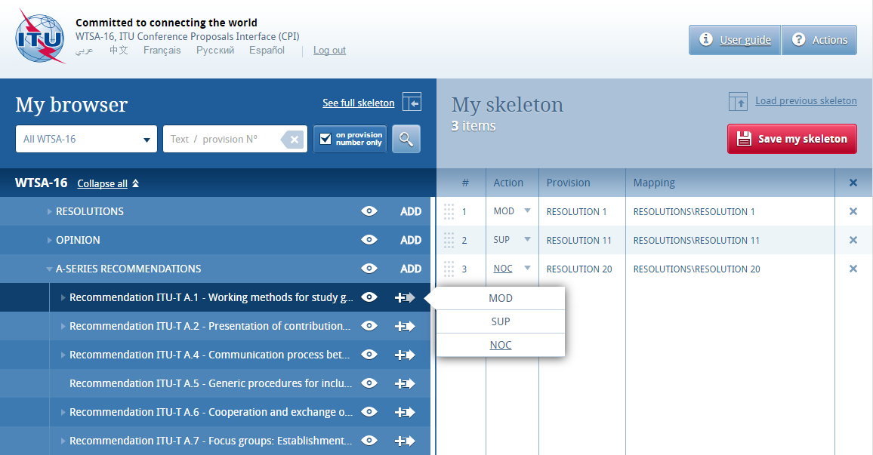
Conference Proposal Interface (CPI)
Baseline texts
Baseline texts will be available to delegates from June 2016 through the Conference Proposals Interface (CPI) website.
These baseline texts should be used as the starting point for all suggested changes.

Slide 6
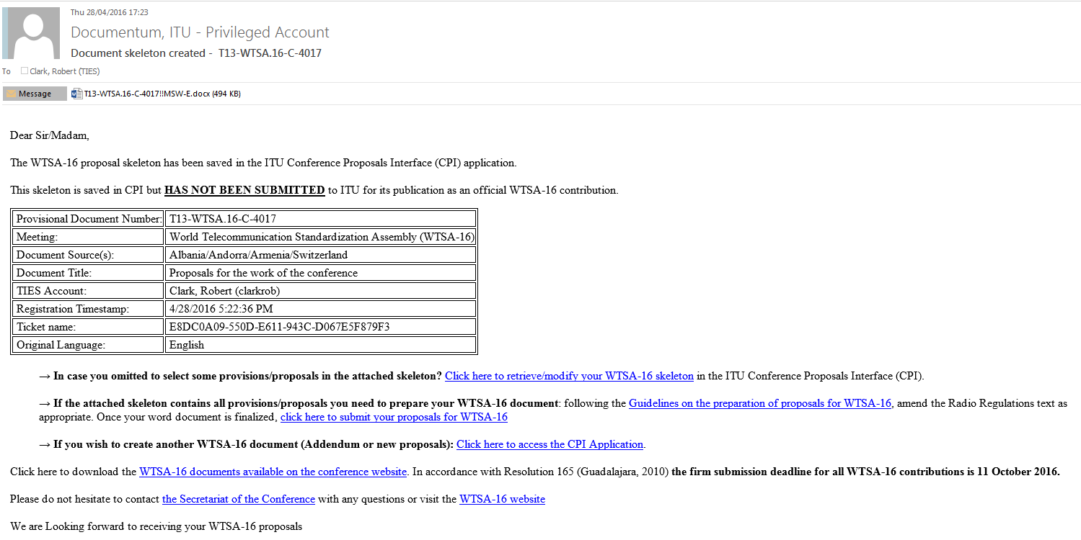
Email confirmation

Slide 7
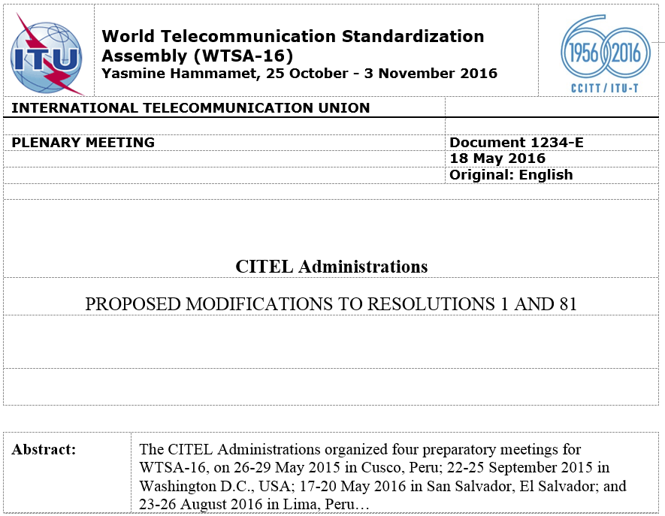
Anatomy of a proposal (1/2)
- Document number (if known) and language; - date of submission; and - original language of submission.
Member(s) or region submitting proposal(s)
Proposal title
Description of background or content of this proposal (250 words max.).
Do not delete or use any empty cells in the header

Slide 8
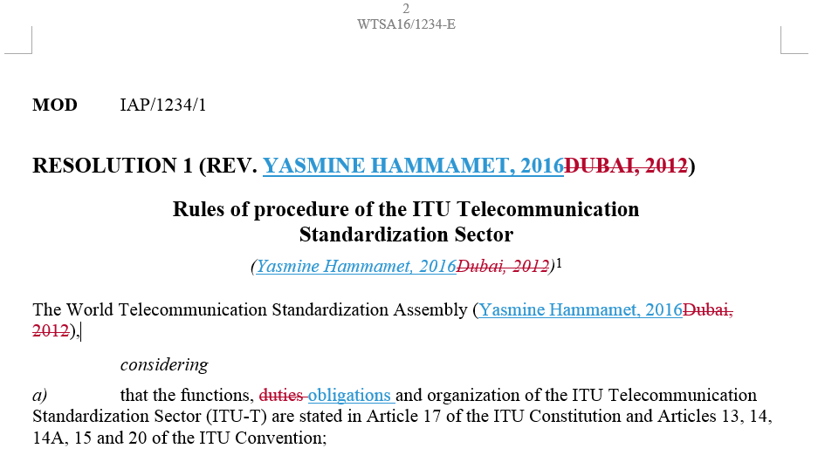
Anatomy of a proposal (2/2)
- MOD: Action type “modify existing provision”; - IAP: “Inter-American Proposals” (or Member-State identifier); - /1234: Document number (if known);
- /1: First proposal in this document.

Slide 9
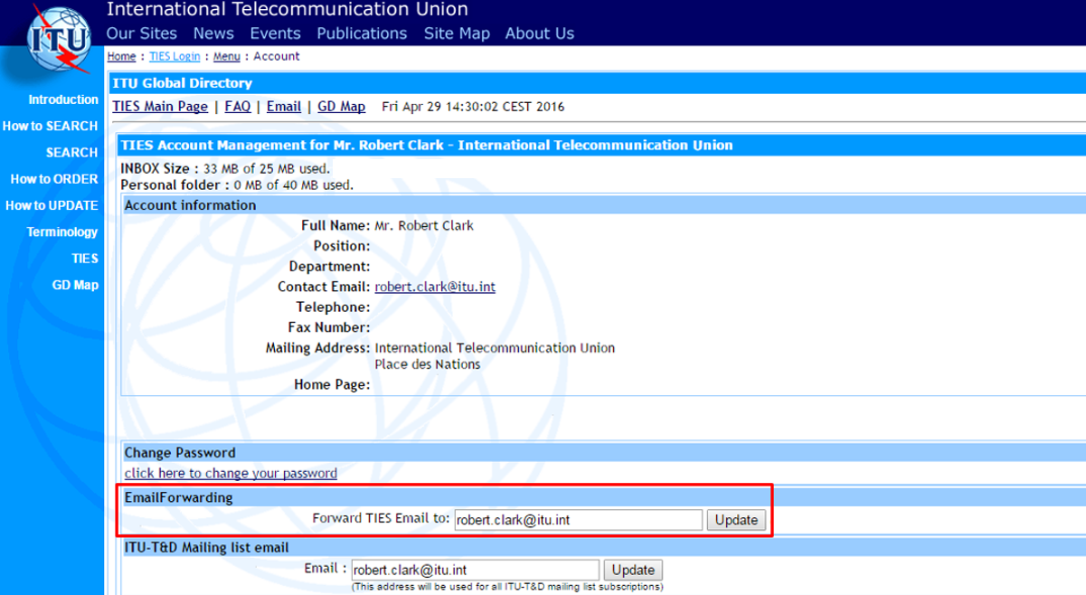
Setting TIES email forwarding
http://www.itu.int/online/mm/scripts/account

Slide 10
CPI Live demo
https://www.itu.int/net4/Proposals/CPI/WTSA16

Slide 11
Thank you
Any questions?
Rob Clark
ITU-T Study Groups Department (robert.clark@itu.int)
WTSA-16 Secretariat: wtsa-doc@itu.int

