Slide 1
ITU-T STUDY GROUP 12
Performance, QoS and QoE
Kwame Baah-Acheamfuor Chairman, SG12
Key areas of work, achievements and outlook

Slide 2
Key areas of work
Subjective tests and objective models
Hands-free
eCall
Voice
Video
SG12
Performance,
QoS, QoE
Ear-phones
In-service quality management
Terminal characteristics
Video gaming
OTT
Hearing aids
Tele-presence
Web browsing
Charging
Network performance
Availability
Provisioning
NFV, 5G, etc.
Transmission
Administration

Slide 3
Achievements

Slide 4
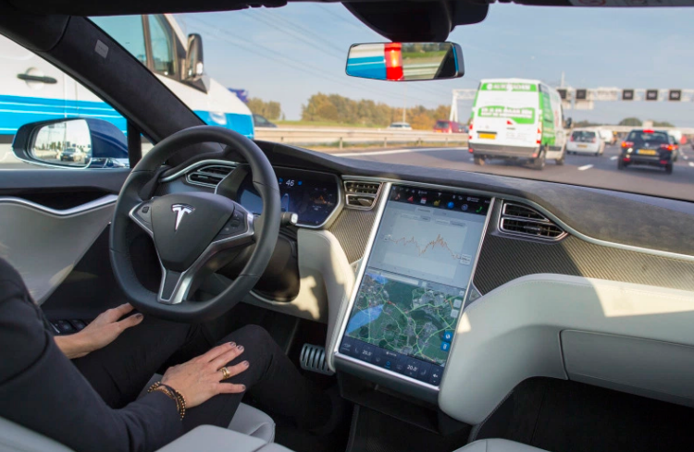
Key SG12 achievements in 2013-2016 (1)
First VoLTE standard in ITU-T: End-to-end QoS for voice over 4G
Widely used objective test methods for hands-free in vehicles
Rapid progress on QoE assessment and prediction for UDP and TCP/HTTP-based video streaming services, including OTT video
Completion of buffer models for media streams on TCP transport; hand-over performance among multiple access networks
Notes:
First VoLTE standard in ITU-T: End-to-end QoS for voice over 4G
Widely used objective test methods for hands-free in vehicles
Rapid progress on QoE assessment and prediction for UDP and TCP/HTTP-based video streaming services, including OTT video
Completion of buffer models for media streams on TCP transport; hand-over performance among multiple access networks

Slide 5
Key SG12 achievements in 2013-2016 (2)
Approval of 23 new and 25 revised ITU-T Recommendations
Adoption of subjective test methods for speech intelligibility, telemeetings and web browsing
Completion of opinion model for network planning of video and audio streaming applications
Revised MOS terminology, interpretation and reporting
New QoE definition: QoE is the degree of delight or annoyance of the user of an application or service
Notes:
Adoption of subjective test methods for speech intelligibility, telemeetings and web browsing
Completion of opinion model for network planning of video and audio streaming applications
Revised MOS terminology, interpretation and reporting
New QoE definition: QoE is the degree of delight or annoyance of the user of an application or service
Approval of 23 new and 25 revised ITU-T Recommendations

Slide 6
Challenges

Slide 7
Challenges faced by SG12 in 2013-2016
Conflicts with SG11 on QoS measurements and testing
Limited participation of Sector Members from developing countries
Notes:
Conflicts with SG11 on QoS measurements and testing
Limited participation of Sector Members from developing countries

Slide 8
Outlook

Slide 9
Outlook on SG12 in 2017-2020
Addition of lead role on quality assessment of video communications and applications – new work in the pipeline
Strong interest in QoS/QoE from administrations and regulators in developing countries. Regional Group and Quality Service Development Group play catalytic role for new SG12 work
Number of proposed Questions stable: one merger, one new: Virtualized deployment of recommended methods for network performance, QoS and QoE assessment
Notes:
Addition of lead role on quality assessment of video communications and applications – new work in the pipeline
Number of proposed Questions stable: one merger, one new: Virtualized deployment of recommended methods for network performance, QoS and QoE assessment
Strong interest in QoS/QoE from administrations and regulators in developing countries. Regional Group and Quality Service Development Group play catalytic role for new SG12 work

Slide 11
Abbreviations and acronyms
5G 5th generation network
eCall Emergency call system
HTTP Hypertext Transfer Protocol
LTE Long-Term Evolution
MOS Mean opinion score
NFV Network function virtualization
OTT Over the top
QoE Quality of experience
QoS Quality of service
TCP Transmission Control Protocol
UDP User Datagram Protocol
VoLTE Voice over LTE

