Slide 1
ITU-T Study Group 11
Signalling requirements, protocols, test specifications and combating counterfeit products
Achievements and future plans
Andrey Kucheryavy, Chairman ITU-T SG11
March 2022

Slide 2
Areas of study of SG11 (2017-2021)
Protocols
Signalling and protocols, including for IMT-2020 technologies
Testing
Establishing test specifications, conformance and interoperability testing for all types of networks, technologies and services that are the subject of study and standardization by all ITU‑T study groups
Combating counterfeiting and ICT theft
Combating counterfeiting of ICT devices and the use of stolen ICT devices

Slide 3
SG11 structure and related groups
Vice-chairmen:
Isaac Boateng (Ghana)
Jose Hirschson Alvarez Prado (Argentina)
Shin-Gak Kang (Korea, Rep.of)
Karim Loukil (Tunisia)
Awad Ahmed Ali Hmed Mulah (Sudan)
Khoa Nguyen Van (Viet Nam)
João Alexandre Moncaio Zanon (Brazil)
Xiaojie Zhu (China)
Secretariat (TSB):
Denis Andreev (Advisor)
Carolina Lima (Administrative assistant)
WORKSHOPS
SG11 Chairman
Andrey Kucheryavy (Russian Federation)

Slide 4
General statistic of SG11 (2017-2021)
10
12
STUDY GROUP MEETINGS
WPs MEETINGS
WORKSHOPS
88 Recommendations
12 Technical papers and Supplements
1231 Participants (76 countries)
660 Contributions
3 SMEs
New Focus Group (FG-TBFxG)
53
7
RGMs MEETINGS
REGIONAL GROUPS MEETINGS

Slide 5
SG11 structure and related groups
5
14
WORKING PARTIES & CASC
QUESTIONS
WORKSHOPS
2
1
REGIONAL GROUPS
(AFR, EECAT)
FOCUS GROUP (FG-TBFxG)

Slide 6
SG11 collaboration
ITU-R SGs
243 oLSs sent
WTO
ILAC
OECD
ORAN
ONUG
ITU-T SGs
3GPP
TM Forum
ISO/IEC JTC 1
BBF
NGMN
IETF
NIST
ATU
RCC
IEEE
ITU-D SGs
APT
MMFAI
BEREC
IECEE
TIP
CITEL
ETSI
Cable Labs
MEF
LAS
CEPT
RIPE NCC
GSMA

Slide 7
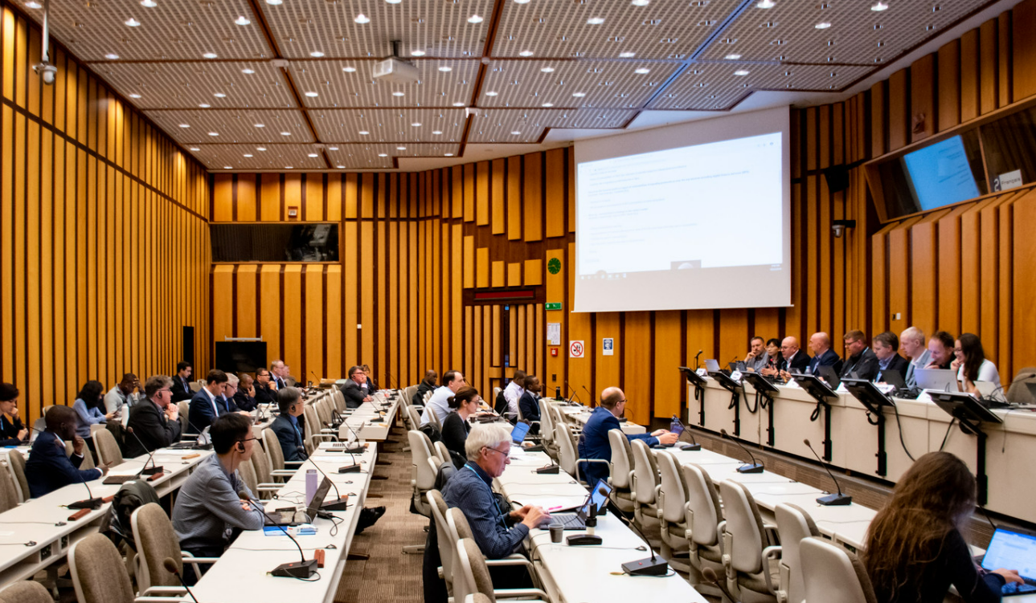
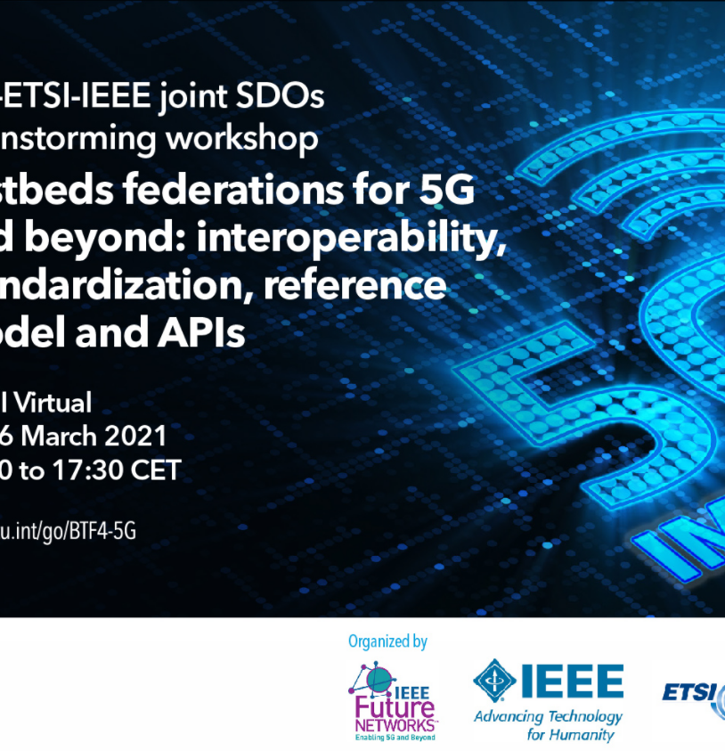
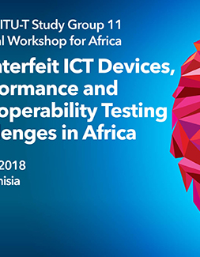
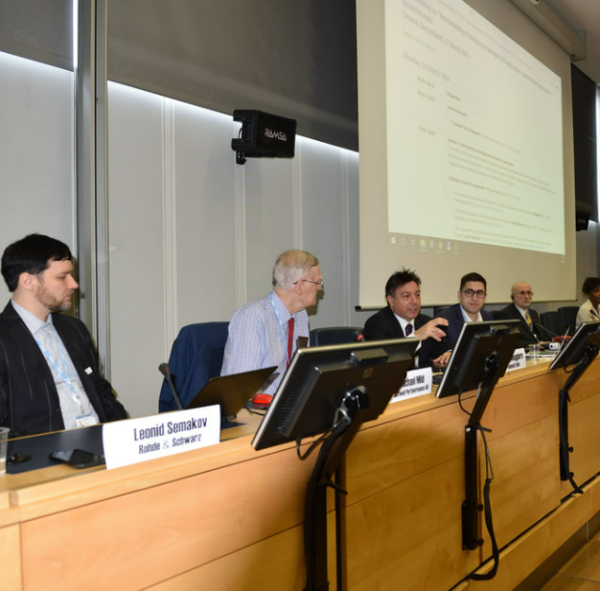
SG11 organized 17 Workshops (2017-2021)

Slide 8
Key directions of study (2017-2021)
TL recognition
Signalling requirements
(existing and emerging technologies/networks)
Combating counterfeit stolen
Security of protocols (e.g. SS7)
SG11
Action plan
Interconnection of VoLTE and IMT-2020
IMT-2020 control plane
Combating counterfeit ICT devices
Test specs

Slide 9
New-subcategories of Q.series
Q.5000-Q.5049 Signalling requirements and protocols for IMT-2020
Q.4100-Q.4139
Protocols and signalling for P2P communications
Q.4060-Q.4099
Testing specifications for IMT-2020 and IoT
Q.5050-Q.5069
Combating counterfeiting and stolen ICT devices

Slide 10
Key achievements: Signalling (2017-2021)
VoLTE/ViLTE signaling
Network signaling
IMT-2020 signaling
ITU-T Q.3640
ITU-T Q.3953
ITU-T Q.3644
Network slice manager
NFV-MANO
ITU-T Q.5021
Signalling optimization
Service function discovery
ITU-T Q.3059
Orchestration in NGNe ITU-T Q.3058
ETS
Interconnection,
roaming
Protocol for network slice management
Capability exposure APIs
VoLTE
ViLTE
VoLTE
ViLTE
OSS
Signalling for emergency issues
APIs
3rd party APP
Signalling for IoT ITU-T Q.3055
Virtualization ITU-T Q.3054
ITU-T Q.5020
IMT-2020
ITU-T Q.Sup.69 ITU-T Q. Sup.70
ITU-T Q.3060
IMS
IMS
basic call & Suppl.serv
ITU-T Q.5002
Distributed ENUM for IMS
interworking
vBNG ITU-T Q.3405
TE
ITU-T Q.5022
D2D
ITU-T Q.5023
ITU-T Q.3617-Q.3630
Q.4000-Q.4016
Intelligent edge computing
AI-assisted intelligent network slicing
cloud
ITU-T Q.3643, Q.3645
TE
IMS interworking
AI-based intelligent data processing capability
ITU-T Q.5001
ITU-T Q.3641, Q.3642
SS7 and protocols security
SDN signalling
P2P communications
ITU-T Rev. Q.731.3 – Q.731.6
Boradband access network
Multimedia Streaming Protocol
Verified Calling Party number
TE
Virtual
Data
Centers
ITU-T X.609.3-X.609.5
TE
ITU-T Q.3713-Q.3720
SS7
Sew
Peer
Peer
Entity A
Entity B
GW
ITU-T Q.3718
SDN
Hybrid P2P
ITU-T
Q.4100
Q.4101
SS7 vulnerabilities & mitigation measures
TR-SS7-DFS
QSTR-USSD
DFS
ITU-T Q.3740
Q.3741
Q.3745
Signalling mapping – virtual/physical networks
4G, 5G
Peer
Peer
Entity C
Entity D
Services
Content Distribution Protocol
ITU-T Q.3716
ITU-T X.609.6-X.609.10
Interconnection between trustable network entities
ITU-T Q.3057

Slide 11
Key achievements: Testing (2017-2021)
Internet measurements, remote testing
Protocols test specs, monitoring
ITU-T Q.3056
ITU-T Q.3640,Q.3940, Q.3953 Q.4014.1, Q.4014.2
ITU-T Q.3952 Q.4060, Q.4062, Q.4063, Q.4065
Remote testing of NP
Internet resource
Augmented Reality testing
Probe
Interconnection, services test specs
IoT and tactile test specs
Probe
Telco
Peering
point
Internet
ITU-T Q.4066
IoT
AR
IMS
Telco
ITU-T Q.4061
ITU-T Q.3963
TE
TE
Cloud monitoring
SDN
Internet related performance measurements
ITU-T Q.3914
Web evaluating
ITU-T Q.3960, Q.Supp.71
Cloud computing
Test specs life cycle management
Internet
ITU-T Q.3961
vBNG
Cloud interop test specs
ITU-T Q.4067
Testbed federations
Interop test specs
ITU-T Q.4040
ITU-T Q.4041.1
ITU-T Q.4042.1
ITU-T Q.4043
ITU-T Q.4044
Monitoring system
TL
ITU-T Q.4064
vBNG
ITU-T Q.3916
ITU-T Q.3915
API-3
API-2
ITU-T Q.4068
I₂
ITU C&I Programme
TL
Open APIs for interoperable testbed federations
TL
Reference table of ITU-T Recommendations to be used for C&I
Pilot projects on C&I
API-1

Slide 12
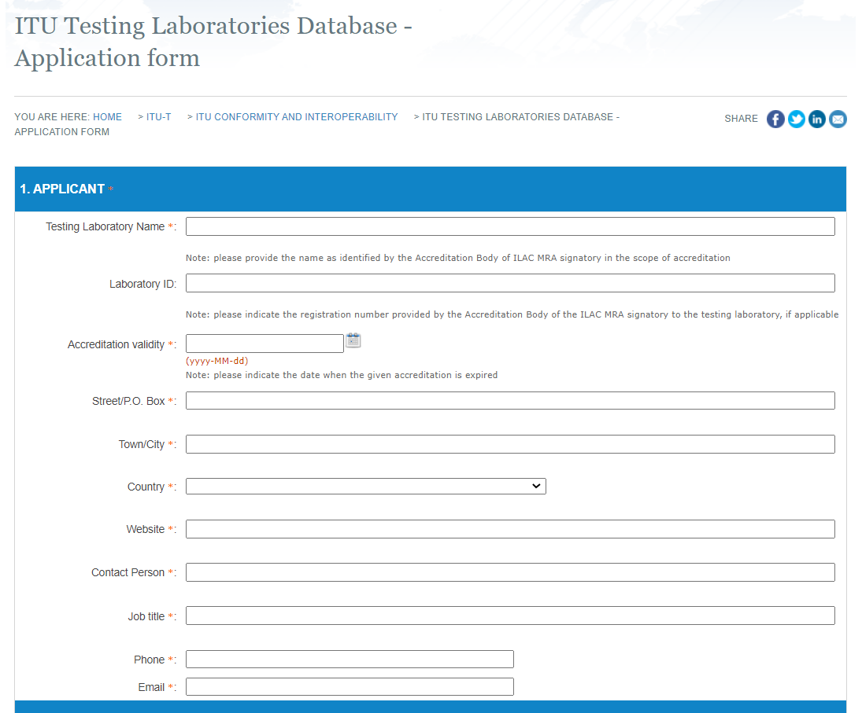
Key achievements: CASC (2017-2021)
Conformity Assessment Steering Committee (ITU-T CASC) collaborates with International Laboratory Accreditation Cooperation (ILAC) on establishing ITU Testing Laboratory recognition procedure
Outcomes:
SG11 approved the ITU Guidelines which define the high-level framework on TL recognition procedure and appointment of ITU technical experts who can be involved in the TL’s assessment team.
Appointed 11 ITU-T Technical experts on ITU-T Recommendations H., K., M. and X.series.
SG11 agreed that ITU recognizes the TLs which are accredited by an Accreditation Body (AB) that is a signatory to the ILAC Mutual Recognition Arrangement (MRA) for testing, which scope of accreditation contains ITU-T Recommendation(s).
Any TL, including non-ITU member, needs to approach AB that is a signatory to the ILAC MRA. Once accredited, TL can be recognized by ITU based on the request submitted via online form.
TSB Circular 368

Slide 13
Key achievements: Counterfeit & ICT theft (2017-2021)
Combating counterfeiting of ICT devices
Web portal
Resolution 96 of WTSA-16
ITU Telecommunication Standardization Sector studies for combating counterfeit telecommunication/information and communication technology devices
IMEI Global Database
Regional Central
Equipment Identity Register
ITU-T Q.5052
Technical Report on Counterfeit ICT Equipment (2015)
QTR-CICT - Survey report on counterfeit ICT devices in Africa region (2017)
ITU-T Q.5050 “Framework for solutions to combat counterfeit ICT devices” (2019)
Questionnaire on Reliability of International Mobile Equipment Identity (IMEI)
​Addressing mobile devices with duplicate unique identifier
ITU-T Q.5053
Audit interface for blacklisted IMEI
Black-list
Audit System
PLMN
Equipment Identity Register
ITU-T QTR-RLB-IMEI
Reliability of IMEI
Counterfeit mobile device
ITU-T Q.5052 “Addressing mobile devices with a duplicate unique identifier” (2020)
ITU-T Q Suppl.73 “Guidelines for Permissive versus Restrictive System Implementations to address counterfeit, stolen and illegal mobile devices” (2021)
ITU-T Q Suppl.74 “Roadmap for the Q.5050-series - Combat of Counterfeit ICT and Stolen Mobile Devices” (2021)
ITU-T Q.Suppl.75 “Use cases on the combat of counterfeit ICT and stolen mobile devices” (2021)
Country 1…n
Combating the use of stolen ICT devices
Resolution 97 of WTSA-16
Combating mobile telecommunication device theft
ITU-T Q.5051 “Framework for combating the use of stolen mobile devices” (2020)

Slide 14
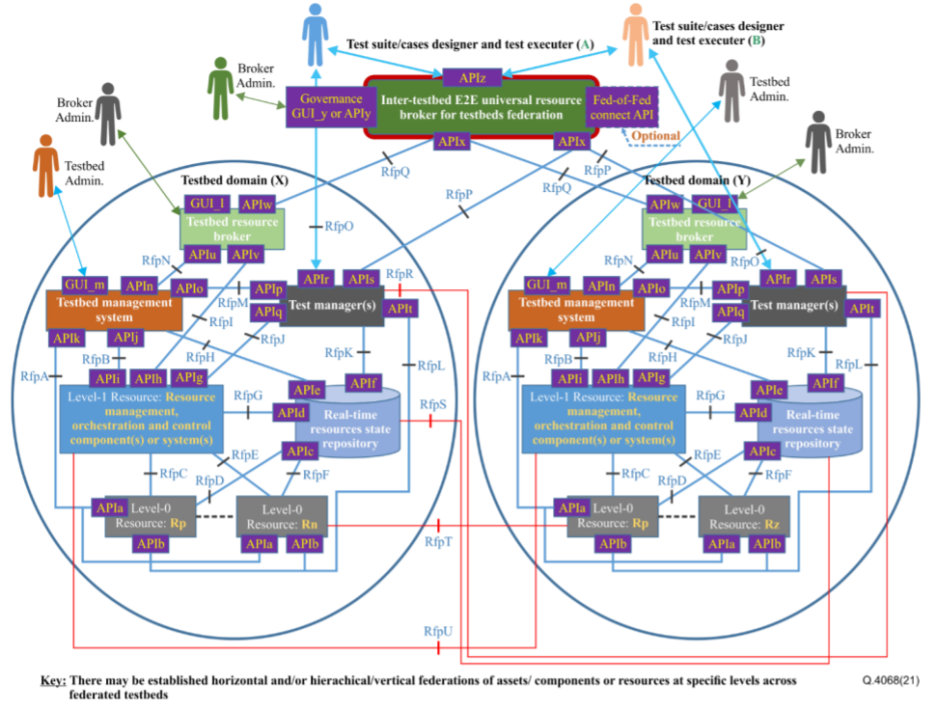
ITU-T Focus Group on Testbeds Federations for IMT-2020 and beyond (FG-TBFxG)
First meeting: virtual, 4-7 April 2022
www.itu.int/go/fgtbf
Harmonize testbeds specifications across SDOs/Fora
Develop the required application program interfaces (APIs) aligned with the Testbeds Federations Reference Model (ITU-T Q.4068)
Define a set of use cases for Federated Testbeds and associated APIs, such as “Testbed-as-a Service” (TaaS)
ITU-T Q.4068 “Open application program interfaces (APIs) for interoperable testbed federations”

Slide 15
Future plans (2022-2024)
Lead on developing protocols for all types of networks and its applications, including NFV, QKDN, IMT-2020 and beyond
Enhance security of signalling protocols using digital certificate-based approach for ICT communications including those to be used in DFS
Develop signalling and test specifications for interconnection of networks
Develop APIs for Testbed Federations and test specifications for remote testing
Combat counterfeit and stolen telecommunication/ICT devices and counterfeit or tampered telecommunication/ICT software
Implement C&I programme and develop test specifications
Facilitate recognition of TLs and continue collaboration with existing accreditations bodies (e.g. ILAC)

Slide 16
Notes:
white
wtsa logo
Itu logo
Thank you

