Slide 1
ITU-T STUDY GROUP 16 Multimedia
Highlights and future directions
Noah Luo, Chairman ITU-T SG16

Slide 2
ITU-T SG16 Multimedia
Advanced multimedia communication
Multimedia systems and services
Media Coding
Legacy systems
Speech-to-speech translation, Intelligent Visual system and services,
AI-enabled multimedia
Digital Culture
DLT services
IPTV, Digital Signage, Intelligent Transportation Systems, E‒health, Accessibility,
Audio, video and data compression
Immersive life
experience
AI-enabled
multimedia
Videoconferencing/telepresence, Media gateways, Network signal processing, Echo cancellation, Noise reduction, Voiceband data (modems, fax, text telephony)
Notes:
Conferencing systems
Telepresence, media gateways, videoconferencing
Advanced multimedia communication
Multimedia systems and services
IPTV, Digital Signage, Intelligent Transportation Systems, E‒health, Accessibility (IoT moved to in SG20 in Oct. 2015)
Media Coding
Audio and video coding
TDM legacy and transition to IP systems
Network signal processing, echo cancellation, noise reduction, voiceband data (modems, fax, text telephony)

Slide 3
Results
8
4
116
STUDY GROUP MEETINGS
WORKING PARTY MEETING
RAPPORTEUR GROUP MEETINGS
Significant collaborative work with:
Questions:
slimer, stronger, focused and consolidated
ISO/IEC
IEEE
IETF
3GPP
11
16
14
WTSA-16
WTSA-20
Notes:
8 SG, 4 WP meetings; 116 Rapporteur group (e-)meetings
Significant collaborative work (ISO/IEC, IEEE, …)
Questions: 18 (WTSA-12) → 16 → 11 (WTSA-16) → 16 → 14 (WTSA-20)

Slide 4
Results
Work items under study
Texts approved
Notes:
Some results at the end of the study period.

Slide 5
Collaboration
Internal
External
Regional SDOs
ISO
SG20 (Accessibility, IoT)
SG9 (IPTV,CDN, Accessibility)
SG16
JCT1
SG17 (ITS, ICT Security)
UNECE
SG11 (C&I)
IETF
IEEE
WHO
CONTINUA (PCHA, HIMSS, IHE)
SG2 (Accessibility)
SG12 (QoS/QoE)

Slide 6
Trends
Maturity in classical areas abreast with AI and other enabling technologies
Growth in digital services and video-centric services
Notes:
Maturity in classical areas
audio compression, videoconferencing, media gateway, legacy TDM systems and their interfacing with IP networks
Increase in e-services and video-centric services

Slide 7
Three aspects moving forward
Traditional multimedia services, application and systems: continuation of existing lines of work for “conventional ICTs”
Vertical-industry oriented services: ICTs application focused on needs of specific sectors
Finance and banking sector
Health sector
Culture sector
Entertainment sector
Transport sector
...
Enabling technologies: producing high-quality, reusable building blocks
Notes:
Verticals:
Finance and banking sector: SG16 develops Recommendations on Distributed Ledger Technologies and DLT-based services. Q22/16 received the deliverables of ITU-T FG DLT to meet the ICT and security requirements of financial industry and many Technical Papers and Recommendations have been developed in a short period.
Health sector: SG16 has established a Question (Q28/16) on e-health, it focuses on standardization of multimedia systems and services to support digital health applications (including e-health). ITU-T SG16 has also established a Focus Group on artificial intelligence for health (FG-AI4H) in partnership with the World Health Organization (WHO) to establish a standardized assessment framework for the evaluation of AI-based methods for health, diagnosis, triage or treatment decisions.
Culture sector: SG16 has spawned studies on requirements, file format or metadata for digital culture service and application to a new Question focusing on multimedia standards for digital culture. The first Recommendation published was ITU-T T.621 “File structure for interactive mobile comic and animation content”, and subsequent studies include Requirements for an information system of objects in museums, Scenarios, framework and metadata for digitalized artwork images display systems, requirements and reference framework for digital representation of cultural relics/artworks using augmented reality, requirements and metadata for digitization of ethnic costumes. It also plans studies on uniform data classification standards, and digital metadata standards suitable for the intangible cultural heritage.
Entertainment sector: in addition to existing areas such as media compression and immersive technologies, networking technologies such as IPTV and content delivery networks, wider areas as over-the-top (OTT) delivery content mechanisms are growing areas of standardization, together with topics such as video gaming (which has aspects touching digital culture studies as well as safe listening).
Transport sector: SG16 studied vehicle gateway platform/‌ITS services and applications, such as functions and service requirements of a vehicle gateway platform to support vehicle communications, enhancements to support emergency and early warning services (e.g. for traffic accidents); SG16 also studied standards for civilian unmanned aerial vehicle (CUAV) communication service, includes requirements and unified application framework for CUAV communication services and applications, as well as interfaces between the CUAV system and other vertical industry application system. SG16 is the parent group of two related focus groups. As the parent group of FG-VM, studies on standards for vehicular multimedia services and infotainment applications have quickly evolved. As parent of the FG-AI4AD, it is exploring the frontiers of standardization for services and applications enabled by AI systems in autonomous and assisted driving.

Slide 8
Technological view
Digital services and video-centric services
Media compression
Digital Health, Digital Culture, DLT, ITS, Future multimedia mechanisms
VR, immersive systems and artificial Intelligence
Accessibility
Human dimension in communications
Systems: IPTV, Cable, Broadcasting
Streaming, interactivity, immersive

Slide 9
Functional view
Digital services and video-centric services
Entertainment industry
Traditional ICT standardization
Enabling technologies
Transport Sector
Finance and banking sector
Culture sector
Notes:
Verticals:
Finance and banking sector: SG16 develops Recommendations on Distributed Ledger Technologies and DLT-based services. Q22/16 received the deliverables of ITU-T FG DLT to meet the ICT and security requirements of financial industry and many Technical Papers and Recommendations have been developed in a short period.
Health sector: SG16 has established a Question (Q28/16) on e-health, it focuses on standardization of multimedia systems and services to support digital health applications (including e-health). ITU-T SG16 has also established a Focus Group on artificial intelligence for health (FG-AI4H) in partnership with the World Health Organization (WHO) to establish a standardized assessment framework for the evaluation of AI-based methods for health, diagnosis, triage or treatment decisions.
Culture sector: SG16 has spawned studies on requirements, file format or metadata for digital culture service and application to a new Question focusing on multimedia standards for digital culture. The first Recommendation published was ITU-T T.621 “File structure for interactive mobile comic and animation content”, and subsequent studies include Requirements for an information system of objects in museums, Scenarios, framework and metadata for digitalized artwork images display systems, requirements and reference framework for digital representation of cultural relics/artworks using augmented reality, requirements and metadata for digitization of ethnic costumes. It also plans studies on uniform data classification standards, and digital metadata standards suitable for the intangible cultural heritage.
Entertainment sector: in addition to existing areas such as media compression and immersive technologies, networking technologies such as IPTV and content delivery networks, wider areas as over-the-top (OTT) delivery content mechanisms are growing areas of standardization, together with topics such as video gaming (which has aspects touching digital culture studies as well as safe listening).
Transport sector: SG16 studied vehicle gateway platform/‌ITS services and applications, such as functions and service requirements of a vehicle gateway platform to support vehicle communications, enhancements to support emergency and early warning services (e.g. for traffic accidents); SG16 also studied standards for civilian unmanned aerial vehicle (CUAV) communication service, includes requirements and unified application framework for CUAV communication services and applications, as well as interfaces between the CUAV system and other vertical industry application system. SG16 is the parent group of two related focus groups. As the parent group of FG-VM, studies on standards for vehicular multimedia services and infotainment applications have quickly evolved. As parent of the FG-AI4AD, it is exploring the frontiers of standardization for services and applications enabled by AI systems in autonomous and assisted driving.

Slide 10
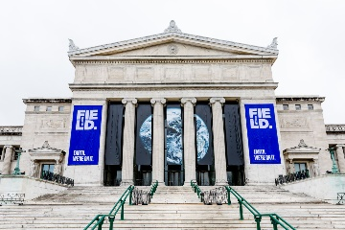
Digital Services
Combined use of ICTs for service delivery:
Distribution and delivery of e-services:
Healthcare
The building blocks and delivery platforms developed by SG16 are used to enable applications in specific areas
Education
Commerce
Entertainment
Example: Smart cities and communities by SG20
Culture
Transportation
Notes:
Combined use of ICTs for service delivery in a specific industry area, such as healthcare, education, administration, commerce, transportation, entertainment, etc.
Distribution and delivery of e-services: channel agnostic
E.g. Internet, cable networks, NGN, GSTN, IMT-2020, future networks, and wireless networks
The building blocks and delivery platforms developed by SG16 are used to enable application in specific areas
E.g. smart cities applications of e-services by SG20

Slide 11
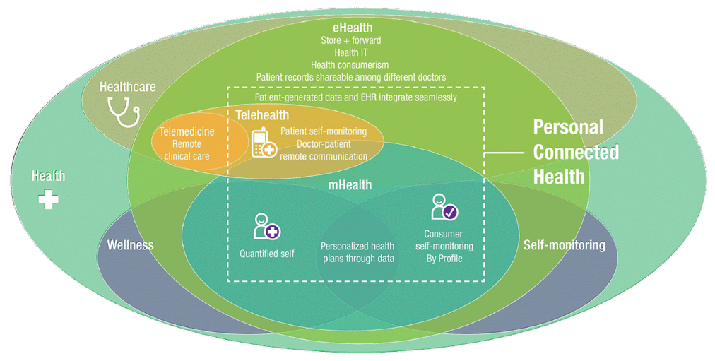
Digital Health
Notes:
Addressed a specific area: personal connected health – partnership with Continua (PCHA); much more to do! Mobile health, format for data exchange and interoperability
ITU-T H.810-H.850 suite with the Continua Design Guidelines and associated conformance testing specifications (45 Recommendations)

Slide 12
Video contents – a strategic area
Opportunities for revenue generation
80%
Video compression: new H.266 approved
70%
Higher demand more efficient compression mechanisms
New IP-based digital TV systems
of Internet Traffic was video in 2015
Forecast for 2022
Notes:
Important opportunities for revenue generation
Content generation and content delivery
QoE / QoE monitoring: constant challenge
Video compression: new challenges → JVET
Higher demand means that more efficient compression mechanisms remains relevant
Higher resolution for larger screens (4K, 8K)
Good quality with higher compression for smaller screens
Source for video traffic statistics: CISCO VNI Complete Forecast Highlights
https://www.cisco.com/c/dam/m/en_us/solutions/service-provider/vni-forecast-highlights/pdf/Global_2020_Forecast_Highlights.pdf

Slide 13
Use of digital video
Consumer electronic video equipment
Digital TV broadcast & cable; Digital TV sets
Internet video Over-the-top (OTT)
IPTV
Digital Signage
Artificial Intelligence
Over-the-top (OTT) applications
Mobile: 4G / 5G
Notes:
Consumer electronic video cameras
Moving JPEG; MPEG1-Video; H.262
H.264
Digital TV broadcast & cable; digital TV sets
SD: H.262 or H.264 / HD: H.264 / UHD: H.265?
Internet video – over-the-top
YouTube, Apple: convergence around H.264
Skype (v7: H.264)
IPTV; Digital Signage; Over-the-Top (OTT) applications
Mobile: 3G / 4G / 5G

Slide 14
Future areas for video
Besides going after the "best and newest" video codec… it matters what you do with video
Future IP-based broadcasting
Accessibility
Delivery of high volume of video content
Artificial Intelligence
Notes:
Besides going after the "best and newest" video codec… it matters what you do with video
Protocols and systems supporting delivery of high volume of video content
Real-time streaming remains a challenge
Higher compression with high quality and lower delay
Highly interactive systems require tactile Internet
Virtual reality and immersive environments (ILE)
Future IP-based broadcasting
E.g. ATSC 3.0 PHY, approved 2016-03
Adding Artificial Intelligence to video: face / object / action recognition, and acting on it
Accessibility: still many open technical and economic issues

Slide 15
Digital services
Video
SG16
SG16 "Multimedia" continued to be very productive during the study period
Growth of video consumption drives newer codecs, systems and applications
Work growth in digital services and video-centric services and components,
empowering various industry verticals in their
Digital transformation
Notes:
SG16 "Multimedia" continued to be very productive during the study period
Work growth in e-services and video-centric services and components
Video will be key to ITU-T's future success
Expected increase in standardization in these areas
Growth of video consumption drives newer codecs, systems and applications
especially delivery over IP and the Internet

Slide 16
Notes:
Thank you

