Slide 1
Leveraging technology standards to prevent and mitigate driver distraction
Scott Pennock
Senior Standards Manager
Notes:
The word “leveraging” in the title is important because it highlights the role of standards as a tool instead of a complete solution
Only standardizing the pieces that need to be standardized for the solution to work will enable the safety aspects and still allow product differentiation and innovation

Slide 2
Outline
The problem
A comprehensive solution
Barriers
Strategies for today and tomorrow
Conclusions

Slide 3
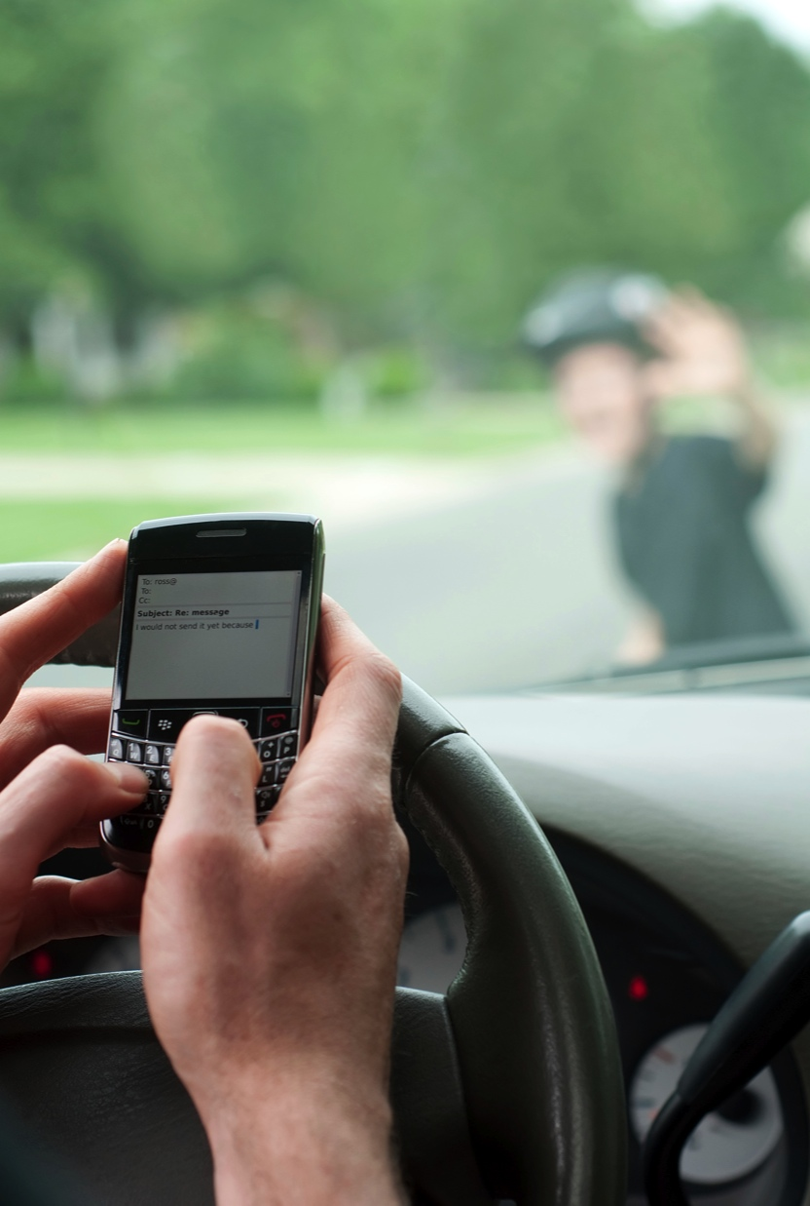
Understanding the problem…
Interaction with Nomadic Device (ND) can negatively affect:
  Situational Awareness
  Decision making
  Vehicle control
Strong motivation to interact with ND
  Drivers want/need access to information and entertainment
  They underestimate the risks
  There are no better alternatives
Notes:
The first major aspect of the problem is that interacting with a ND can negatively affect things that are important to safe driving such as SA
SA is defined as “… the perception of elements in the environment within a volume of time and space, the comprehension of their meaning, and the projection of their status in the near future.”
The so-called driver distraction problem is really a problem of “situational awareness” (SA)—distraction is only an issue when it results in a breakdown of situational awareness and vehicle control
Similarly, high workload can cause a breakdown in SA
There is strong evidence from naturalistic studies that the main issue is visual distraction, but other forms of distraction such as manual, cognitive, and auditory cannot be ignored
Poor SA can also lead to poor decision making such as what a safe vehicle speed is, glance behaviour, and decisions on when to interact with a ND
ND interaction can also negatively affect the ability to control the vehicle as shown in the figure
The second major aspect of the problem is that there is strong motivation for drivers to interact with NDs
First, they want or need to access the information and entertainment that is important to them
Second, they underestimate the risks. This is largely due to the fact that they get away with unsafe driving behaviour most of the time
Third, there are no better alternative. It is not that drivers want to interact with applications on NDs while driving—it is difficult. Rather, there are usually few alternatives.

Slide 4
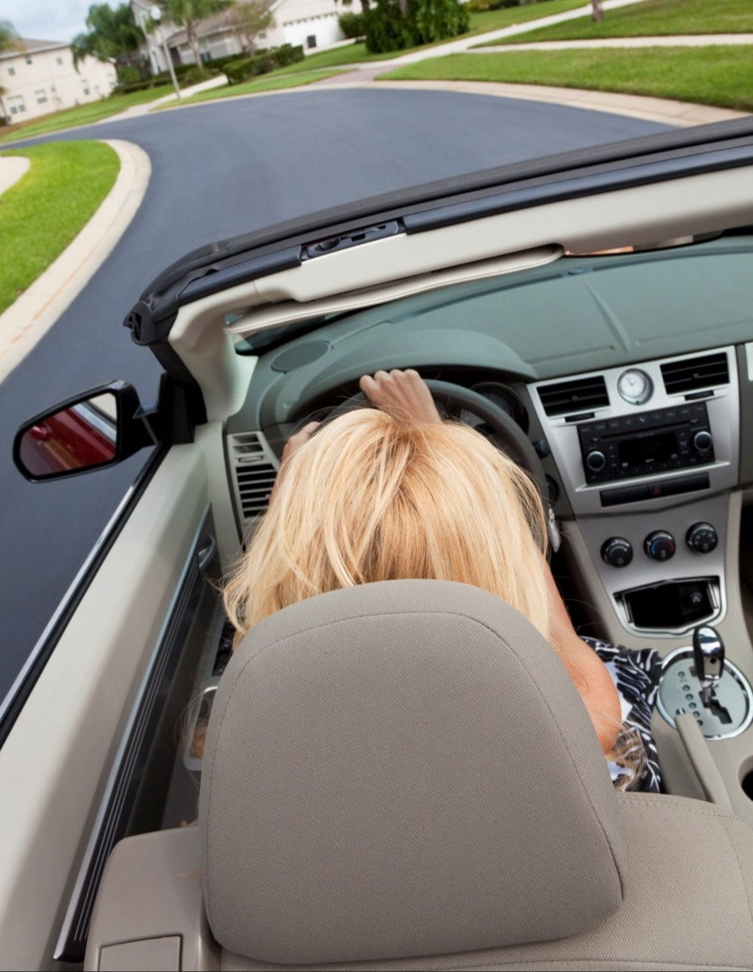
A comprehensive solution…
Prevent distraction and suboptimal workload before it happens
  Good basic Human-Machine Interface (HMI) design
  All interaction through vehicle
  Manage interaction based on situation
  Education/training/laws
Mitigate distraction and suboptimal workload when it occurs
  Monitor driver, roadway, and vehicle
  Adjust interaction to mitigate
Notes:
The part of the solution, or line of defense, is to prevent distraction and suboptimal workload BEFORE IT HAPPENS
There are several things that should be done to ensure this.
One is good basic HMI design. This includes things like placement of displays, controls, and microphones; the ability to easily pause/resume interaction with an app; and how quickly visual messages can be comprehended
Another is that all interaction should be done through the vehicle’s Driver-Vehicle Interface (DVI) instead of the ND’s UI. This leverages the DVI which can be better optimized for safe interaction and also allows for a centralized point of control. Without a centralized point of control there is no way to prevent a social media status update from a ND from interfering with a collision avoidance warning.
Managing interaction based on the current situation is also important. For example, message delivery could be delayed if the driver is trying to merge into heavy traffic. Or a modality of a traffic alert could be switched from a visual message to an auditory message under visually demanding roadway situations.
Education, training, and laws are also an important of preventing distraction/high workload
Education can help influence driver’s decision to engage in a risky behaviour in the first place
Training can help automate driver responses and an understanding of how the system works
Laws can also be effective if they are enforced; but should be used only in situations where there is strong evidence there behaviour with high risk that can be effectively addressed with laws
The other part of the problem, or second line of defense, is to mitigate distraction/workload when it is occurs
This can be done by monitoring the driver, roadway, and vehicle stand and adjusting interaction with the driver accordingly

Slide 5

Lack of common standards a major barrier to achieving a comprehensive solution
We need:
  Comprehensive Human-Machine Interface (HMI) design and performance guidance to ensure safe interaction
  Vehicle-to-X (V2X) interface and protocol standards to connect X to a centralized point in the vehicle
  Vehicle-to-Application (V2A) interface standard to interact with driver through the Driver-Vehicle Interface (DVI)
  Standardized mechanisms to manage all driver interaction
Notes:
Lack of common standards a major barrier to achieving a comprehensive solution
More specifically we need…
Comprehensive HMI design and performance guidance for systems designers, developers, operators, and application authors
There is some good guidance available, but there is no 1 place to go that can point you to all the various standards and guidelines. There is guidance on visual-manual distraction, but it could use more harmonization. Guidance on speech interfaces and how to measure cognitive load is lacking, but there are efforts underway in SAE and ISO to provide some guidance.
V2X interface and protocol standards are needed connect devices, roadside stations, and cloud-based servers to a centralized point in the vehicle; this will enable all communications with the driver to be managed and the driver to interact with devices/applications through the DVI
A V2A interace standard is needed to enable external applications to interact with driver through the DVI which was optimized for safe interaction
We also need standardized mechanisms to manage all driver interaction. Not all aspects of the mechanisms need to get standardized, but we need to figure out which pieces it makes sense to standardize. For example, driver state…
Current technology and standards landscape
No harmonized technology standards
Automaker specific
MirrorLink
Android for auto
Apple iOS in the car
Industry standards (ITU-T, ISO, W3C, SAE, BT, Webinos?, etc.)
No harmonized HMI design and performance guidance
The big 3 (Alliance, ESoP, JAMA)
NHTSA, HFCV principles (Battelle)
SDOs (ITU, SAE, ISO, CEA)
IMAGE=picture of disorganization, ducks in line, or unorganized groups of icons representing standards and technology entities
Other points to make:
Even if there were a single industry accepted standard for device connectivity (e.g., Android for auto, ML, etc.), it would not completely address the problem because cloud-based apps/services are on the rise and existing approaches to device connectivity are not compatible such that the vehicle can effectively manage all communications with the driver.
No comprehensive source for guidance on HMI design and performance (only cover subset of modalities, design principles—but not performance, system level—but not subsystem)
No harmonized technology standards
Automaker specific
MirrorLink
Android for auto
Apple iOS in the car
Industry standards (ITU-T, ISO, W3C, SAE, BT, Webinos?, etc.)
No harmonized HMI design and performance guidance
The big 3 (Alliance, ESoP, JAMA)
NHTSA, HFCV principles
SDOs (ITU, SAE, ISO, CEA)
There has been quite a bit of standardization work on how to measure driver distraction; in particular SAE, ISO, JAMA, and NHTSA—but surprisingly little standardization of technology that could enable management of situational awareness by controlling when and how all communications takes place with drivers
Infotainment trends:
Mobile integration advances & fragmentation
Scale & reuse infotainment modules, reduce head unit SKUs
Changing HMI landscape
Cloud connection
HTML5 and Android application environments
One consistent UI across low to high-end processors
Blending of safety and consumer systems to reduce BOM costs (merging on one processor)
Merging safety (ex: ISO-26262) with infotainment
Trends
Device “driving” Infotainment (ex: Mirrorlink)
Bring your own display (BYOD)
Trend towards delightful Distraction

Slide 6









Strategy for TODAY
Video decode and composition
Device detection and selection
Connectivity protocols
Connection context management
Active device display
Seamless support for multiple device types to vehicle (safer than handheld use)
Apple
Touch & hard button input
Android
P
R
N
D
Auto sensors
MirrorLink
Hands free phone and voice recognition
Leverage speech and multimodal interfaces (safer than visual-manual interfaces)
Notes:
Short-term strategy (do what we can now)
Educational campaigns
Laws and enforcement where overwhelming data to support them
Technical solutions based on the realities/limitations of current technology/standards landscape
Leverage speech and multimodal interfaces (safer than visual-manual interfaces)
Seamless support for multiple device types to vehicle (safer than handheld use)
Android for auto
Apple iOS in the car
MirrorLink
Auto specific
IMAGE=depict vehicle using various connection types and speech interface

Slide 7

Strategy for TOMORROW
Comprehensive harmonized HMI design and performance guidance
Common set of standards that:
  Specify communications interfaces and protocols between subsystems (vehicle, ND, etc.)
  Define mechanisms to manage Situational Awareness
Notes:
Long-term strategy (work towards common set of standards that enable interop, commmonize safety aspects, and still allow differentiation of UX)
Comprehensive harmonized HMI design and performance guidance
Common set of standards that
Specify communications interfaces between subsystems (vehicle, ND, etc.)
Enable mechanisms to manage SA
IMAGE=same image as comprehensive solution slide, but add icons representing ITU, UNECE, automakers/supplliers, nomadic device manufacturers, app authors, network service providers, regulatory authorities, and academia OR scaffolding picture used in ITU-UNECE workshop presentation
Other points to make:
Currently, there is no forum with participation from all of the stakeholders
Recently formed collaboration between UNECE and ITU seems like a good opportunity to bring the automotive and ICT communities together to work on a comprehensive solution

Slide 8

Conclusions
Driver distraction and workload caused by nomadic devices is a problem that needs a comprehensive solution
A comprehensive solution is not currently possible largely because the necessary technology standards do not exist
However, that should not stop us from doing what we can TODAY with the tools that we have

Slide 9
Conclusions (continued)
We should work on technology standards for TOMORROW that can deliver a more comprehensive solution
The newly formed collaboration between the UNECE and ITU provides a unique opportunity to work on a more comprehensive solution

Slide 10
Scott Pennock
Senior Standards Manager

Slide 11
Back-up slides

Slide 12
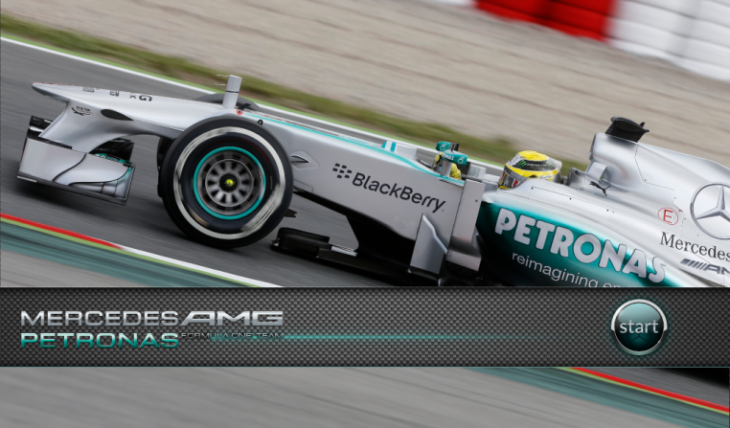
Qt in the real world – F1 BB Mercedes AMG Petronas

Slide 13
Qt in the real world – F1 BB Mercedes AMG Petronas
Tablet application for VIP guests watching the F1 races from the Mercedes backstage area
BlackBerry PlayBook OS
Also runs on Android, iOS, desktop, QNX, BlackBerry 10 and current non-Windows Nokia phones
Integrates live streaming video from TV cameras
Integrates live audio stream from pit crew intercom
Interfaces with race data real time systems
Allows for Video record and playback
Interfaces with driver bio and background data from web sources
Interactive and intuitive touch UI
Smooth, movie grade animations to satisfy the expectations for a demanding target audience
User interface created by a cross functional team of artists and developers in less than 2 weeks

Slide 14
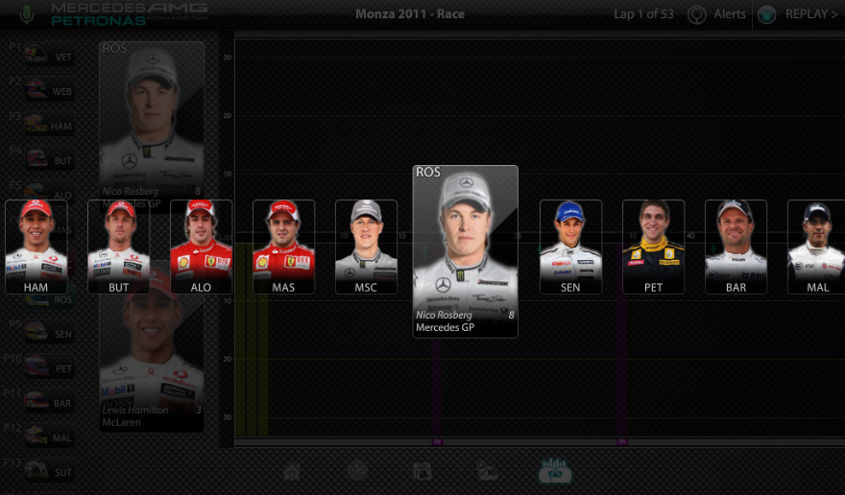
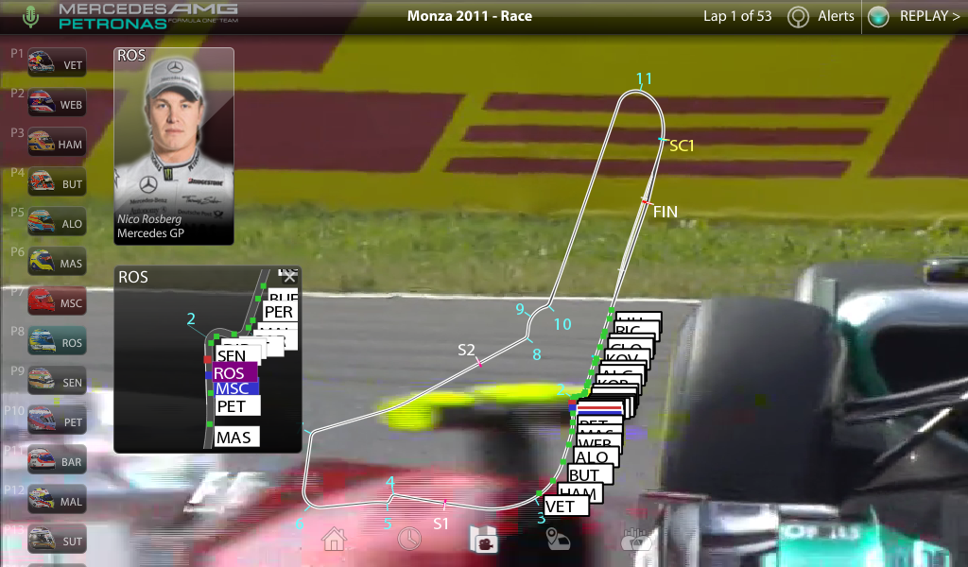
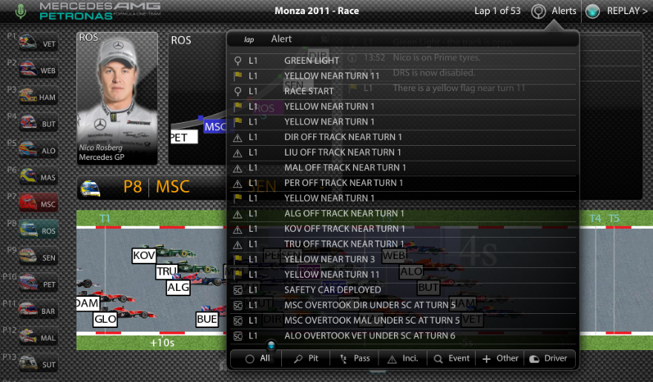
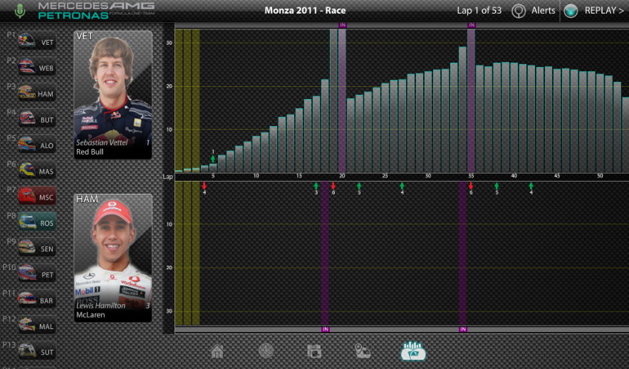
Qt in the real world – F1 BB Mercedes AMG Petronas

