Slide 1


Cybersecurity @ ITU

Slide 2

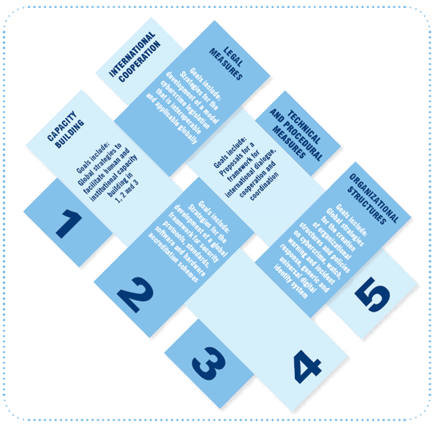


ITU’s mandate on Cybersecurity
2003 – 2005
WSIS entrusted ITU as sole facilitator for WSIS Action Line C5 - “Building Confidence and Security in the use of ICTs”
2007
Global Cybersecurity Agenda (GCA) was launched by ITU Secretary General
The GCA is a framework for international cooperation in cybersecurity
2008 to date
ITU Membership endorsed the GCA as the ITU-wide strategy on international cooperation.
Building confidence and security in the use of ICTs is widely present in ITU resolutions.
In particular several ITU Conferences (ITU Plenipotentiary- PP, WTSA, and WTDC) have produced Resolutions (PP Res 130, 174, 179, 181, WTSA Res 50, 52, 58, and WTDC 45, 67, 69) touching on the most relevant ICT security related issues, from legal to policy, to technical and organization measures.

Slide 3
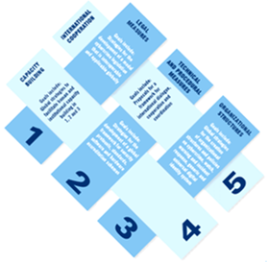
Global Cybersecurity Agenda (GCA)
GCA is designed for cooperation and efficiency, encouraging collaboration with and between all relevant partners, and building on existing initiatives to avoid duplicating efforts.
GCA builds upon five pillars:
  Legal Measures
  Technical and Procedural Measures
  Organizational Structure
  Capacity Building
  International Cooperation
Since its launch, GCA has attracted the support and recognition of leaders and cybersecurity experts around the world.

Slide 4





GCA: From Strategy to Action
1. Legal Measures
ITU Cybercrime Legislation Resources
Publication on Understanding Cybercrime: A Guide for
Developing Countries (new edition: November 2014)
HIPSSA, HIPCAR, ICB4PAC Projects (executed with EU)
MoU with UNODC for assistance to Member States
2. Technical and
Procedural Measures
ITU Standardization Work: ITU-T SG 17
ITU-R recommendations on security
ICT Security Standards Roadmap
ITU-T JCA on COP
3. Organizational Structures
National CIRT deployment and cooperation
Regional Cybersecurity Centres (RCCs)
Regional and International Cyber Drills
Global
Cybersecurity
Agenda (GCA)
4. Capacity Building
ITU National Cybersecurity Strategy Guide
Global Cybersecurity Index (GCI)
Cyberwellness Profiles
Technical assistance and projects in LDCs
Elaboration of Best Practices at ITU-D SG 2 Q3/2
Regional Cybersecurity Workshops
Training for high-level Member State officials
5. International Cooperation
ITU’s Child Online Protection (COP) Initiative
Collaboration with other IGOs and Private Sector
UN-wide Coordination Mechanisms

Slide 5


Legal aspect - Partnerships
ITU-UNODC collaboration since 2011
Joint assistance to Member States in mitigating the risks posed by cybercrime
Best practices in cybercrime legislations
Information Sharing
ITU-EC-ACP PROJECTS
HIPCAR- Enhancing Competitiveness in the Caribbean through the Harmonization of ICT Policies, Legislation and Regulatory Procedures​​
HIPSSA- Support for Harmonization of the ICT Policies in Sub-Saharan Africa​
ICB4PA​C- In parallel to the ITU and EU co-funded project in the Caribbean the same organizations launched a project in the Pacific​
Notes:
Since May 2011, ITU and UNODC​ have collaborated globally to assist Member States in mitigating the risks posed by cybercrime with the objective of ensuring secure use of information and Communication Technologies.
This MoU necessitated the expertise and resources for the establishment of legal measures and legislative frameworks at national level, within the principle of international cooperation for the benefit of all countries in the world.
--------
ITU and the EU launched in December 2008 three projects to, amongst other, develop and promote harmonized policies and guidelines for the ICT sector as well as human and institutional capacity building in the field of ICT through training, education, and knowledge sharing measures. The three projects are the following:
​​HIPCAR- Enhancing Competitiveness in the Caribbean through the Harmonization of ICT Policies, Legislation and Regulatory Procedures​​
HIPSSA- Support for Harmonization of the ICT Policies in Sub-Sahara Africa​
ICB4PA​C- In parallel to the ITU and EU co-funded project in the Caribbean the same organizations launched a project in the Pacific​

Slide 6
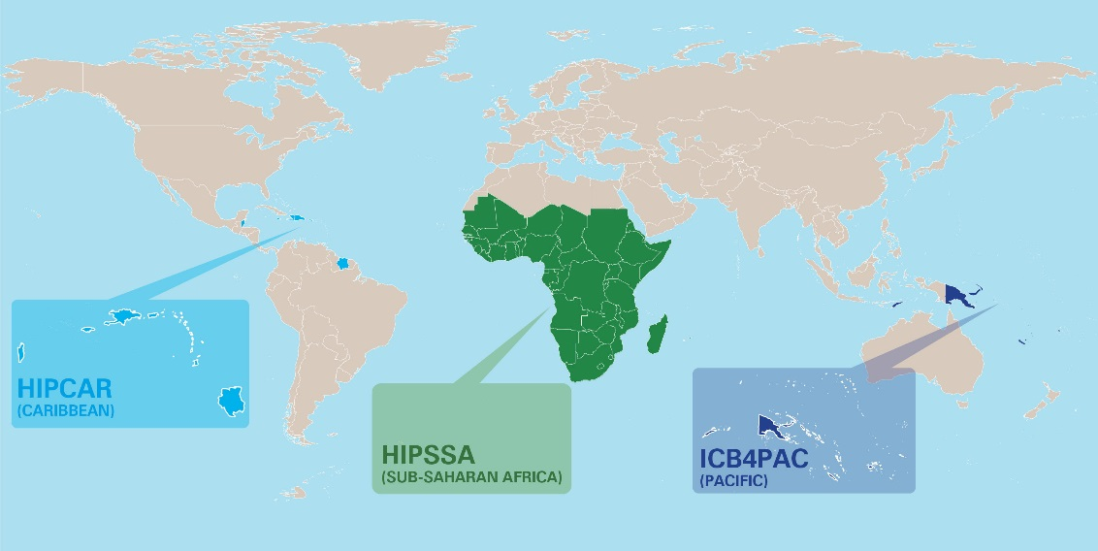


Support for the Establishment of Harmonized Policies for the ICT Market in the ACP States
2008-2013
Model policies and legislation at a regional level
Technical in-country assistance to transpose the regional model policies and legislations into national legislative frameworks
Included Cybersecurity components
Notes:
Harmonization does not mean the same solution for all the countries. It means similar responses to similar issues and thus, different responses to different problems. These solutions incorporate the best national, regional and international practices.Model policies and legislation have been developed at a regional level with the full involvement of all relevant stakeholders. Following validation of this region-wide activity, technical in-country assistance has been made available to individual countries for transposing the regional model policies and legislations into national legislative frameworks that concur with national specificities.
With these recommendations incorporated into their national economic and social activities, these countries will now be in a position to take full advantage of being part of a harmonized legislative landscape.

Slide 7
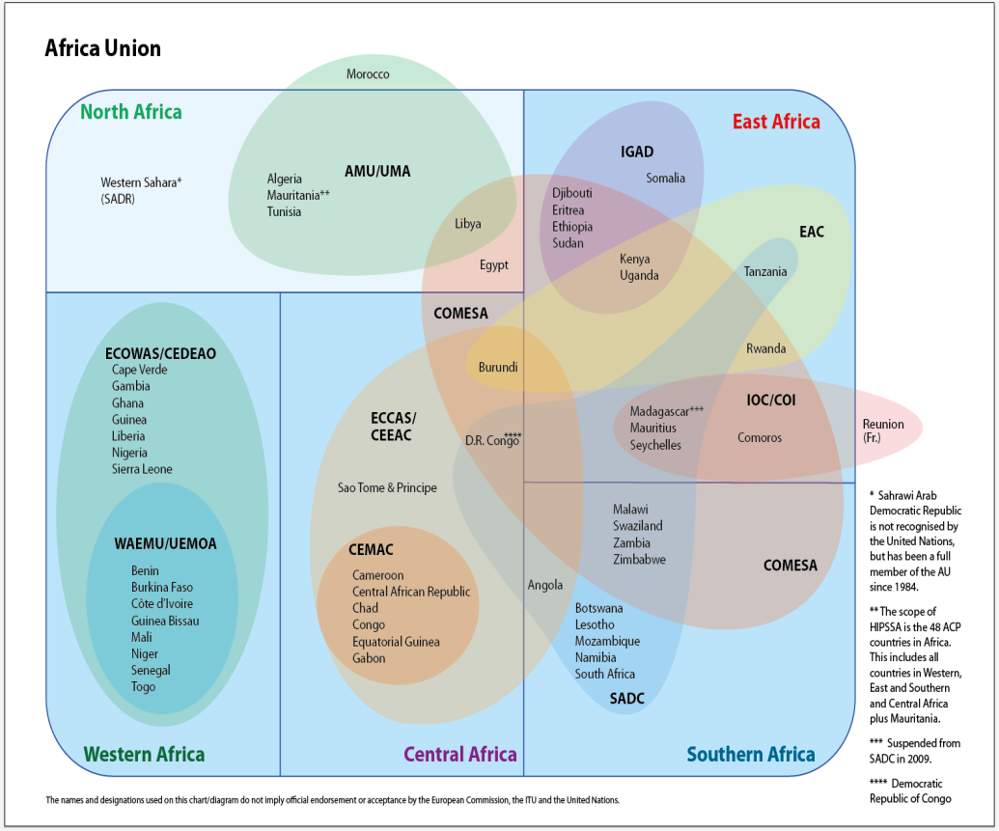
HIPSSA PROJECT
Harmonization of the ICT Policies in Sub-Saharan Africa
Sub-regional programs:
1) East Africa
2) Central Africa
3) Southern Africa
4) West Africa
Regional Outcomes on Cybersecurity
  ECOWAS cybersecurity guidelines
  ECCAS Model Law / CEMAC Directives on Cybersecurity
  SADC model law on data protection/ e-transactions/cybercrime
In-Country Technical Assistance
Notes:
Given the geographical, political and cultural diversity of the region, special attention was paid to adapting the methodology of the Project to specific needs and conditions. It was also noted that countries in different geographic regions belong to different economic, monetary and regulatory associations, or they may belong to several of them at the same time. The methodology of the Project has taken into account these very sensitive issues to avoid potential competition between the regional organizations. Therefore, the Project was divided into four sub-regional programs:
1) East Africa
2) Central Africa
3) Southern Africa
4) West Africa
One of the programme’s broad objectives was to:
Economic Community of West African States (ECOWAS)
This report was put together to respond to the “Request for Collaboration on ICT Legal Texts” addressed to the ITU by Jean de Dieu Somda, Vice President, ECOWAS Commission (Dated 11 August 2009). ITU hopes that these comments can assist the ECOWAS Commission in its work to increase understanding on how countries in the region can go about criminalizing the misuse of ICTs in their national legislation and as a result help countries in the region hestablish a sound legal foundation. The comments are based on the recently released ITU Toolkit for Cybercrime
Legislation and ITU publication on Understanding Cybercrime: A Guide for Developing Countries, and other relevant resources.
Model Law of Economic Community States of Central African States (ECCAS) / Directives on Cybersecurity of the Economic Community and Monetary Union of Central Africa (CEMAC)
(Adapted Google translation from French document)
The ECCAS Model Law projects related respectively to personal data protection, electronic transactions and the fight against cybercrime were developed with the active participation of all stakeholders in the context of the HIPSSA project. They take into account changes nationally and internationally and are based not only on a critical evaluation of the legislations of the ECCAS / CEMAC Member States and the international conventions on cybersecurity, but also on the interventions and regulatory practices in the Member States of ECCAS , the good international practices international and the following general principles :
- The regulation is based on clearly defined policy objectives;
- The regulations, directives and reference frameworks of the Community do not affect the possibility for each Member State ECCAS to take the necessary measures to ensure the protection of safety interests, maintain the public order and safety and to allow the investigation, detection and prosecution of criminal offenses, including the establishment by the national regulatory authorities of specific obligations applicable to providers of electronic communications services;
Southern African Development Community (SADC) Model Law
As members of the HIPSSA Steering Committee co-chaired by the African Union’s Commission (AUC) and the ITU, the Southern African Development Community (SADC) Secretariat and Communication Regulators’ Association of Southern Africa (CRASA) Secretariat provided guidance and support to the consultants, Mr. Jan Marc Van Gyseghem and Ms. Pria Chetty who prepared the draft document. This draft document has been reviewed, discussed and validated by broad consensus by participants of the workshop organised in collaboration with CRASA and SADC Secretariats held in Gaborone, Botswana from 27 February to 3 March 2012.It was further adopted by the SADC Ministers responsible for Telecommunications, Postal and ICT at their meeting in Mauritius in November 2012
IN-COUNTRY TECHNICAL ASSISTANCE
​
Following the validation and approval of this region-wide activity, in-country technical assistance was made available for transposing the regional guidelines into national legislative and regulatory frameworks that concur with national specificities. Namibia Tanzania Zimbabwe Lesotho * Rwanda Zambia

Slide 8
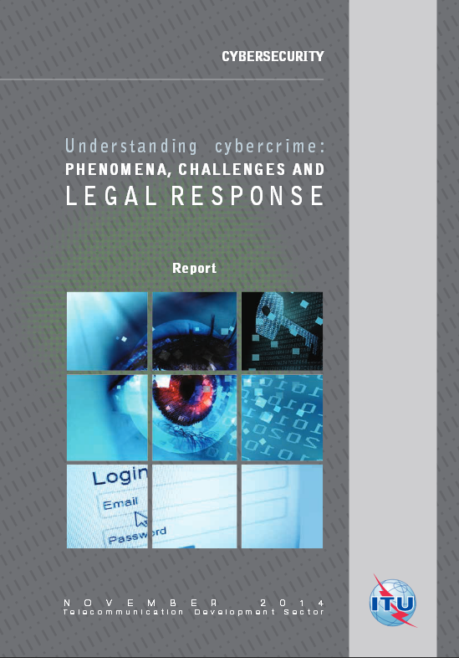

New edition 2014: ITU Publication on UNDERSTANDING CYBERCRIME: Phenomena, Challenges and Legal Response
The Guide serves to help developing countries better understand the implications related to the growing cyber-threats and assist in the assessment of the current legal framework and in the establishment of a sound legal foundation.
COMBATTING CYBERCRIME: TOOLS AND CAPACITY BUILDING FOR EMERGING ECONOMIES
Joint project among several partners under the coordination of the World Bank to build capacity in developing countries in the policy, legal and criminal justice aspects of the combat against “cybercrime”
Notes:
National Strategies- Assistance framework
In order to help countries tackle the issues relating to Cybersecurity, ITU can provide support individually designed to meet the requirements of the requesting Country. Starting with an effective assessment of the current status of capacities and legislation as well as the countries demands, ITU will provide a tailored roadmap.
World Bank project to build capacity among policy-makers, legislators, public prosecutors & investigators, and civil society in developing countries in the policy, legal and criminal justice aspects of the enabling environment to combat “cybercrime”. The project will do this through synthesizing international best practice in these areas in a published tool that enables assessment of and best practice guidance with respect to the legal issues associated with combatting cybercrime; and field testing the tool in selected pilot countries.

Slide 9
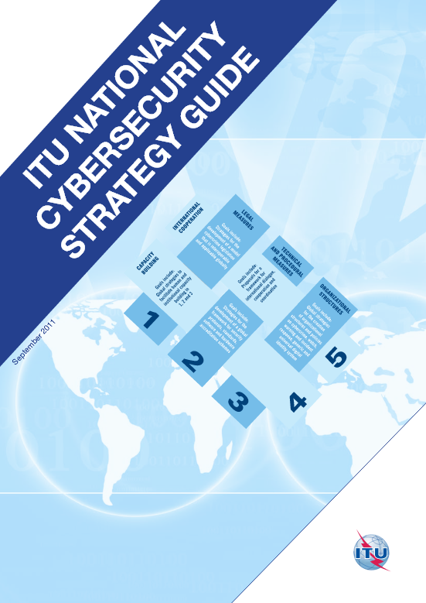

National Strategies
Developing comprehensive and efficient National Cybersecurity Strategies is fundamental for building a secure ICT ecosystem.
A new reference tool being planned
ITU together with its partners helps countries organize Child Online Protection Strategy Framework workshops to assist national stakeholders in planning and deploying an effective and practical approach to COP at a national level.
Notes:
- An integral and challenging component of any national Cybersecurity strategy is the adoption of regionally and internationally harmonized, appropriate legislations against the misuse of ICTs for criminal or other mischievous purposes.
In order to help countries tackle the issues relating to Cybersecurity, ITU can provide support individually designed to meet the requirements of the requesting Country. Starting with an effective assessment of the current status of capacities and legislation as well as the countries demands, ITU will provide a tailored roadmap.
- ITU together with its partners helps countries organize Child Online Protection Strategy Framework workshops to assist national stakeholders in planning and deploying an effective and practical approach to COP at a national level.

Slide 10
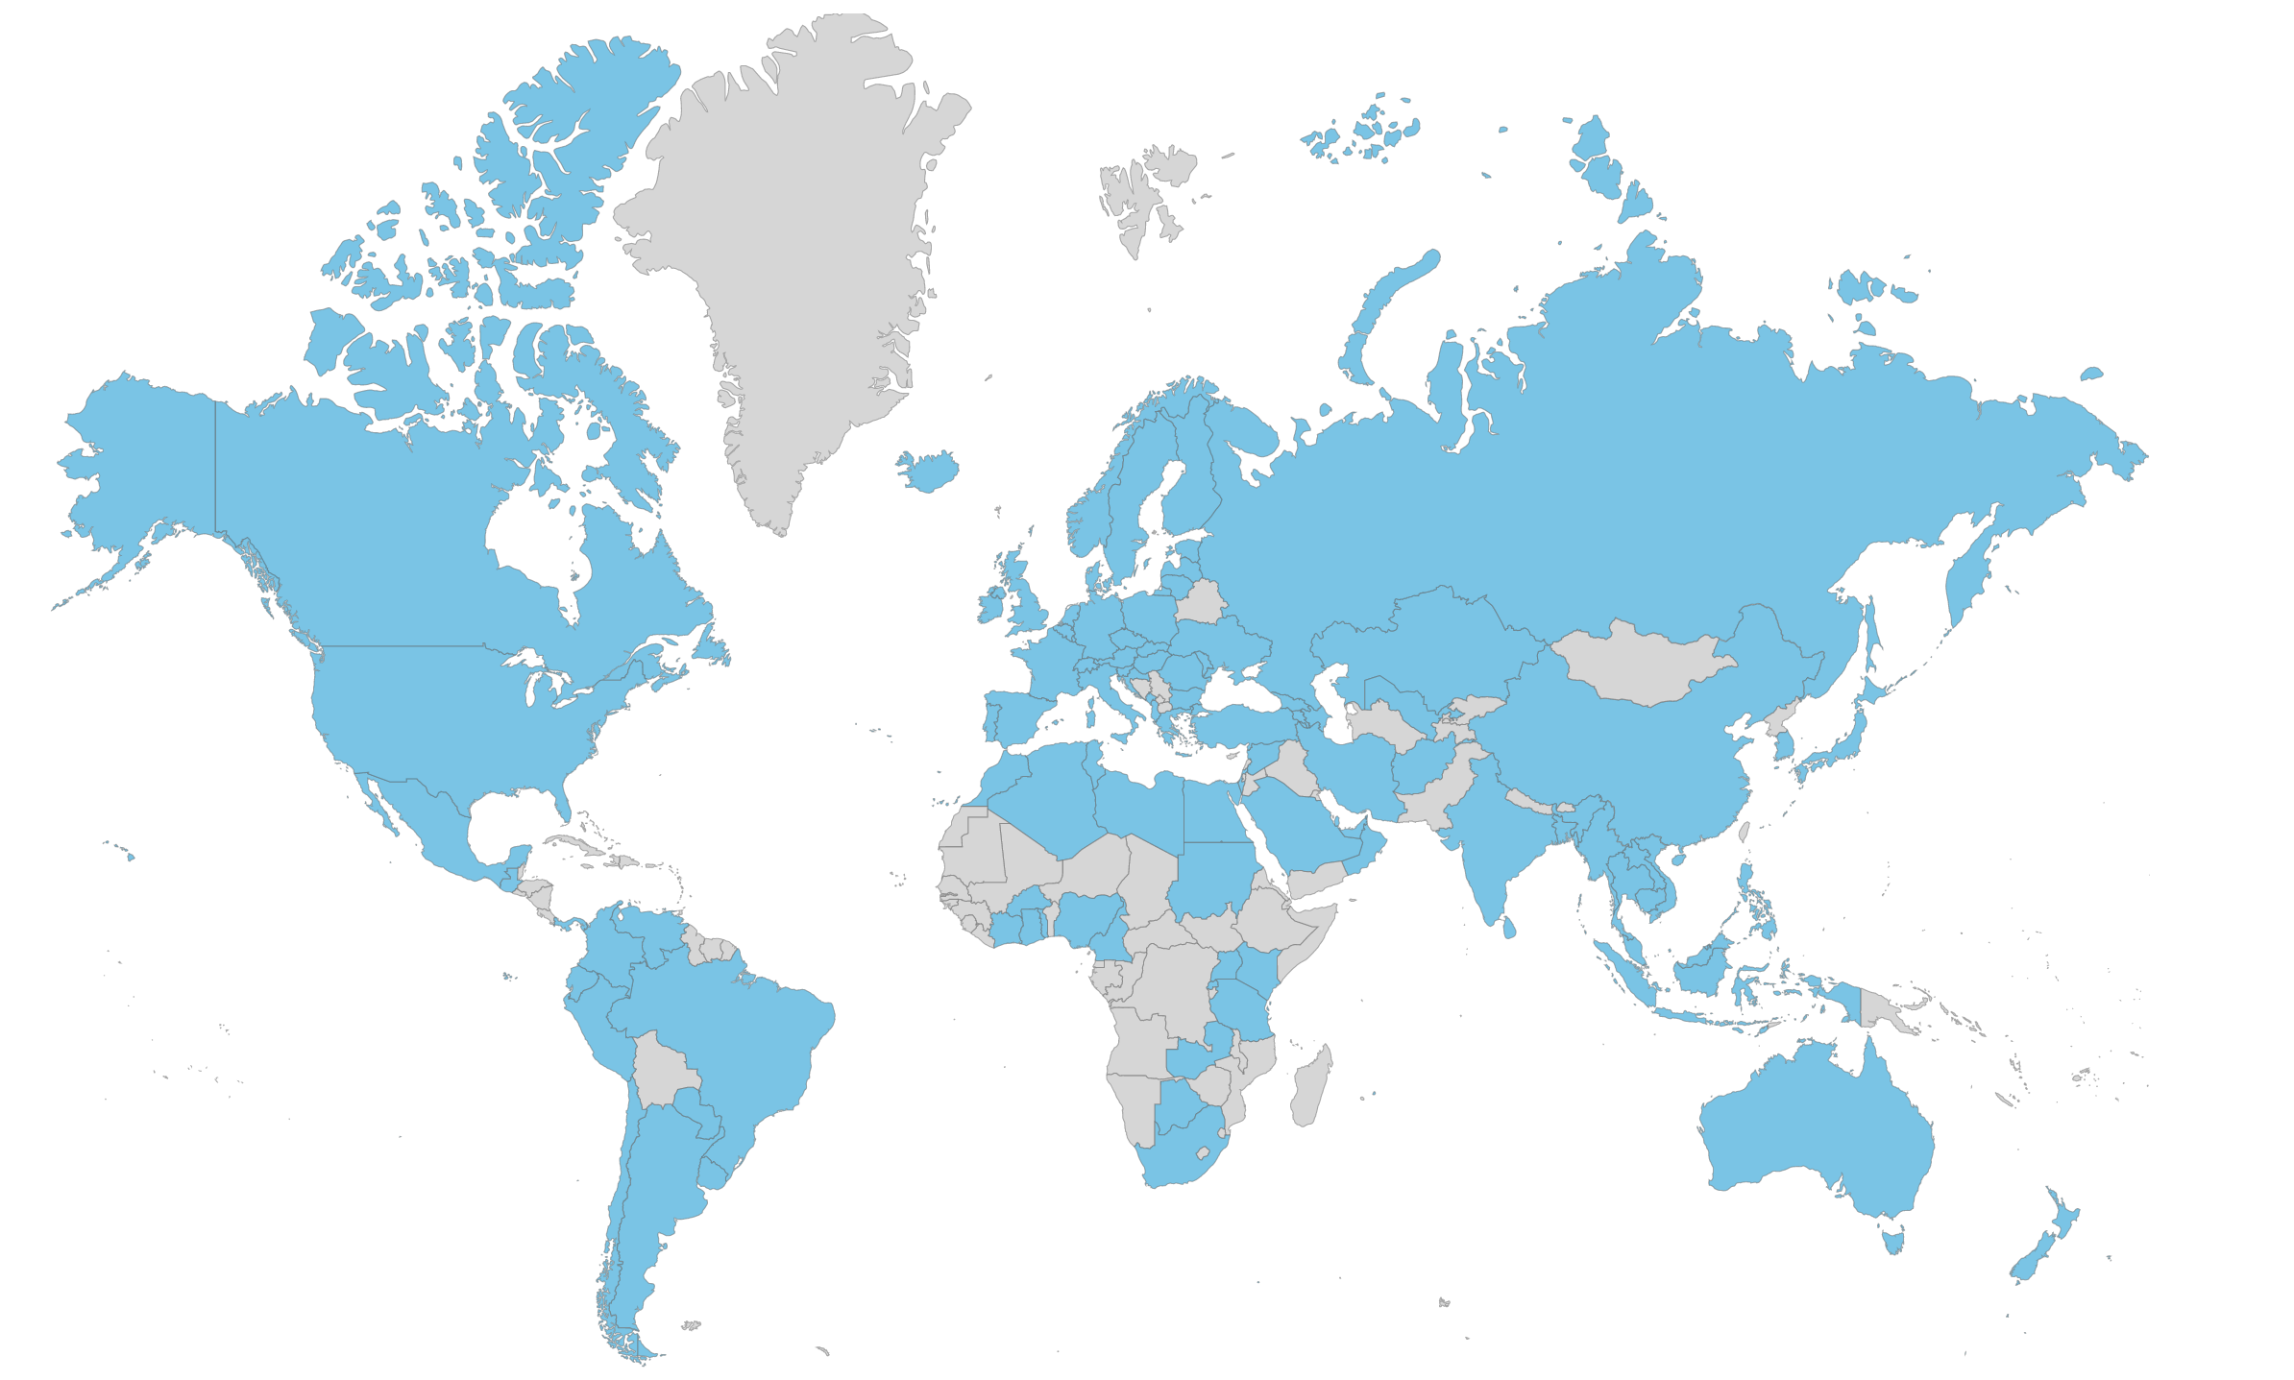
National CIRTs for enhancing global resilience
101 National CIRTs Worldwide

Slide 11
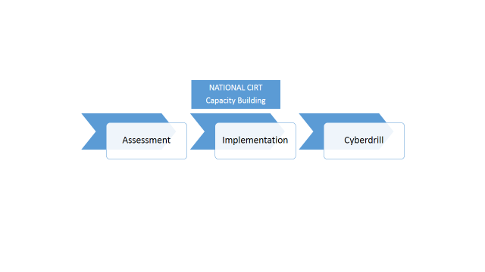
ITU’s National CIRT Programme
Assess existing capability of/need for national cybersecurity mechanisms
On-site assessment through meetings, training, interview sessions and site visits
Form recommendations for plan of action (institutional, organizational and technical requirements)
Implement based on the identified needs and organizational structures of the country
Assist with planning, implementation, and operation of the CIRT.
Continued collaboration with the newly established CIRT for additional support
Capacity Building and trainings on the operational and technical details
Exercises organized at both regional and international levels
Help enhance the communication and response capabilities of the participating CIRTs
Improve overall cybersecurity readiness in the region
Provide opportunities for public-private cooperation

Slide 12

ITU’s National CIRT Programme
Assessments conducted for 64 countries
Implementation completed for 9 countries
Implementation in progress for 6 countries
11 cyber drills conducted with participation of over 100 countries – recently in Rwanda and in Egypt

Slide 13

Objective
The Global Cybersecurity Index (GCI) aims to measure and rank each nation state’s level of cybersecurity development in five main areas:
Legal Measures
Technical Measures
Organizational Measures
Capacity Building
National and International Cooperation
Goals
- Promote cybersecurity strategies at a national level
- Drive implementation efforts across industries and sectors
- Integrate security into the core of technological progress
- Foster a global culture of cybersecurity
105 countries have responded
Final Global and Regional Results 2014 are on ITU Website
Next iteration in progress
Notes:
Kenya is ranking 5th in the region and 15th in the global ranking .
This index gives a very good oversight of the existing gaps in the global cybersecurity landscape and helps concentrate efforts in specific areas.

Slide 14
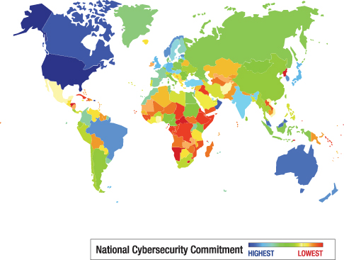

Slide 15
Global Ranking 2014 - Top 5
Country | Index | Global Rank
United States of America | 0.824 | 1
Canada | 0.794 | 2
Australia | 0.765 | 3
Malaysia | 0.765 | 3
Oman | 0.765 | 3
New Zealand | 0.735 | 4
Norway | 0.735 | 4
Brazil | 0.706 | 5
Estonia | 0.706 | 5
Germany | 0.706 | 5
India | 0.706 | 5
Japan | 0.706 | 5
Republic of Korea | 0.706 | 5
United Kingdom | 0.706 | 5
Many countries share the same ranking which indicates that they have the same level of readiness.
The index has a low level of granularity since it aims at capturing the cybersecurity commitment/preparedness of a country and
NOT its detailed capabilities or possible vulnerabilities.

Slide 16
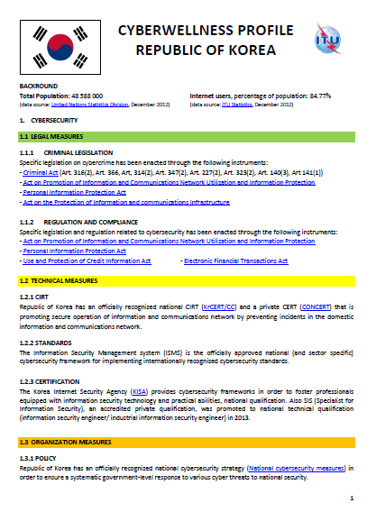
Cyberwellness Country Profiles
Factual information on cybersecurity achievements on each country based on the GCA pillars
Live documents
Invite countries to assist us in maintaining updated information
Example →

Slide 17

Enhancing Cybersecurity in Least Developed Countries project
We are only as secure as our weakest link
Aims at supporting the 49 Least Developed Countries in strengthening their cybersecurity capabilities.
  How
  Assessment for selected key government ministries &
  subsequent solutions provision
  Capacity building through training of trainers, workshops,..
  Customised guidelines on legislation, regulation and technologies
End Result
protection of their national infrastructure, including the critical information infrastructure, thereby making the Internet safer and protecting Internet users
serve national priorities and maximize socio-economic benefits in line with the objectives of the World Summit on the Information Society (WSIS) and the Millennium Development Goals (MDGs).
Implemented in 4 countries- different stages of planning/implementation in 15 more
Notes:
17
As at date, the project has been implemented in Sierra Leone and is at different stages of implementation in Afghanistan, Angola, Bhutan, Burundi, Chad, Comoros, Djibouti, Gambia, Haiti, Kiribati, Lao, Mauritania, Myanmar, Republic of Guinea, Rwanda, Tanzania, Uganda, Vanuatu and Zambia.

Slide 18

Child Online Protection Initiative
Key Objectives:
Identify risks and vulnerabilities to children in cyberspace
Create awareness
Develop practical tools to help minimize risk
Share knowledge and experience
Partners:
10 international organizations
34 civil society organizations
13 private sector organizations

Slide 19
ITU Study Groups
A platform for information exchange between ITU Member States and Sector Members (industry, academia etc.)
ITU-D Study Group 2
  Question 3/2: Securing information and Communication networks: Best practices for developing a culture of Cybersecurity
ITU-T Study Group 17 : Security
  Standardisation work on cybersecurity

Slide 20















Building a global partnership
Founding Member and Co-initiatior of CSIRT Maturity initiative
Best practices in cybercrime legislations, joint technical assistance to member states, information sharing
Tap on expertise of globally recognized industry players and accelerate info sharing with ITU member states
Collaboration in Study Group 2 Question 3 and in Cyberdrills
Collaboration with ABI Research – The Global Cybersecurity Index (GCI)
Capacity building initiatives,
joint consultations and more.
Collaboration with FIRST – To share best practices on computer incident response, engage in joint events, facilitate affiliation of national CIRTS of member states
Collaboration with Member States – Regional Cybersecurity Centres
Joint activities to combat the proliferation of SPAM
Notes:
At the Global Conference on Cyber Space in Hague in April this year the Global Forum on Cyber Expertise (GFCE) was launched. A Forum to to strengthen cyber capacity and expertise globally.Complement and reinforce existing bilateral, multilateral,multi-party, regional and international
efforts to build cyber capacity and expertise - CIRT Maturity initiative help emerging and existing CSIRTS to increase their
maturity level – with OAS, MS, Govt of Netherlands
Recent one is ISOC : During the ITU Plenipotentiary Conference 2014, a letter of agreement was signed between ITU and ISOC on joint activities related to combat the proliferation of SPAM.

Slide 21
Collaboration with
Cooperation agreement signed in 2014
  ITU will facilitate the affiliation process of ITU Member State’s national CIRTs to FIRST.
  ITU will be able to make use of FIRST’s Best Practice Guide Library (BPGL) throughout the various phases of its CIRT establishment programme.​​
  FIRST will facilitate the interaction between ITU and FIRST Members within its various fora, to enable more effective cooperation among existing and newly established CIRTs and thus enhance the global cybersecurity development process.
  FIRST and ITU will engage each other in relevant conferences or fora that will allow more interaction and cooperation.
Recently
  Waiver of FIRST affiliation application fees for CIRTs participating in ITU Cyberdrills.
Notes:
Montenegro (done), Kenya (in the process), Tanzania (in the process), Zambia (in the process) Cote D’ Ivoire (in the process) and Rwanda (just started).

Slide 22
UN-wide cooperation mechanisms
UN-wide Framework on Cybersecurity and Cybercrime (2013)
  Developed by ITU and UNODC along with 33 UN Agencies.
  Enables enhanced coordination among UN entities in their response to concerns of Member States regarding cybercrime and cybersecurity
UN System Internal Coordination Plan on Cybersecurity and Cybercrime (2014)
  Developed building on the UN-wide Framework on Cybersecurity and Cybercrime upon request by the UN Secretary-General, Mr. Ban Ki-moon
  Designed as a guide to improve the internal coordination activities of the UN system organizations on related matters

Slide 23
Upcoming ITU Cybersecurity Events
WSIS Forum 2015
  Many Cybersecurity related sessions
  Launching of GCI & Cyberwellness report 28 May @14h Room A
Cyberdrills
  Americas : Columbia 3-6 August
  Europe & CIS : Montenegro 30 September to 2 October
  Other
  International Conference "Keeping Children and Young People Safe Online", Warsaw, Poland, 22-23 September
  ITU Asia-Pacific training on Cybercrime Investigation and Forensics, 30 November to 3 December

Slide 24
Thank You - Merci
http://www.itu.int/en/ITU-D/Cybersecurity
cybersecurity@itu.int

