Slide 1
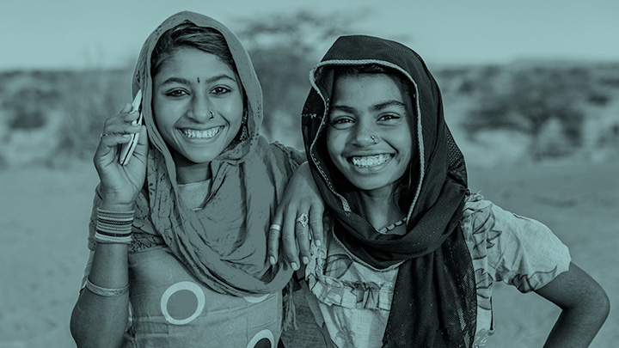
The Mobile Industry and the SDGs
Dominique Lazanski, GSMA
WSIS Forum
15 June 2017

Slide 2
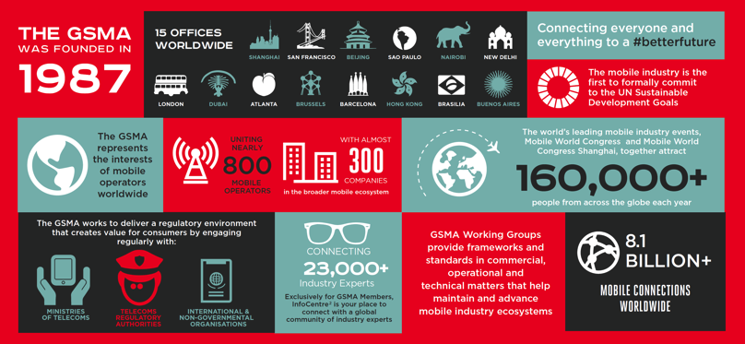
About the GSMA

Slide 3




GSMA Programmes: Convening the mobile industry towards the SDGs
Spectrum
Mobile for Development
Identity
Internet of Things
Notes:
Spectrum: Building the foundation for the future of mobile
Spectrum programme aims to ensure that mobile operators have timely and affordable access to appropriate spectrum to meet the rapidly growing demand for mobile broadband services. This includes securing spectrum to expand connectivity and rural coverage in developing markets to launching 5G in developed markets.
Mobile for Development is a dedicated global team within the GSMA, which brings together our mobile operator members, tech innovators, the development community and governments, to prove the power of mobile in emerging markets. We identify opportunities and deliver innovations with socio-economic impact in financial services, health, agriculture, digital identity, energy, water, sanitation, disaster resilience and gender equality.
To date Mobile for Development has impacted 30 million lives across 49 countries. Mobile is the single technology which cuts across geographies, cultures and income levels and we expect the impact on emerging markets to grow exponentially.
Identity: The GSMA Identity programme aims to help digital service providers and consumers find the optimum balance between privacy, security and convenience. Working with its operator partners, the programme has prioritised the development of digital identity services. Working together, they aim to bring to market digital identity solutions that provide a safe, seamless and convenient consumer experience, a consistent user interface and low barriers to entry across the digital identity ecosystem.
Internet of Things: The GSMA Internet of Things programme is an initiative to help operators add value and accelerate the delivery of new connected devices and services in the IoT. This is to be achieved by industry collaboration, appropriate regulation, optimising networks as well as developing key enablers to support the growth of the IoT in the longer term.
Our vision is to enable the IoT, a world in which consumers and businesses enjoy rich new services, connected by an intelligent and secure mobile network.

Slide 4

Our Industry Purpose
In launching our purpose, we are highlighting our commitment to playing a leading role in the achievement of the SDGs.
Ours is the first large industry association to align itself to the SDGs
Notes:
SDG Narrative:
The SDGs have set us on an incredible path to solving the greatest challenges of our time. Mobile networks have the power to accelerate this journey in a way that no other technology can. We have already connected over 5 billion people, enabling greater inclusion in vast cities and remote villages, transforming communities, delivering healthcare in ways never imagined, opening doors to education, employment and income opportunities, creating smarter cities, empowering people with the tools they need to thrive and driving a more sustainable planet. The Sustainable Development Goals are big, and so is the mobile industry’s ambition – to connect everyone and everything to a #betterfuture.

Slide 5
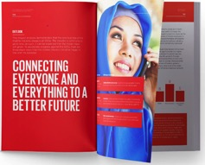

The Mobile Industry Impact Report: Sustainable Development Goals
The GSMA’s 2016 Mobile Industry Impact Report illustrates how the industry is not only transforming the world through technology and innovation, but how it is also integral to the successful delivery of the UN SDGs.
All SDGs are impacted by the mobile industry to varying degrees,
with the greatest effect being felt by Goals 1, 4, 9, 13.
Second edition to be launched at UNGA 2017
Notes:
This first-of-its-kind report offers critical insights into the transformative impact of the mobile industry on individuals, societies and economies around the world, in developed and developing markets. Importantly, it establishes a benchmark through which the industry will assess its success in contributing to the Sustainable Development Goals (SDGs) and serves as a blueprint for other industries as they commit to achieving the SDGs.
The second Mobile Industry Impact Report will be launched in September 2017 at UNGA and will look at progress over the past year as well as opportunities to accelerate the mobile industry’s impact
SEE HAND OUT

Slide 6











GOALS
SOLUTION COMPONENTS
ANNOUNCEMENT AT MWC 2017
Accelerating our industry’s impact: Big Data for Social Good
Accelerate our industry’s impact
on SDGs
16 Mobile Operators
Active in 100+ countries
Representing 2B+ connections
Coming together and using big data
to address:
Code of conduct, principles and guidelines
Common algorithms to generate insights
Reduce lives lost or hurt during
a disaster
Enable humanitarian agencies to better deploy aid to those in need
Identify and establish partners
Terms of activation
Epidemics
Natural
Disasters
Environmental
Management
Establish scalable common processes and mechanisms and build an ecosystem to support timely planning and response to crises
Impacting:
Output formats for sharing insights
Mechanism for collating and delivering insights
5
Notes:
In February 2017, the GSMA launched the “Big Data for Social Good” initiative, which will leverage mobile operators’ big data capabilities to address humanitarian crises, including epidemics and natural disasters. The programme is being launched with 16 MNOs of the world’s leading mobile operators, which collectively account for over two billion connections across more than 100 countries. The UN Foundation is a supporting partner, providing coordination and integration with the broader ecosystem, including organisations such as Global Partnership for Sustainable Development Data (GPSDD), the Digital Alliance (DIAL) and Data2x.
Through Big Data for Social Good, mobile operators will provide key insights based on anonymised meta-data generated by their networks to support the response in these critical situations. For instance, by monitoring the flow of people to and from impacted areas, public health organisations can more effectively respond to prevent epidemics, slow the spread of disease and better target relief efforts. With access to mobile network insights, humanitarian agencies can more accurately aid evacuation, response and recovery efforts.
Initial trials of Big Data for Social Good for epidemics are set to begin during the summer 2017, with Bharti Airtel in India, Telefónica in Brazil, and Telenor in Bangladesh, Myanmar and Thailand. The objective of the multi-operator pilot is to develop common capabilities to monitor, alert, predict and manage the spread of diseases that, if unaddressed, could create epidemics. In the trials, operators will provide insights based on anonymised meta-data using common data feeds and algorithms to provide insights into human movement patterns. The trials will enrich this information with third-party data sources such as hospital intakes, death counts and weather data, among others, to provide meaningful insights that local and international government and humanitarian agencies can use to make decisions on when, where and how to deploy resources. The GSMA expects to publish the results of these trials at Mobile World Congress in February 2018.

Slide 7
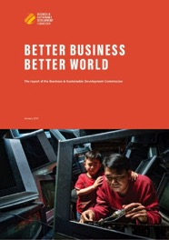
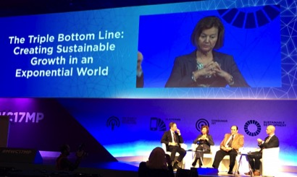
Responsible and Sustainable Business
Advancing responsible business models and practices for systemic impact
Galvanising leadership on the world stage by creating a movement of Ambassadors, Champions & CEOs of the Future
Sustainable business models could open economic opportunities worth at least US$12 trillion and up to 380 million jobs by 2030.
Better Business, Better World, Business & Sustainable Development Commission, http://report.businesscommission.org
Notes:
The full integration of the social and environmental impacts and addressing wider societal needs represents both a challenge and an opportunity for business. The Sustainable Development Goals (SDGs) provide a roadmap to guide companies, but many companies are still in the early stages of ‘internalising’ and ‘operationalising’ them. Indeed, the majority of CEOs and business leaders have yet to fully engage or advocate for them within their companies. Collaboration across the mobile industry and beyond is key to success in mainstreaming the SDGs and sustainability into core business.
We at GSMA are doing our part to ADVANCE RESPONSIBLE BUSINESS PRACTICES, and GALVANIZE LEADERSHIP.

Slide 8
Public Private Partnerships
We encourage governments to build upon the industry’s foundations by:
Integrating mobile into your political goals across sectors and consider the role it plays in accelerating their delivery.
Embarking on the necessary digital reforms to ensure mobile operators are enabled to build powerful networks, invest and deliver always more innovation and consumer choice.
Notes:
Industry Purpose collaborates and/or partners with UN Foundation, UNDP, UN DPI, Project Everyone, PVBLIC, BMGF
M4D donors include BMGF, UKAID (DFID), DFAT (Australia), Mastercard Foundation, Omidyar Network
We convene governments, regulators and industry at Ministerial Programme and in regions at the Mobile 360 Series events

Slide 9

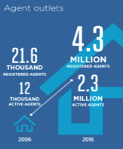
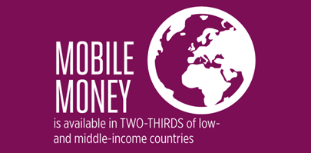
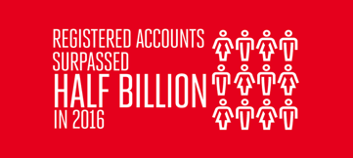
Case Study: In just a decade, mobile money has become a global story…
There are
277 SERVICES
in
92 COUNTRIES
Approximately
1.2 AGENTS per 1,000 adults
In
30
COUNTRIES
active agents 10x more
bank branches
With
174 m
active accounts (90 day basis)
Notes:
Another success story is Mobile Money. SDG 10 Reduce inequality within and among countries with remittances and a reduction of 3%.

Slide 10
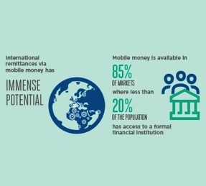
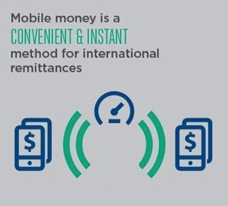
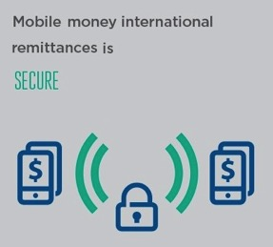
Case Study: In just a decade, mobile money has become a global story…
Reach
Convenience
Security

Slide 11
Thank you.
dlazanski@gsma.com
For more information on the mobile industry’s commitment to the UN SDGs, contact:
industrypurpose@gsma.com
gsma.com/betterfuture

Slide 12







