Slide 1
The Role of Private Sector in Mobilizing ICTs for Sustainable Development Goals (SDGs)
Presented by
RoShni Sen Secretary, Dept of WCD West Bengal, India
WSIS ‘ 2017 Geneva 15th June, 2017

Slide 2
The Role of Private Sector in Mobilizing ICTs for Sustainable Development Goals (SDGs)
WSIS ACTION LINES
C1. The role of public governance authorities and all stakeholders in the promotion of ICTs for development
C11. International and regional cooperation

Slide 3
Relevant sustainable development goals

Slide 4
Mdg & sdg
SDGs are more ambitious than the MDGs. The MDGs helped to halve extreme poverty, the SDGs aim to end it!
The MDGs focused on the poorest countries, the SDGs engage all nations in a shared, universal agenda.
The MDGs prioritized prosperity and inclusion: this time, environmental sustainability is also addressed as a fundamental pillar of global wellbeing.

Slide 5
Key Success Factors for realizing SDG
SDGs are achievable, but they require a breakthrough in both the speed and degree of progress.
Meeting these global ‘stretch’ goals calls for a transformation of societies far deeper and faster than in the past
Radical speed improvement envisaged rather than having Business-As-Usual (BAU) approach
The 2030 Agenda also requires far greater engagement of the private sector, in particular in the provision of technological solutions that can deliver change in prioritized areas.
Governments need to harness all the tools at their disposition—technology, investment, policy and partnerships— as key means of implementation to deliver the necessary step change in trajectory.

Slide 6
Financial implications of sdg
USD 5-7 trillion per year
Total Investment need in developing countries alone: USD 3.9 trillion per year
Major areas: Basic infrastructure (Road, rail, ports, power stations, water & sanitation), food security (agriculture, rural development), climate change mitigation & adaptation, health, edication
Current investment in these sectors: USD 1.4 trillion
Investment gap USD 2.5 trillion
(Source: UNCTAD, 2014)

Slide 7
Financial implications of sdg – Indian Perspective
USD 8.5 trillion (INR 533 lakh crores) over the mandated 15 years
Every year average requirement will be USD 565billion / INR 36 lakh Crores
Public finances alone would be inadequate
Need to innovate in policy strategies to use both public & private finance in achieving SDG

Slide 9
‘future of ict’ facilitates Achieving SDG
Mobile broadband
Internet of Things (IoT)
Robotics
Artificial intelligence
3-D printing
healthcare
education
energy services
agriculture
environmental monitoring and protection
tools for additional, unprecedented advances in -
Future advances in ICTs

Slide 10
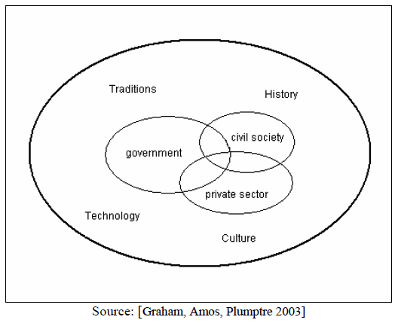
Private sector – an integral part of Governance eco-system
Critical Factors:
How a government & social organisations interact
How they relate to Citizens
Concerns State’s ability to serve Citizens & other Actors
How public functions are carried out, public resources are managed & how regulatory powers are exercised

Slide 11
How ICT can help: Five ways
“More ubiquitous access to and use of broadband Internet networks, which are available in a competitive market and at affordable prices, will help foster innovation and drive the growth of the Internet Economy and the economy in general.” - OECD
To achieve the SDGs ICT needs to be combined with innovative policies, services and solutions to deliver transformation at unprecedented speed and scale.
ICT can be a powerful means of implementation in five major ways:
1. Accelerated upscaling of critical services in health, education, financial services, smart agriculture, and low-carbon energy systems.
2. Reduced deployment costs addressing urban and rural realities.
3. Enhanced public awareness and engagement.
4. Innovation, connectivity, productivity and efficiency across many sectors.
5. Faster upgrading in the quality of services and jobs.

Slide 12
Interconnected Components of Successful ICT Deployment
Areas for Public & Private Partnership

Slide 13
Enabling ICT framework for achieving sdg ….
Upgrade STEM: Foster science, technology, engineering and mathematics skills in primary and secondary education to build long-term technology readiness and scale up ICT training programs with universities.
Harness big data: Create national online and open databases using big data from public service provision and satellites, mobile networks, remote sensors and other connected devices in the Internet of Things.

Slide 14
9 pillars of digital india

Slide 15
Digital india – perfect blend of public private partnerships (Infrastructure ~ Services~ Empowerment)
Broadband for all: Govt plays only regulatory role (TRAI). Both Govt & Private Players are present in market & have level playing field. State Wide Area Network (SWAN), National Optical Fibre Network (NoFN) & National Knowledge Network (NKN) provides High Speed Network Backbone for Governments, Institutions, Common ServiceCentres till village level.
Meghraj – the National Cloud initiative: Strategic control is with the Govt through MeitY & NIC. Govt fully own the infrastructure however, Facility Management Services are taken from Private Organisations.
AADHAAR: PPP Model.
CSC 2.0: Delivered 2.5 lakh Common Service Centres under PPP model for service delivery
DIGILOCKER: Every citizen’s private space in public cloud!
Direct Benefit Transfer: A framework between Govt, Financial Institutions, Service Providers (Private Organisations)
Digital Public Distribution System
GovtEMarketplace for eProcurements
eHospital
AGMARKNET for dissemination of Agricultural market prices
BHIM App for Cashless Transactions
Open Govt Data

Slide 16
Digital india – perfect blend of public private partnerships (Infrastructure ~ Services~Empowerment)
SMART CITIES
AADHAAR BASED PAYMENT SYSTEM
PAYGOV
MYGOV

Slide 17
THANK YOU!

