Slide 1


Aligning ICT & E-Government Strategies
with National Development Strategies
Anir Chowdhury
Policy Advisor
Access to Information (a2i) Programme, Prime Minister’s Office, Bangladesh

Slide 2
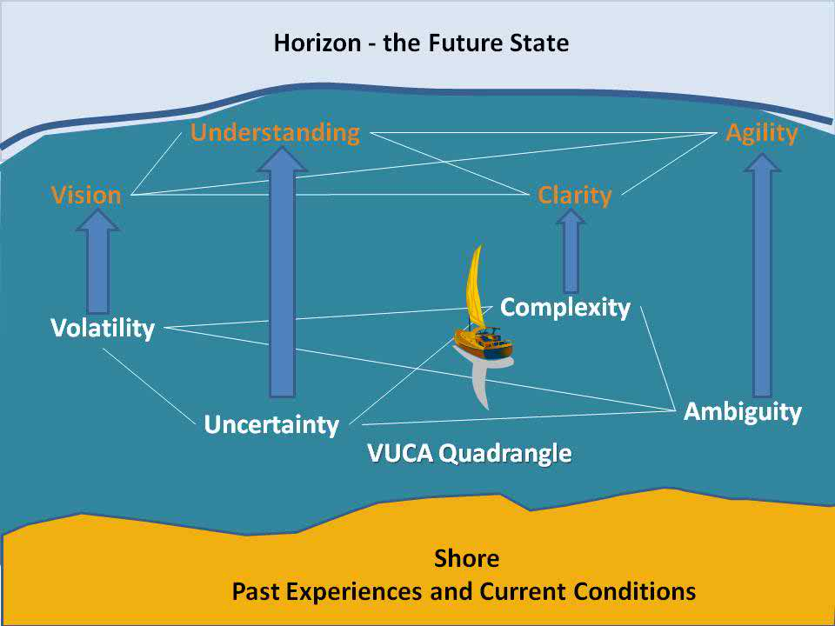
iamtechnologyblog.com

Slide 3
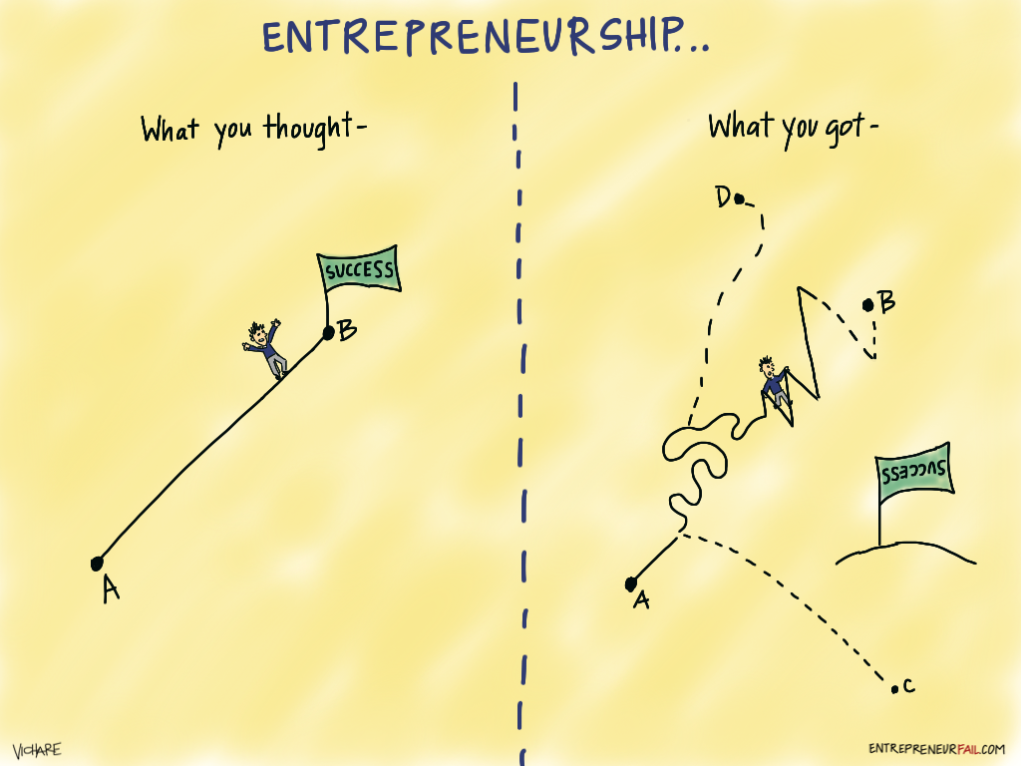

Slide 4


Redefining the Problem …

Slide 5
Why ICT Remains a ‘Lip Service’
ICT is technical and I am not technical
  No overlap with my responsibility
  It’s not a general policy issue like education, agriculture, health and transportation
ICT is a vertical not relevant to me
ICT threatens status quo
ICT needs big strategies before the work can begin

Slide 6
Use Non-threatening Language. CRITICAL!!!
e-Governance
Service at Doorsteps
Business Process Re-engineering (BPR)
Service Process Simplification (SPS)
Corruption, Transparency
TCV

Slide 7


PPP and Micro-Entrepreneurship:
5,000+ Digital Centres
Government services
Innovative Financial Products
‘Assisted’ Rural e-Commerce
2014
10,000+ entrepreneurs
110+ services
5 million+ citizens/month

Slide 8
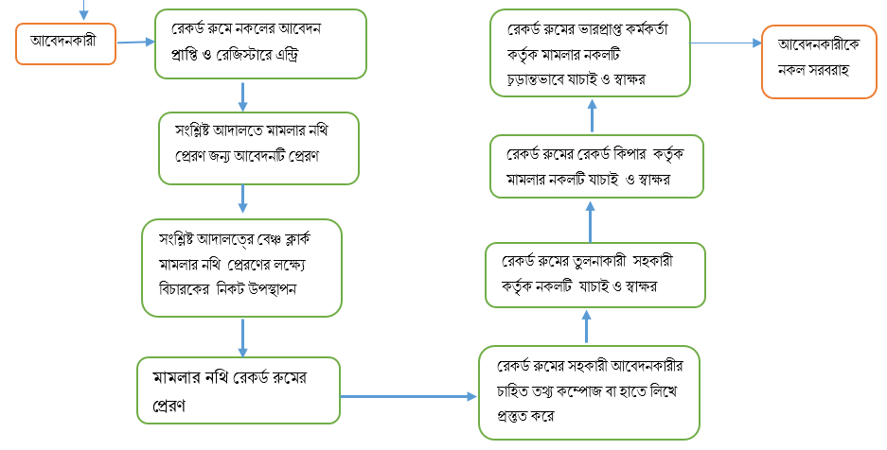
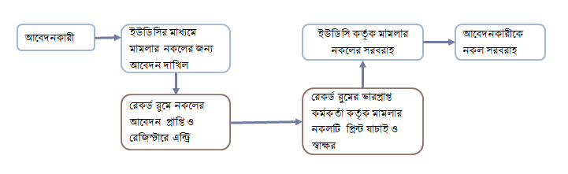
Service Process Simplification (SPS), Coupled with Digitization, And Measured with TCV
Service Process Simplification
Decentralization to Digital Centre
Digitization of Service
T = 7+ days
C = USD 63
V = 40 km x 2-3 times
T = 1 hour
C = USD 4
V = Walking distance
1st rule of technology: automation applied to an efficient operation will magnify the efficiency.
2nd rule: automation applied to an inefficient operation will
magnify the inefficiency.

Slide 9
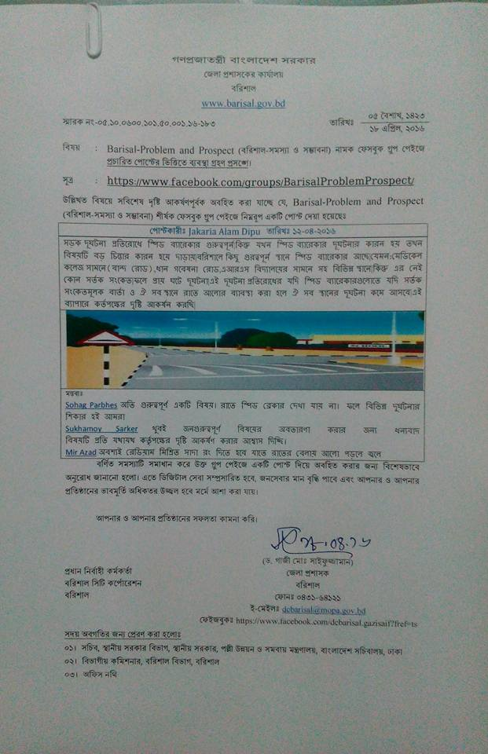
For Citizens Grievance Redressal, Leverage Platforms where the Young People Roam
Every district administrator features a FB page
Unprecedented public accountability and interaction with citizens

Slide 10
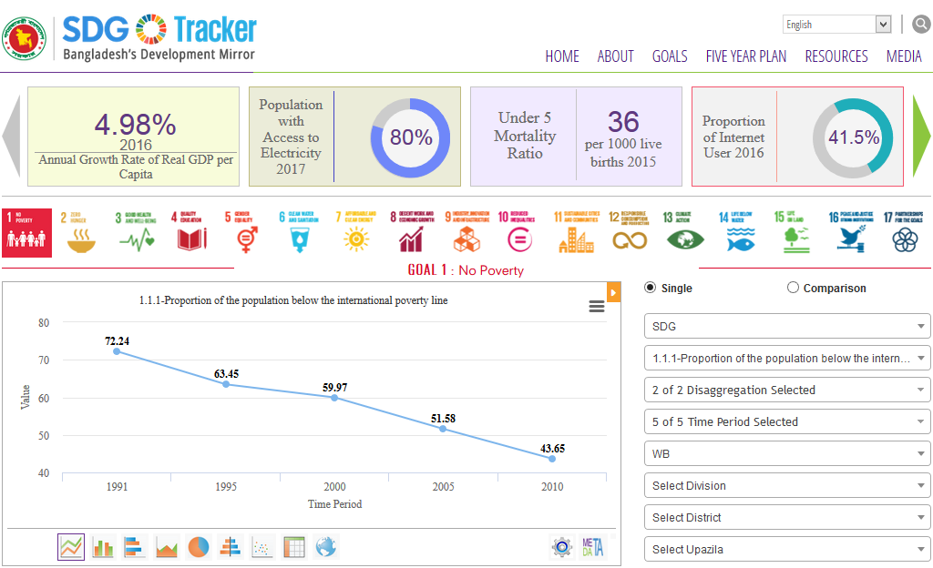
SDG Tracker: Data → Insights
Launch by HPM at UNGA 2017
Interoperable data standards
Trend over time
Comparison across geographic areas
Correlation across related indicators

Slide 11
Coordination for ICT-Supported National Development
National
5-Year Plans (Planning Commission)
SDG Planning and Localization (PMO)
ICT Strategy and Policy (ICT & Telecom Ministry)
ICT in Education Master Plan
(Ministry of Education)
Annual Performance Agreement (Cabinet Division)
Bottom-Up Innovation Ecosystem
(a2i, PMO)

Slide 12
Create Multiplier Effect through Extensive Partnerships
South-South and Triangular Cooperation
(South-South Network for Public Service Innovation)
Public Private People Partnership
(Whole-of-Society)
Political Vision + Bureaucratic Machinery
(Whole-of-Government)

