Slide 1


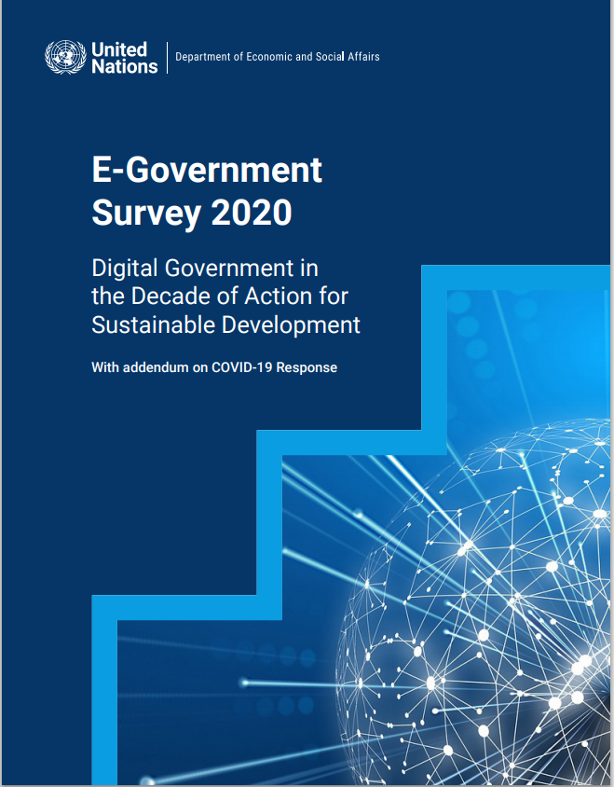

WSIS ALFM C1, C7-E-Government, C11: Session 330: “Creating synergies and partnerships on e-government between national and local levels”
EGDI: Global, Regional and National E-Government Trends
Mr. Vincenzo Aquaro,
Chief, Digital Government Branch, DPIDG, UN DESA

Slide 2





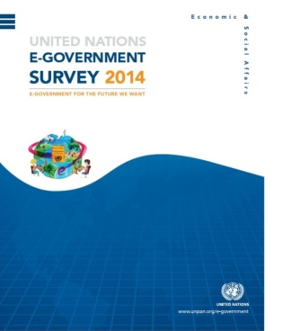


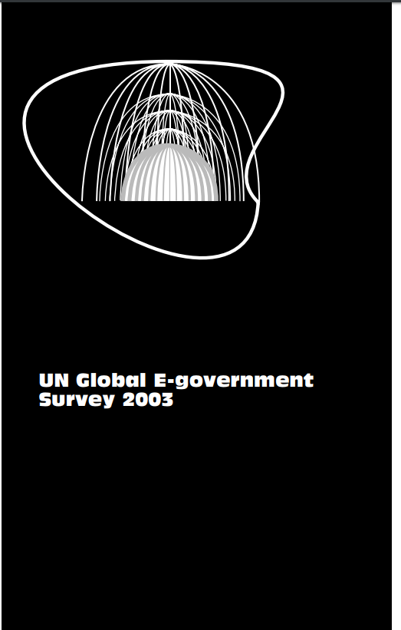
E-Government Survey: A Continuous Improvement
The United Nations E-Government Survey presents a systematic assessment of the use of ICT to transform and reform the public sector by enhancing efficiency, effectiveness, transparency, accountability, access to public services and citizen participation in 193 Countries
2003
2008
2010
2016
2020
Notes:
In March 2001, at the Third Global Forum on Reinventing Government, participants from 122 nations congregated to share best practices, information and ideas related to e-government. The Forum was followed by the first attempt of UNDESA to benchmark e-government development through a research publication in 2001 entitled “Benchmarking E-government: A Global Perspective - Assessing 122 UN Member States,” which analysed the approach, progress and commitment of the UN Member States (MS) in e-government development.
The 2003 edition was the first one covering all MS with the aim “to be a tool at the disposal of the government, which, if applied effectively, can contribute substantially to promoting human development

Slide 3
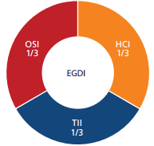

Methodology: EGDI, OSI, TII, HCI
A country’s ranking in the survey is determined by the
EGDI - E-Government Development Index,
the weighted average of three normalized scores on
  Scope and quality of online services
  Online Service Index, OSI
  Development status of telecommunication infrastructure
  Telecommunication Infrastructure Index, TII
  3. Inherent human capital
  Human Capital Index, HCI
0.00
0.25
0.50
0.75
1.00
Notes:
The Survey assesses the e-government development status of all MS of the United Nations, producing the e-government development index (EGDI), which is a weighted average of three most important dimensions of e-government, namely: (1) scope and quality of online services (Online Service Index, OSI), (2) development status of telecommunication infrastructure (Telecommunication Infrastructure Index, TII), and (3) inherent human capital (Human Capital Index, HCI). Since 2001 the methodological framework has remained consistent across survey periods while its sub components have been updated to reflect new trends in e-government as well as new indicators for TII and HCI

Slide 4
EGDI Methodology – Breakdown
News in 2020
To provide a more granular cluster analysis of countries with similar performances, each EGDI group has been further broken down into 4 equally defined intervals (rating classes), identified by:
the 1st quartile
the 2nd quartile
the 3rd quartile
The leading countries have the 4 highest Rating Classes V1, V2, V3, VH
Ranking
Group
Rating
Class
Quartile
1st
2nd
3rd
Quartile
1st
2nd
3rd
Quartile
1st
2nd
3rd
Quartile
1st
2nd
3rd
For instance:
Very High- EGDI group has been further sub-divided into four quartiles:
VH - first top quartile, EGDI scores ranging from 0.8989 to 0.9758
V3 - second quartile, EGDI scores ranging from 0.8375 to 0.8914
V2 - third quartile, EGDI scores ranging from 0.7991 to 0.8361
V1 - forth quartile EGDI scores ranging from 0.7565 to 0.7980
4

Slide 5
Division For Public Institutions And Digital Government
EGDI Performance in 2020
Global and Regional

Slide 6
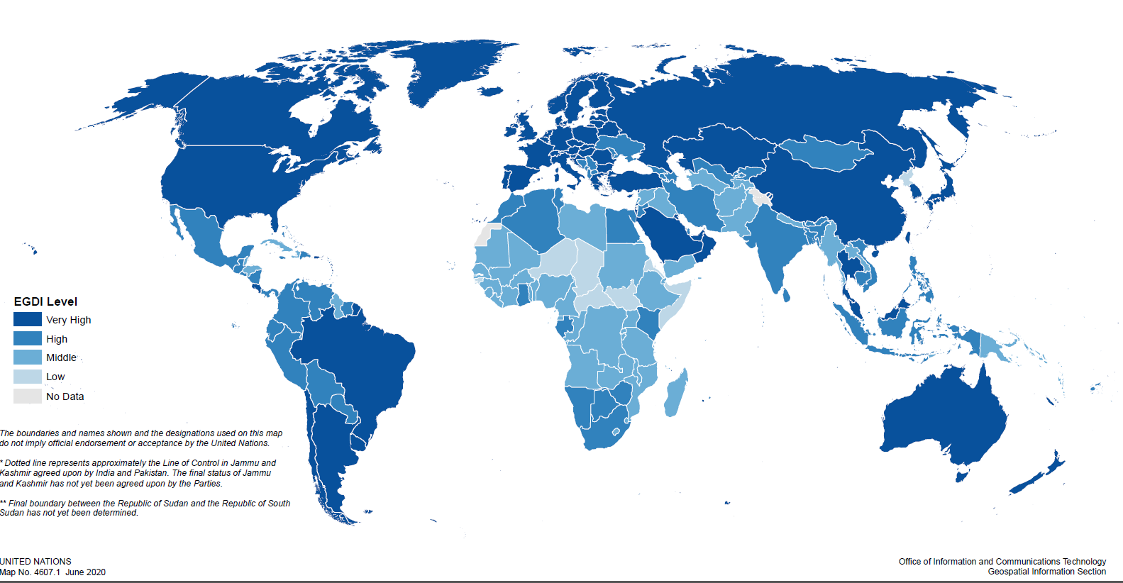

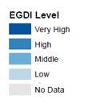


2020: E-Government Development at a Glance
2020 Key Findings
Global trends in e-government development improved
126 UN Member States have High and Very-High EGDI levels
57 countries have “Very-High EGDI” compared to 40 countries in 2018
Only 8 countries have “Low-EGDI” compared to 16 countries in 2018 (7 of them from Africa)
6

Slide 7
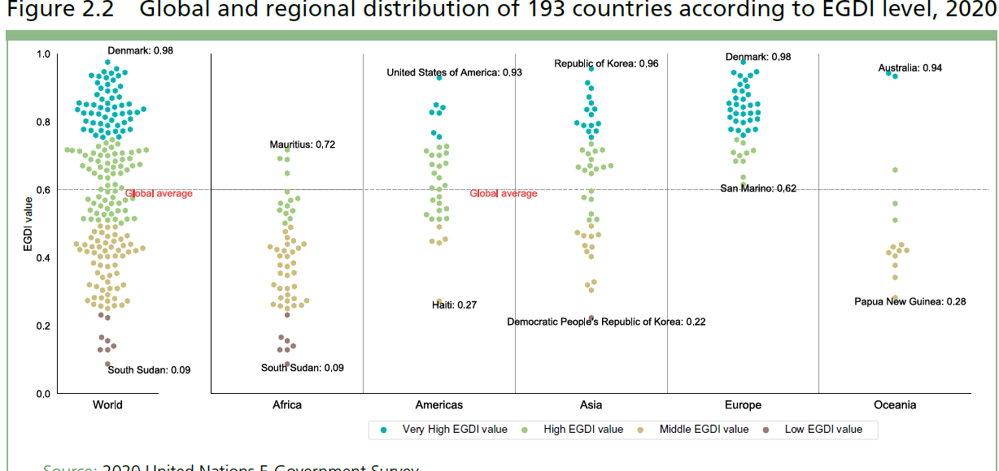
Global and Regional Distribution
Key Findings
The Global average EGDI increased to 0.60 in 2020, from 0.55 in 2018
All MS in Europe have EGDI scores above the global average of 0.60
Oceania and Africa regions remain below the global average of 0.60
Europe - Average EGDI: 0.82
Asia - Average EGDI: 0.64
Americas – Average EGDI: 0.64
Oceania – Average EGDI: 0.53
Africa – Average EGDI: 0.39
.

Slide 8
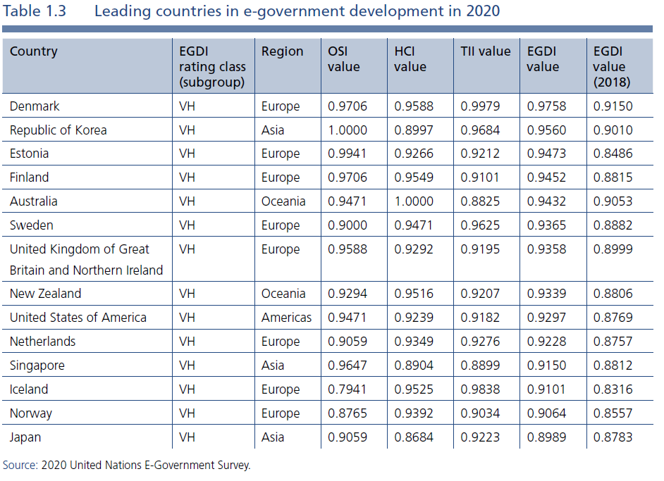
Global Leading Countries (1/2)
Key Messages
14 Countries have the highest Rating Class VH
  8 MS from Europe
  3 MS from Asia
  2 MS from Oceania
  1 MS from Americas
Denmark is leading the global EGDI Ranking
ROK is leading in online service provision
Estonia has the most significant ascend since 2018
8

Slide 9
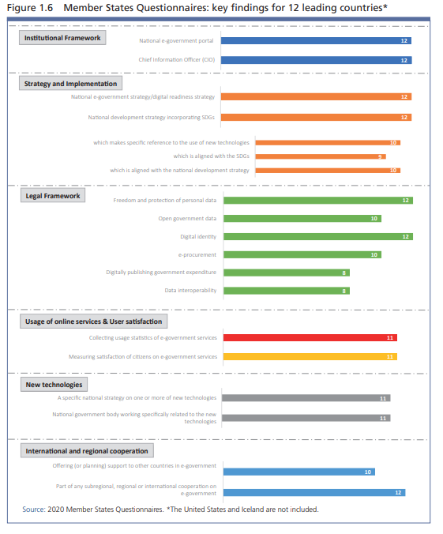
Global Leading Countries (2/2)
Key Messages
Consistency in strategic digital policy areas and in the implementation of digital public services
Providing a one-stop shop through specialized citizen-centric portals
Digital by design, Digital ID, Integrated public services delivery, e-procurement
Agency/Department/Ministry, CIO in charge of a long-term digital agenda, aligned with national development strategies and SDGs
Comprehensive legal and regulatory framework
National strategy for new technologies such as AI, 5G and blockchains
9

Slide 10

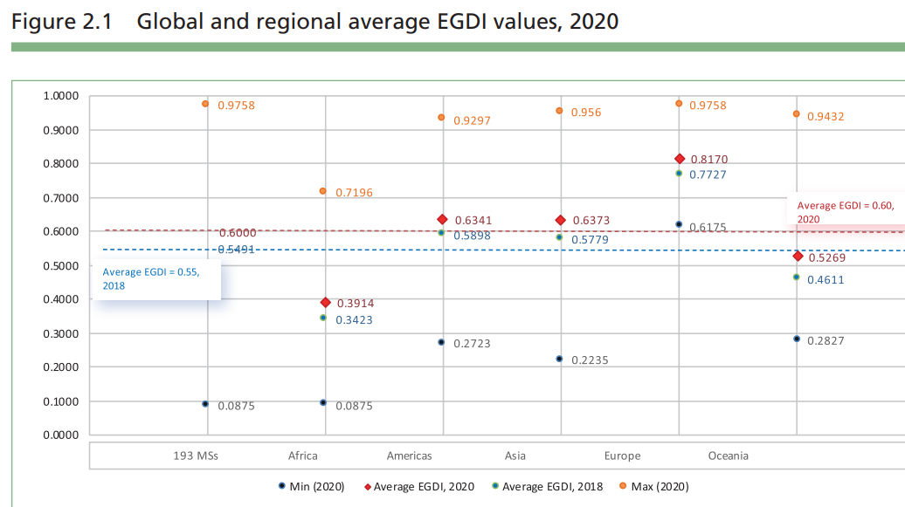
Digital Divide
Key Messages
On average, 66 % of the UN Member States provide online services, however countries offering the full spectrum of services are in the Very-High and High-OSI level groups (93 % and 81 per % respectively)
7 of the 8 countries with the lowest EGDI scores are least developed and/or landlocked countries in Africa
While Africa has made significant progress in e-government development, with only 7 of the region’s 54 countries remaining in the low EGDI group, there is still the persistence of digital divides within and between countries and regions.
Differences in e-government development exist even in highly developed regions
Europe
World Average
Americas
Asia
Oceania
Africa
10

Slide 11
EPI Performance in 2020

Slide 12

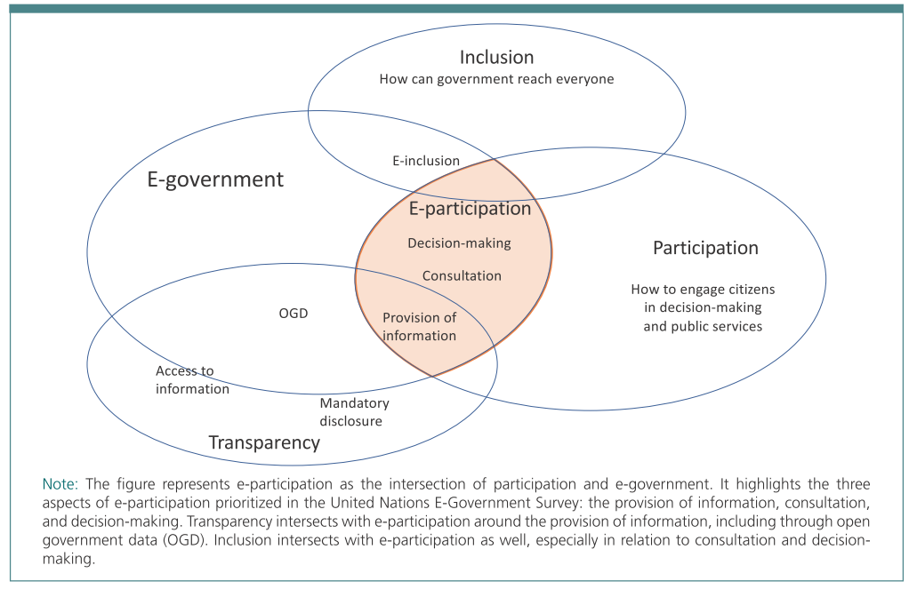
EPI: Conceptual Framework

Slide 13
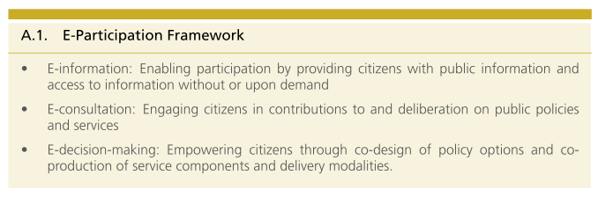
EPI: Metodological Framework
E-consultation
E-information
E-Decision-making
E-Participation Index
OSI

Slide 14
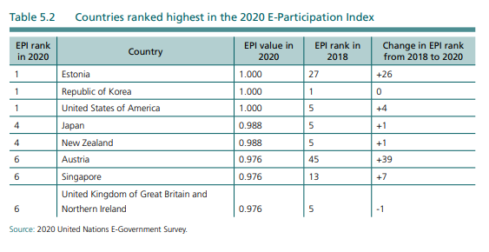
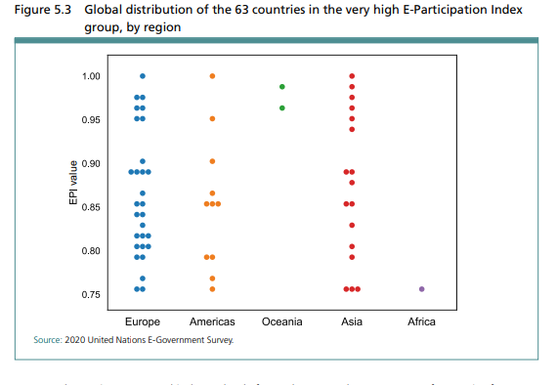
EPI: Global and Regional Snapshot
About half of the 63 countries in the very high EPI group are in Europe, 17 are in Asia, and 11 are in the Americas. In Oceania, only New Zealand and Australia are in this category. South Africa, with a value of 0.75, is the only African country in this group.
For Estonia, the Republic of Korea and the United States of America all of the e-participation features assessed in the Survey are present in these countries. Japan and New Zealand are both ranked fourth, and Austria, Singapore, and the United Kingdom of Great Britain and Northern Ireland are ranked sixth. Five of the eight countries listed in the table were ranked among the top 10 in the 2018 EPI.

Slide 15
LOSI Performance in 2020

Slide 16
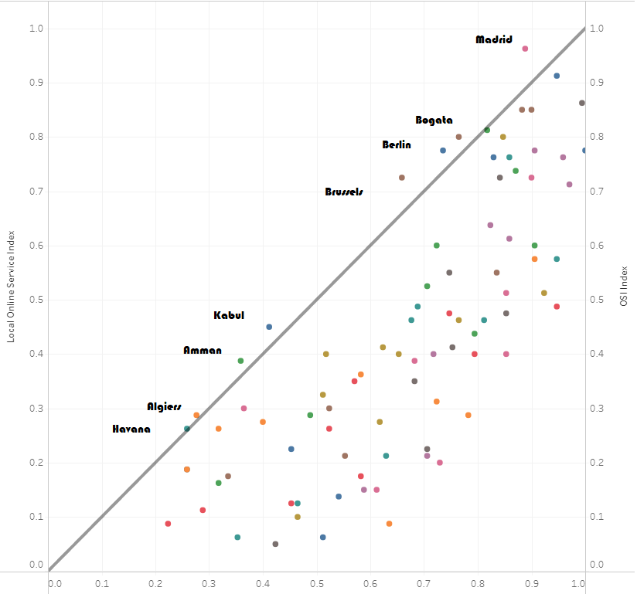
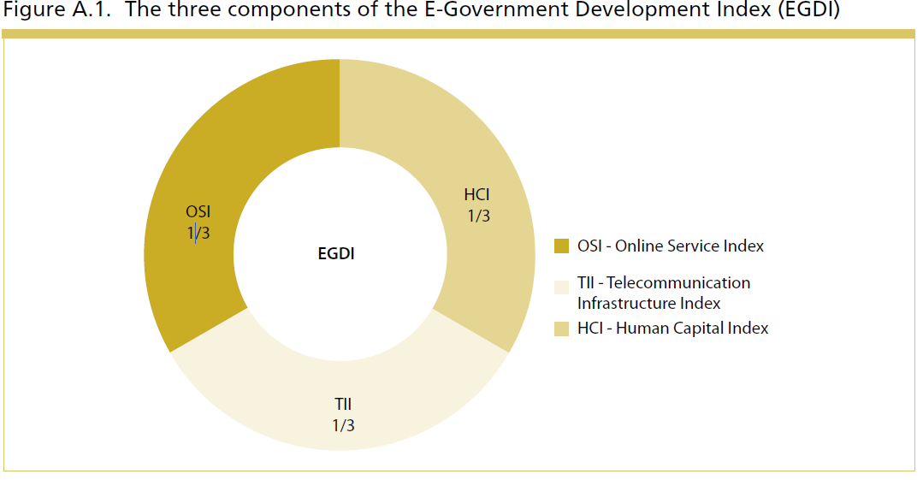
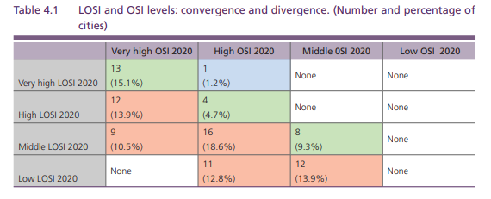
LOSI vs OSI
LOSI
Cities performing better than national portals
LOSI
OSI
Around 70 per cent of the cities surveyed have LOSI levels that are lower than the OSI levels for the countries in which they are located
.

Slide 17
Key Messages …
Digital government plays a vital role in promoting the health and safety of people and in keeping economies and societies working during the ongoing COVID-19 crisis.
COVID crisis has set the agenda and the priorities of where to focus on digital transformation efforts and the adoption of new and innovative approaches for Inclusive Service Delivery.
Governments need to adopt a digital-by-design approach, focusing more on a data-driven people-centric approach and on secure, scalable and resilient infrastructures.
Governments need to strength national, regional, and local project-driven collaborations with private sector, academia, civil society and other stakeholders and to create synergies and partnerships on e-government between national and local levels
Governments need to stress the collaboration with international and regional organizations to bridge the digital divide and to overcome disparities and inequalities for leaving no-one behind.

Slide 18
شكرا
谢谢
Thank You
Merci
Спасибо
Gracias
​
aquaro@un.org

